Slide 1
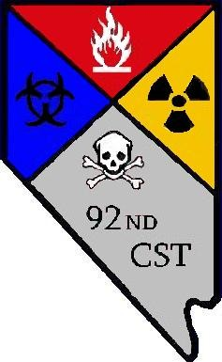
92nd Civil Support Team
Capabilities Brief
Analytical Laboratory System (ALS)
31MAR17 TMCC
ALS Operators
Maj Jami Cavins
1LT Michelle Tucay
SFC Richard Jager

Slide 2
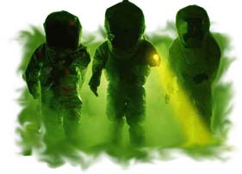
Who We Are…
Designed to support civil authorities in a natural or manmade disaster; specialized training in CBRN/WMD
Work directly as a state response asset with local, state, federal agencies
Work for the Incident Commander while on scene at no cost
22 Full-Time Army and Air National Guardsmen whose only mission is to support civil authorities.
Modular deployment packages
DoD’s first response assets
All members trained and certified to the HAZMAT Technician level (CFR 1910-120)
All equipment meets NIOSH/ ANSI/OSHA Safety/Protection Standards
Notes:
Points per slide….

Slide 3
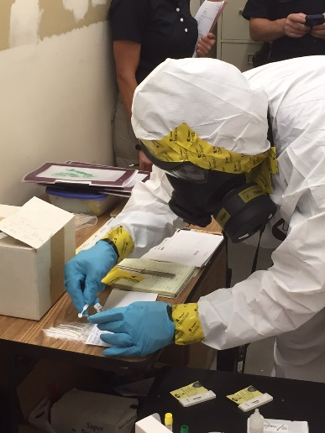
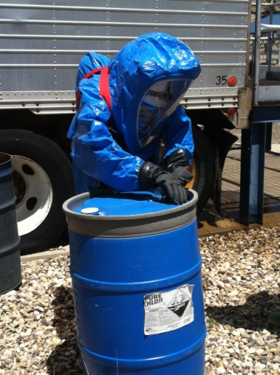
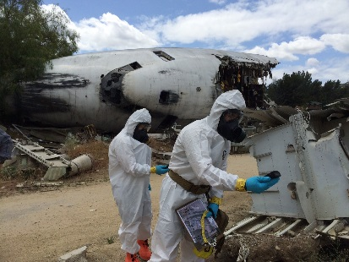
Core Missions…
1
CBRN / WMD SME
Criminal/Terrorism Nexus
CBRN/WMD Production
Dissemination Device
White Powder Calls
Radiological / Nuclear Detection
Illegal Drug Labs (Meth)
Remote Atmospheric Monitoring
Tactical Technical Decon
Homemade Explosives Production
ID only – NOT render safe
2
Traditional HAZMAT
Plug, Patch, Dam, Dike
Tankers, Rail Cars, Industrial Spills
3
All Hazard Mission Command
Initial Command/Control response for National Guard DSCA missions
Follow on ICS LNOs
Notes:
Points per slide….

Slide 4
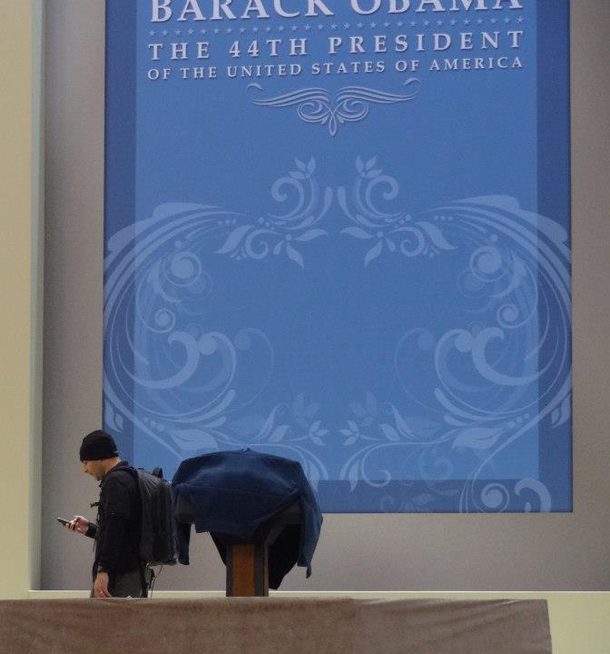
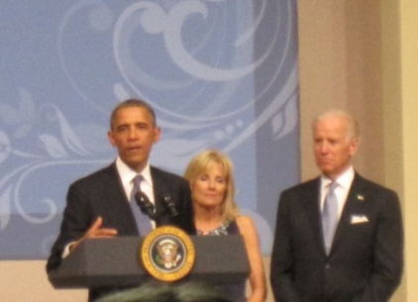
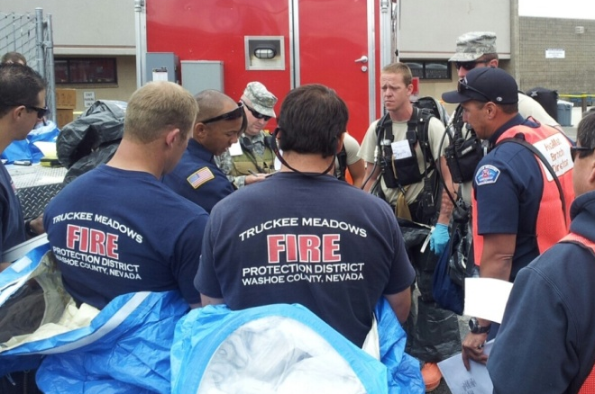
CSTs in Context…
White Powder Response
HAZMAT Spill
58th Presidential Inauguration
Radiation Monitoring
Shuttle Disaster
Toxic Material Recovery
Katrina & 9/11 Ground Zero
ICP Communications
Boston Marathon
Event and Post Blast CBRN Monitoring
Oklahoma Tornado
Military Forces Control
Steve Fawcett Search
ICP Communications in Rural Environment
NASCAR & New Years Eve Events
Event monitoring and standby response
Notes:
Points per slide….

Slide 5
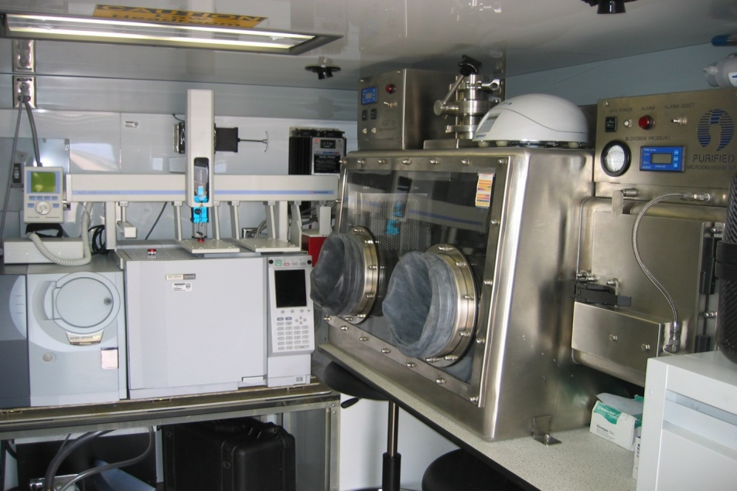
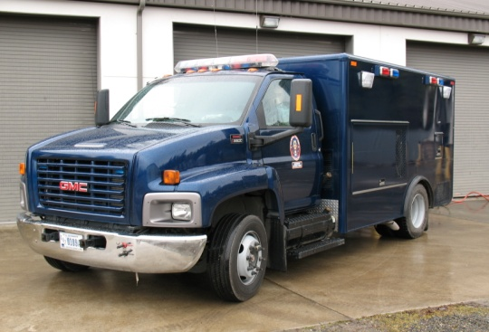
Analytical Laboratory System
Primary Capabilities
Class 3 Glovebox for BSL-4 Agents
Hand-held Immunoassays for detection / identification of Biological Warfare Agents (BWA)
Electrochemiluminescence Immunoassay (ECLIA) for antigen based detection of BWA s
Polymerase Chain Reaction (PCR) for detection / identification of nucleic acid biomarkers
Fourier Transform Infrared Spectroscopy (FTIR) for detection / identification of unknown chemicals
Gas Chromatography Mass Spectroscopy (GC-MS) for detection of Chemical Warfare Agents and TIC/TIMs
Raman Spectroscopy for detection of CWA and TIC/TIMs
Polarized Light Microscopy for “white powder” analysis
Fluorescent Light Microscopy for biological analysis
Mission: Utilizes specialized laboratory instrumentation to identify potential chemical and biological threat agents at the field confirmatory level.
The WMD-CST Laboratory Program is accredited by the American Association for Laboratory Accreditation (A2LA) to conform to ISO 17025 Laboratory Standards
Other Relevant Capabilities
Split samples for confirmatory analysis
Chain of custody protocols
Reach-back to State and Federal Laboratories
Notes:
For States to place emphasis and comments on their State mission
PURPOSE OF SLIDE:
BLUF:
KEY POINTS:

Slide 6
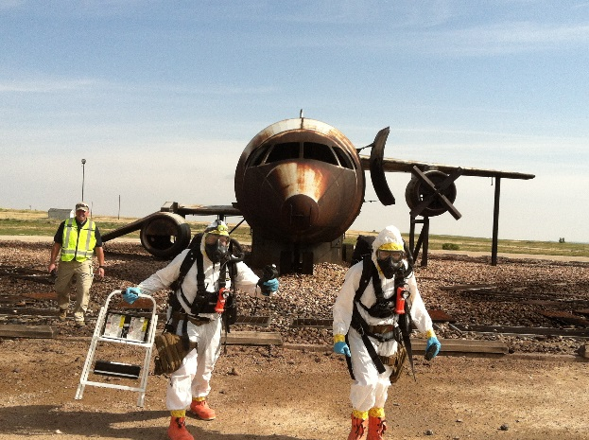
NV CST Basics
Operational Response Posture
24/7 on call response team (4 personnel)
1 Decision Maker, 3 HazMat entry personnel
Capability: 1 x entry, decon, assessment
Additional assets as required
1.5 hours from notification to arrival (non duty hours)
Reno/Sparks, Carson City, Minden, Fernley, Silver Springs
Faster during normal duty hours
On Scene Assistance (we will request from you)
Rescue (back up)
Advanced Life Support
Med Monitoring (potentially)
Availability Status – relayed through daily NVDEM SITREP

Slide 7
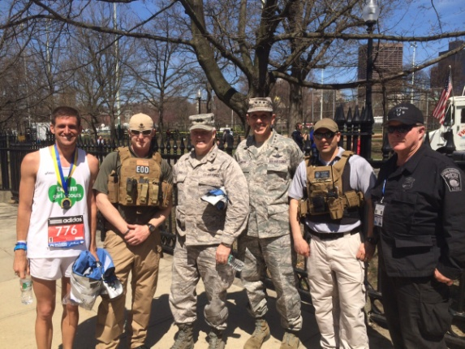
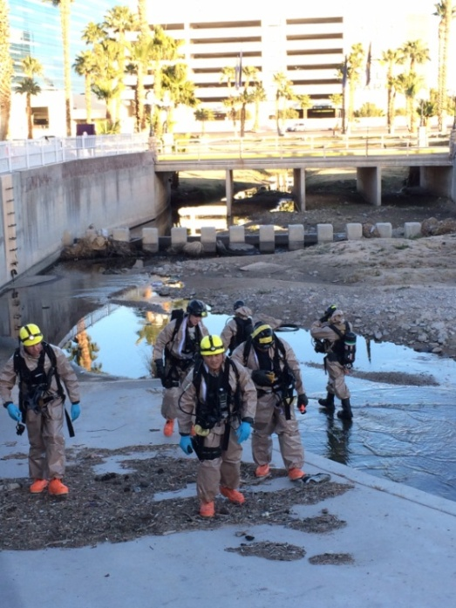
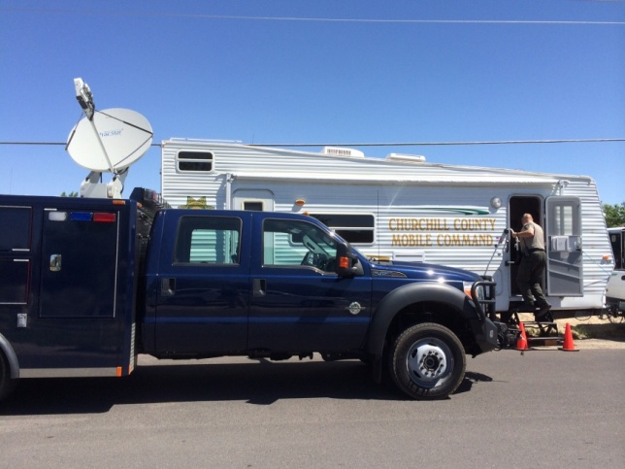
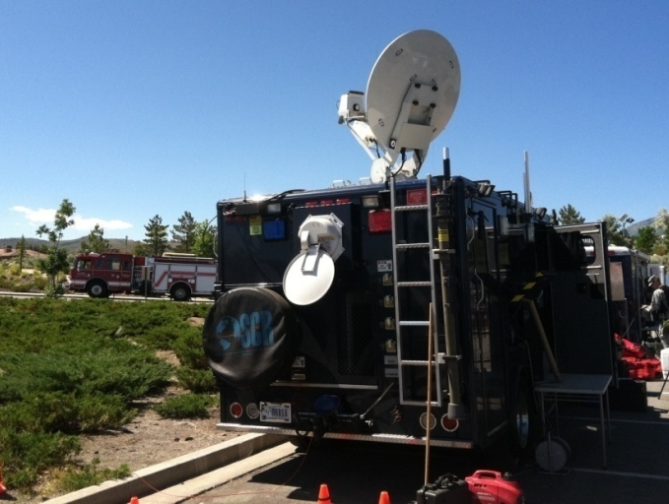
Modular Operations
Pre Event Sweeps / Preventative Rad/Nuke Detection (PRND)
Standby Response Team During Critical Events
Communications Platforms (UCS and ADVON)
Mobile Laboratory for Public Safety Identification of Samples
Notes:
Points per slide….

Slide 8
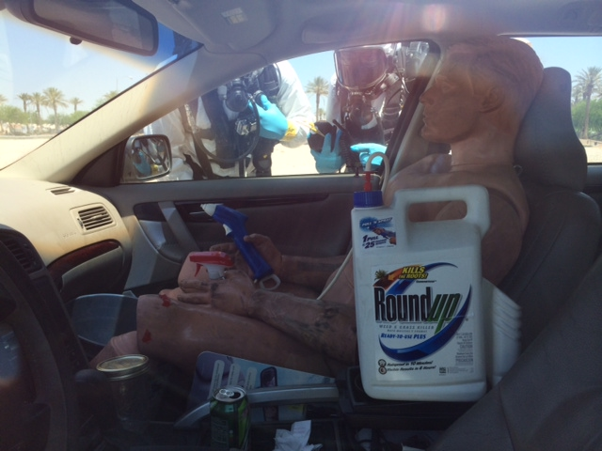
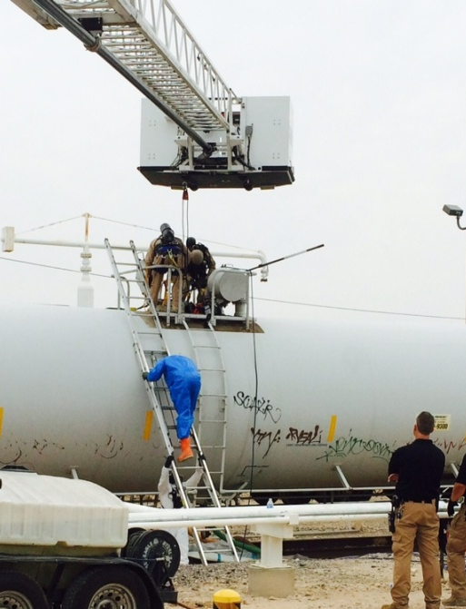
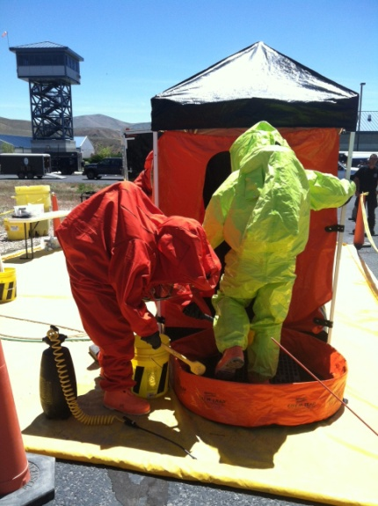
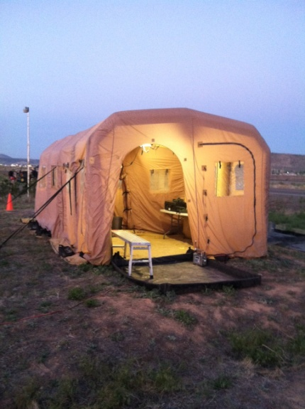
Modular Operations
Training / Teaching (HazMat Awareness, WMD Awareness, Decon, Equipment Usage)
HazMat Victim Recovery Operations
Coroner Victim Decon Assistance
Chemical Suicide Response
Decontamination
Notes:
Points per slide….

Slide 9
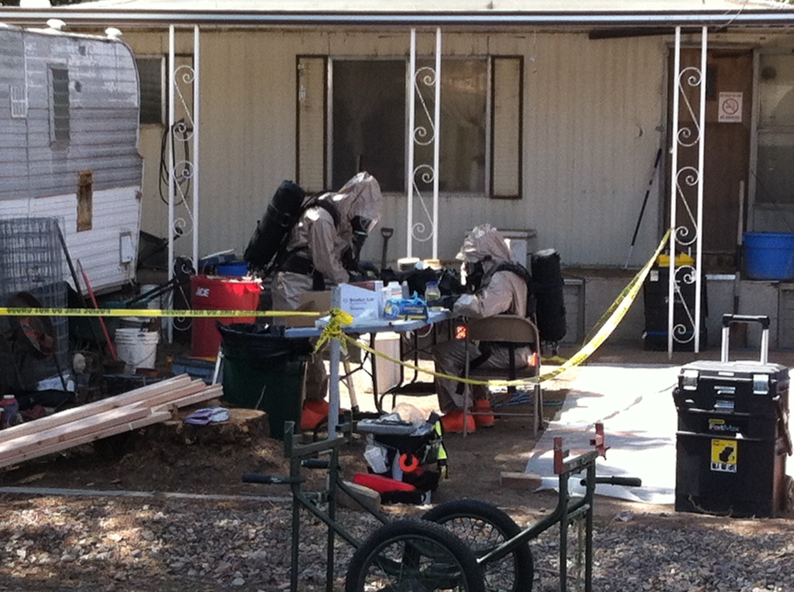

Slide 10
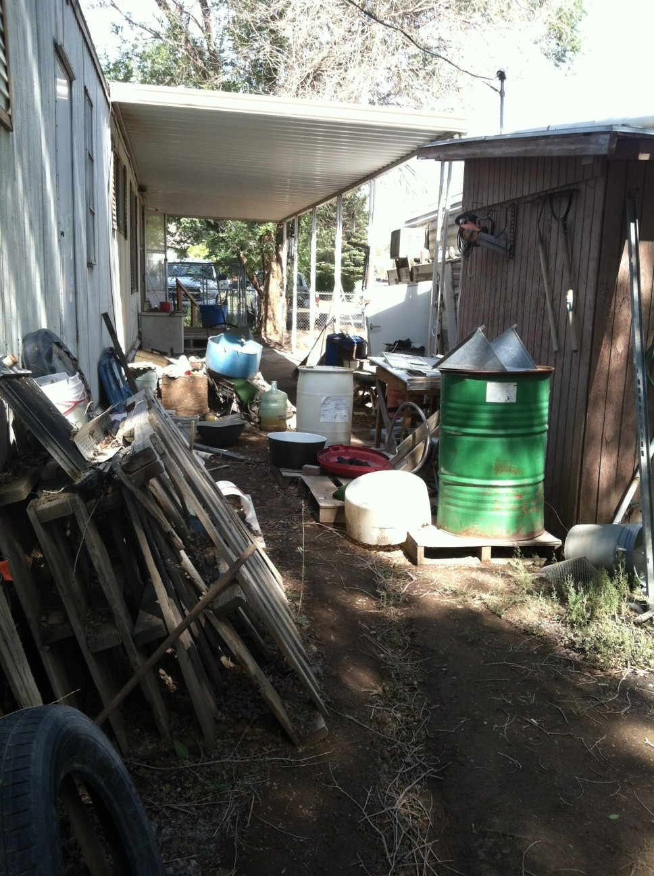
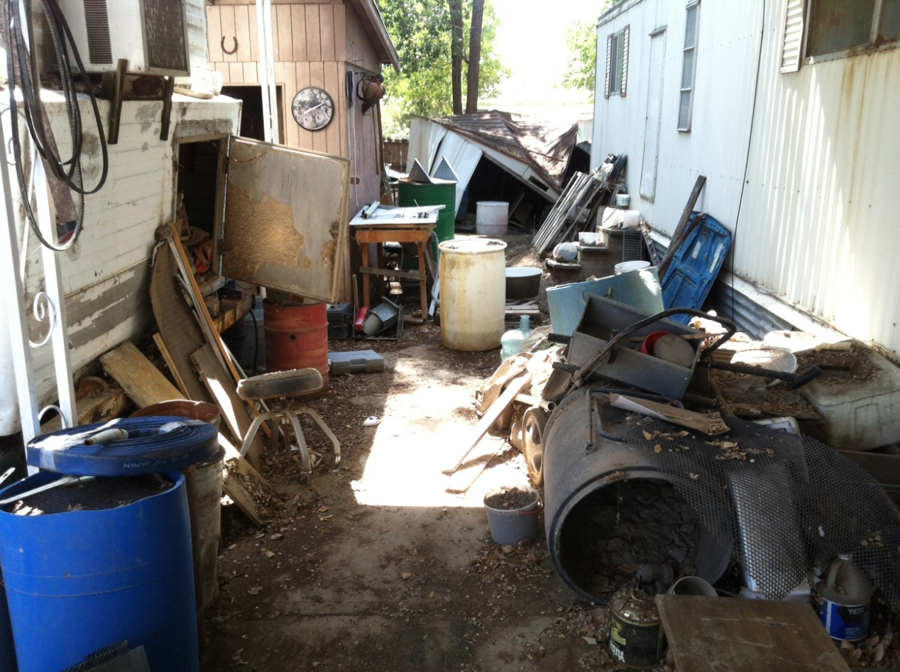
North View
Shed A
South View
Crushed Carbon Material
(High Mercury Content)

Slide 11
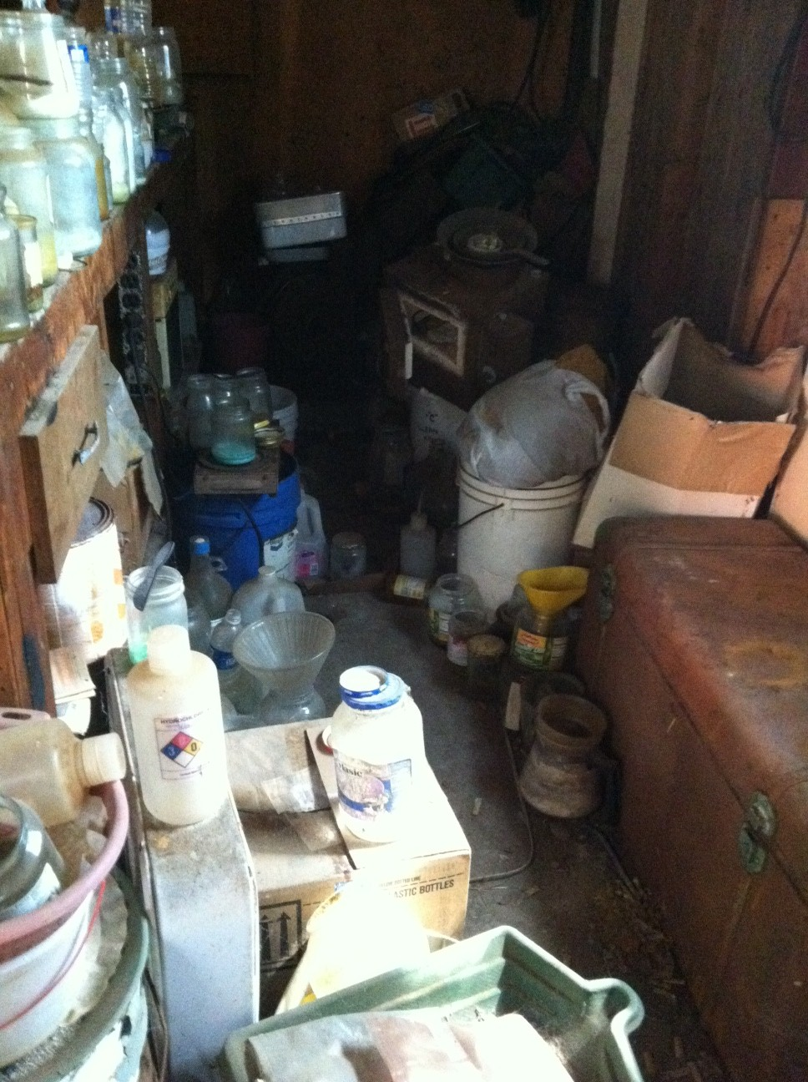
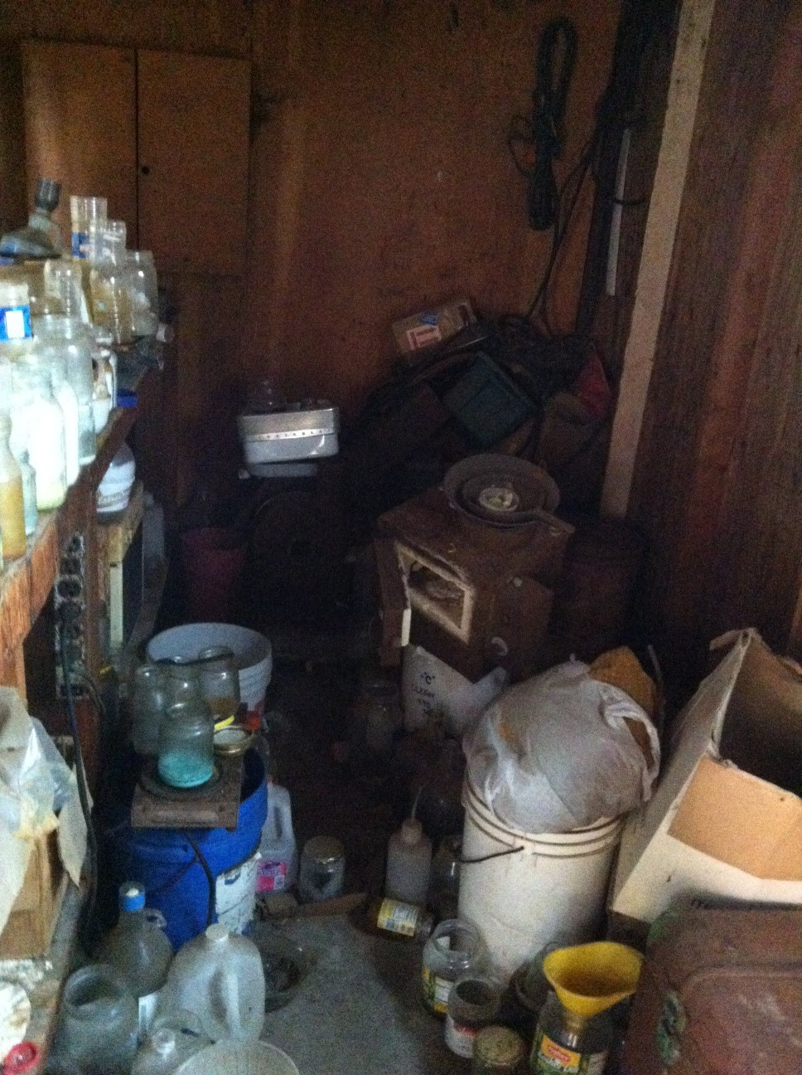

Slide 12
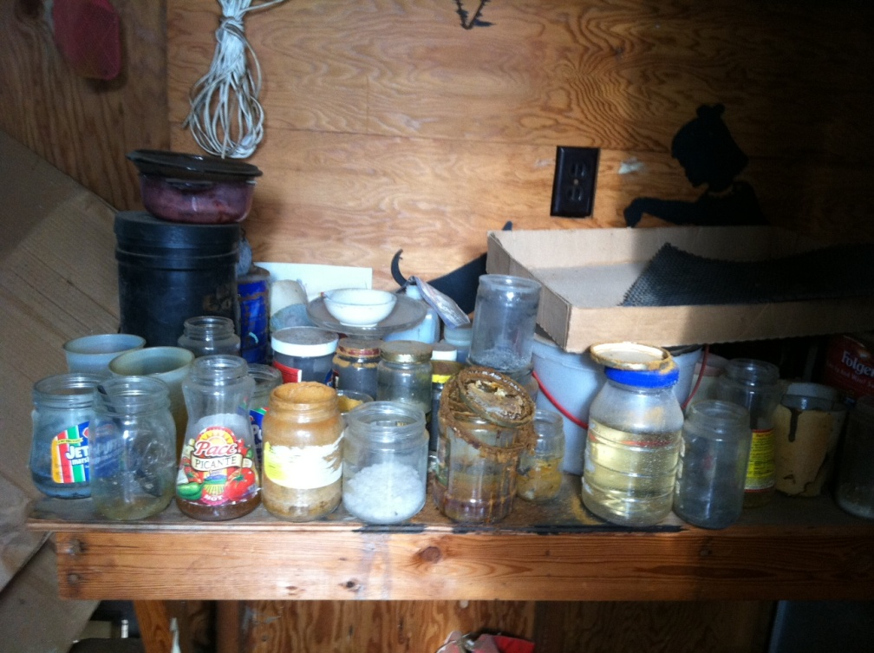
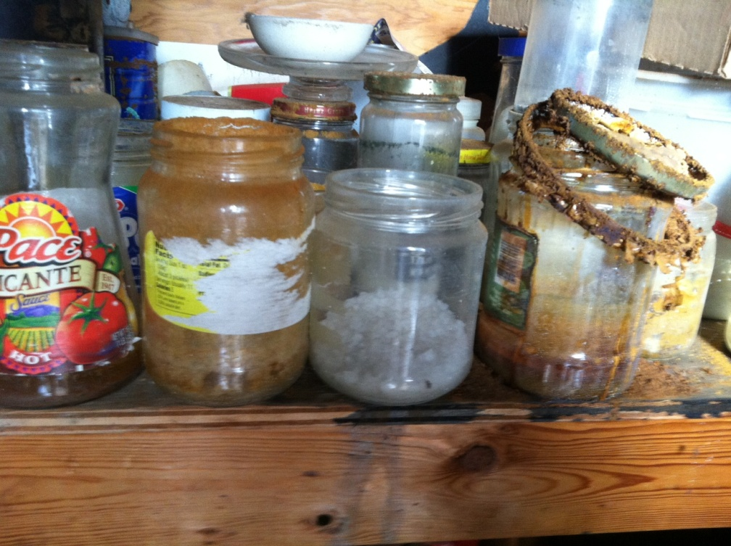
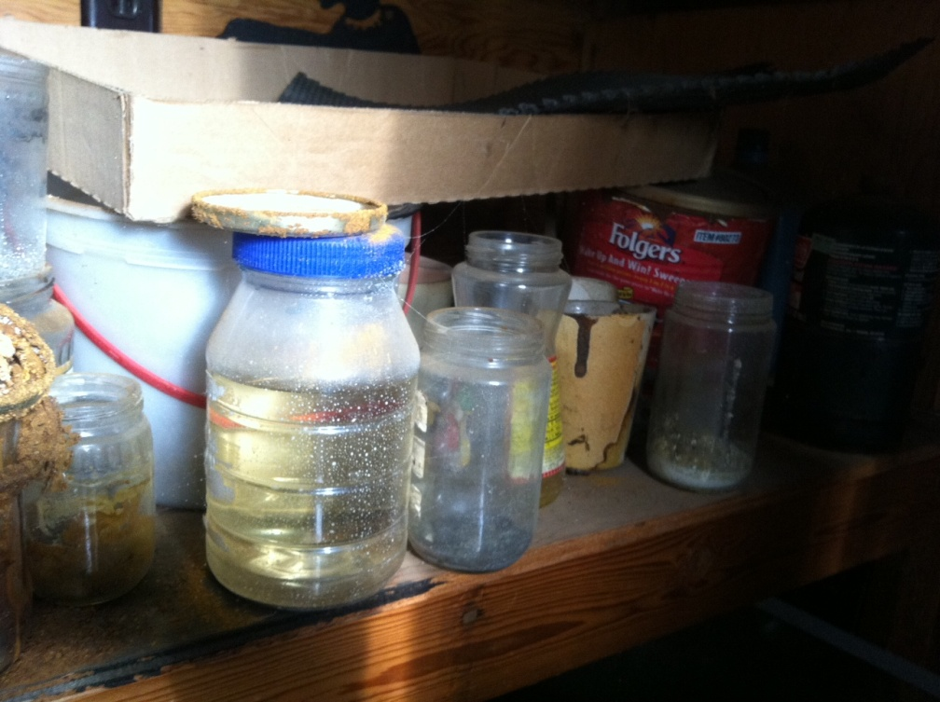

Slide 13
Substances Identified
- Cyanide already identified and mitigated on site by local DuPont HAZMAT personnel.
- Zinc sulfate was identified in trash can
- Mercury was identified by EPA contract personnel on scene
- Methyl Ethyl Ketone (MEK)
- Propane fuel
- 10w-30 motor oil (in camper)
- Phosphoric acid
- Hydrochloric acid
- Cyanide
- Mercury 12-15 lbs
- Muriatic acid
- Phosphoric acid
- Red Phosphorous
- Methamphetamine
- Zinc sulfate
- Nitric Acid/ Iron II/Cobalt II
- Sodium Bicarbonate/Ammonium Carbonate/Silver Nitrate mixture\
- Substance containing 75% Bismuth III Carbonate
- Potassium Carbonate
- Cholestyramine resin (prescription drug)
- Sodium Hydroxide / Potassium Hydroxide
- Potassium Permanganate
- Paint
- Butanol
- Pesticides

Slide 14
Totals
Roll up As of day 1 volume of containers processed:
- 31 containers of acids
- 1 propane cylinder
- 17 containers of bases
- 1 flammable liquid
- 60 containers of non hazardous substances
Roll up as of day 2 of containers processed:
-1 lb of Red Phosphorous
- 9 containers of bases
- 12 lbs of mercury
- 7 containers of oxides
- 3 containers of toxic/flammable
- 62 containers of acids
- 125 containers of non-hazardous substances

Slide 15
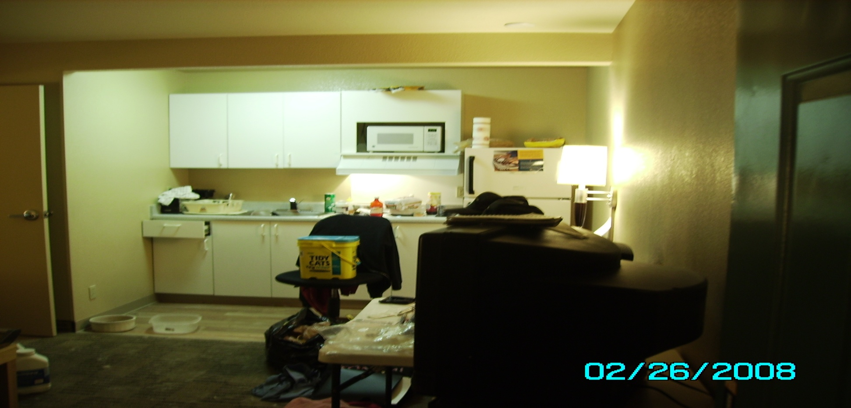
Ricin Incident

Slide 16
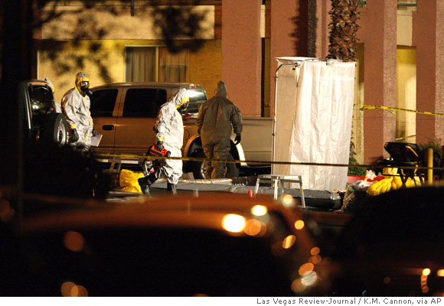
Decon Line

Slide 17
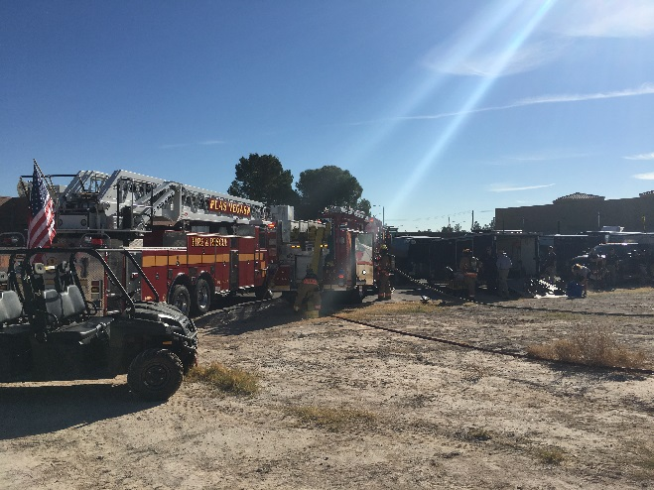
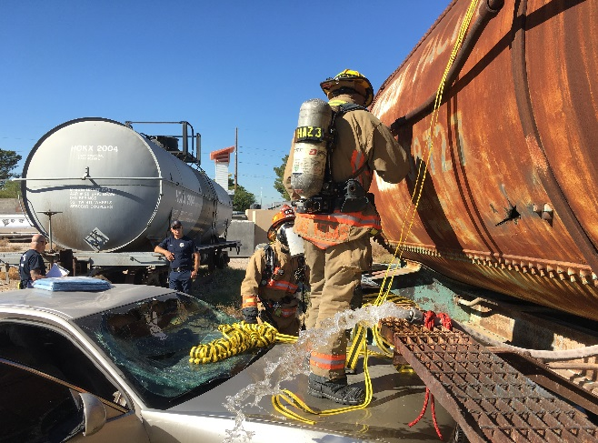
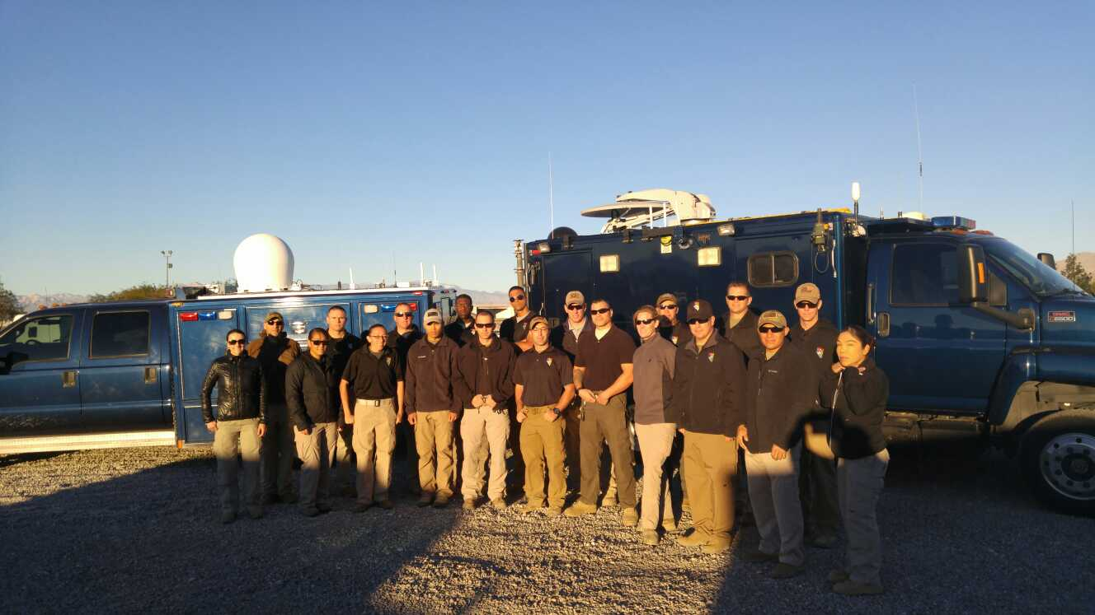
Training…

Slide 18
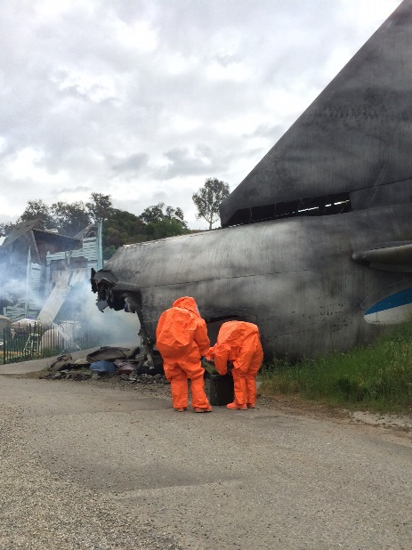

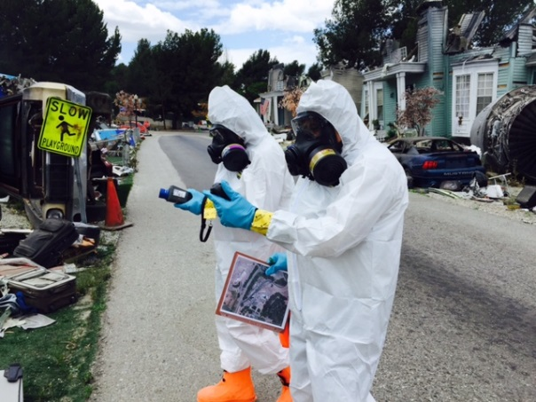
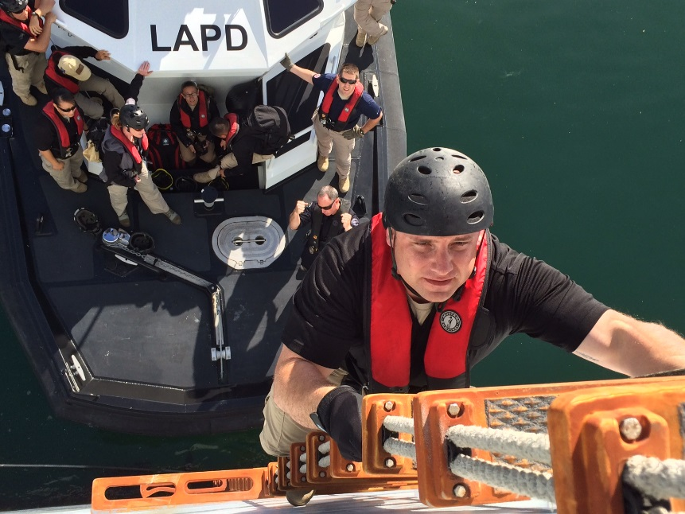
War of the Worlds (Universal Studios) Exercise Burbank, CA

Slide 19
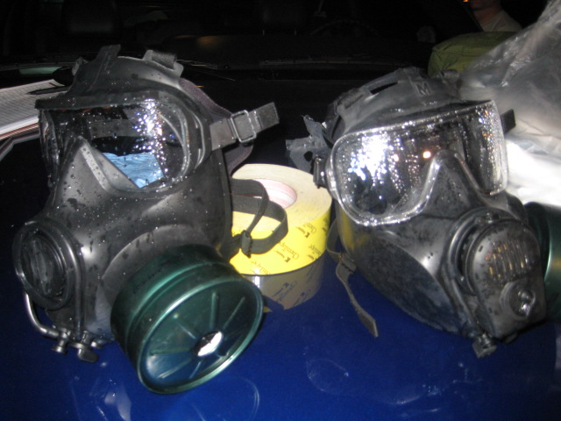
Questions?

