Slide 1
Using case studies from current events to engage General Chemistry students with their environment
Tracy J. Terry, Ph.D.
Assistant Professor
University of New Mexico - Valencia

Slide 2
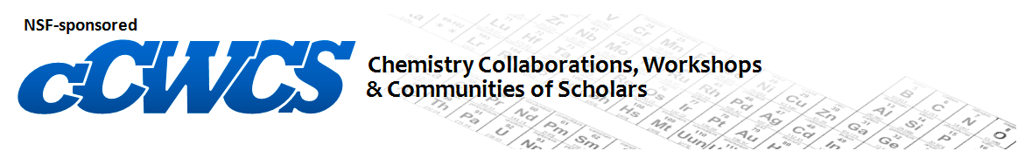
  Development & Implementation of Case Studies in Undergraduate Chemistry Courses
  Jack Eichler at UC Riverside
“Future generations of science students should have the capability to cope objectively with socio-economic, ethical, and environmental issues.”
  - Chowdhurry, M. A. J. Chem. Educ. 2013, 90, 866-872.

Slide 3
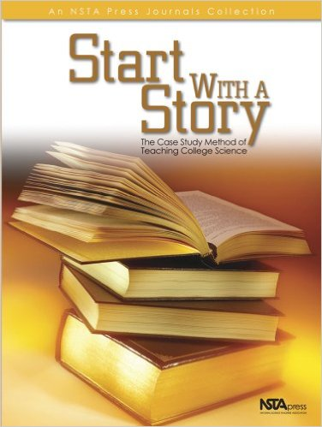
What is a case study?
“a story with an educational message”
– C. F. Herreid¹
Organization of case studies is highly varied
  Directed clicker questions - Debate
  Laboratories in context - Flipped
  Demonstrations - Jigsaw
  Discussions - Trial
  Many more!!

Slide 4
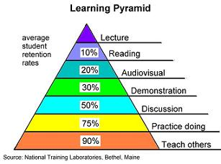
Why use case studies?
Assessment: New Mexico HED Core Competencies
  Apply scientific thinking to real world problems
  Solve problems scientifically
  Communicate scientific information
  Describe the process of scientific inquiry
  Apply quantitative analysis to scientific problems
Most common suggested tool for assessment: Case Studies
Case-Study Assessment Results
  Increase student interest³
  Increased retention of information over weeks^{4,5}
  Increased faculty interest

Slide 5




Where to begin?
Identify a need
  Address student/instructor disinterest
  Address troubled topics
  Fill ineffectively used course time
Carefully define the relevant learning objectives
Search for resources
  NCCSTS
  Journal of Chemical Education
  Journal of College Science Teaching
Find your own story
  DRAMA!
  Socio-economic / Ethical / Environmental
  Local if possible

Slide 6
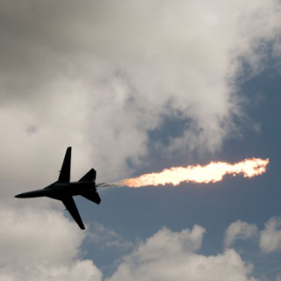
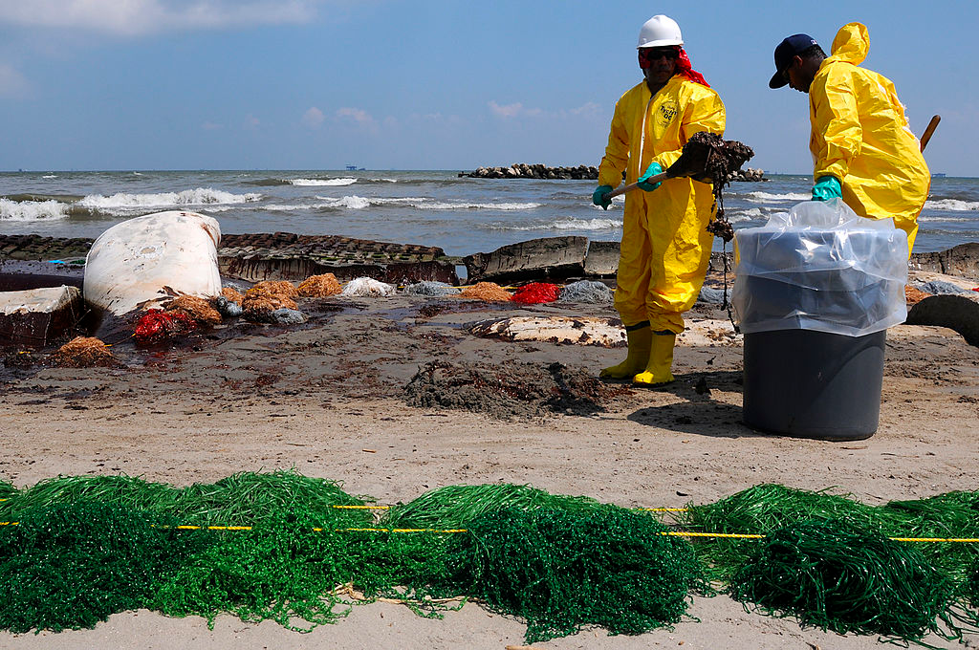
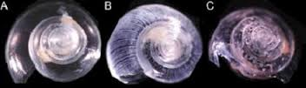
Case Study Outlines
Jet Fuel for Thought
  Jet fuel spill into aquifer under AFB in Albuquerque
  Guided case study
Gulf Oil Spill
  2010 Deepwater Horizon oil spill in the Gulf of Mexico
  Experimental case study
Ocean Acidification
  Ongoing acidification of oceans, decline of mollusks harvests in Pacific Northwest
  Experimental/Demonstration case study

Slide 7
Jet Fuel for Thought
Need Identified
  Engage returning General Chemistry II students
  Poorly used laboratory time – 1st lab of semester
General Chemistry Student Learning Objectives:
  Identify the intermolecular forces experienced between molecules
  Describe how intermolecular forces affect solubility
  Determine relative solubility based on chemical formula or skeletal structure
  Interconvert between concentration units (ppm, ppb, molarity, mass %)
Story: Jet fuel spill at Kirtland AFB and ongoing clean-up
Additional topics covered
  Chemical toxicity
  Need to test aquifer water for contaminants

Slide 8
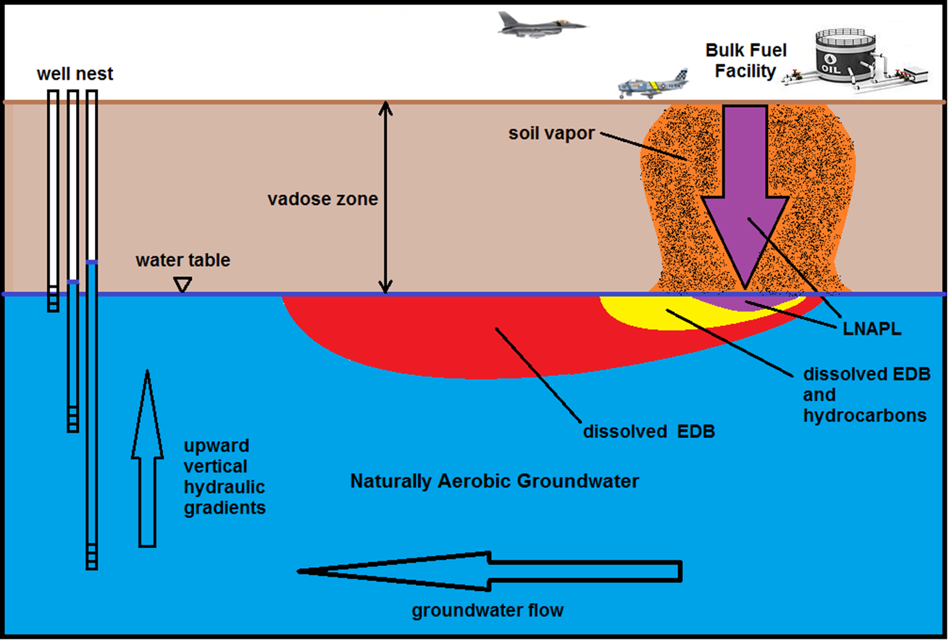
Fuel Spill Overview
NMED KAFB Fuel Spill 2015 Strategic Plan 2.0 (3-23-15)

Slide 9
Set-up
Background reading questions
Newspaper article on the spill
  Timeline and extent of the spill
Define relevant terms
Due to your extensive knowledge of chemical bonding and your ability to predict the physical and chemical properties of molecules, YOUR Group has been hired as chemistry consultants by concerned neighbors located near the spill site to:
assess the current dangers/concerns for Albuquerque residents, and
assess the viability of the proposed remediation plan.

Slide 10
Steps in the Process
Students gather data in groups (10-15 min)
  What do you know?
    From pre-lab assignment
    From local news
  What do you need to know?
    Prioritize questions
  Look up information online
  What’s in the fuel?
  What’s in the aquifer?
  How are they cleaning it up?
  Who pays for it?

Slide 11
Steps in the Process
Groups take turns asking questions
  Jet fuel components (30 min)
    Solubility – Worksheet
      Determine intermolecular forces of components
      Relate structural features to solubility
      Convert solubility units
    Toxicity – Worksheet
      Define MCL (maximum contaminant level)
      Convert MCL levels from EPA web site
  Remediation methods (20 min)
  Detection methods (15 min)
    Forms of GC – Worksheet
      Define MDL (method detection limit)
      Discuss GC detector types (FID/MS/ECD)

Slide 12
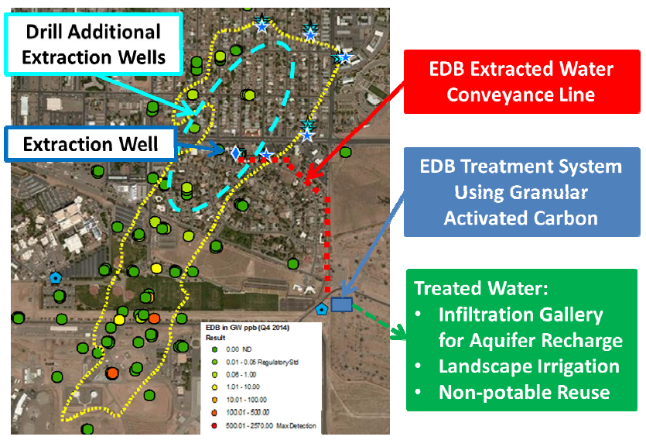
EDB Pump and Treat
NMED KAFB Fuel Spill 2015 Strategic Plan 2.0 (3-23-15)

Slide 13
Steps in the Process
Independent Group Research (20 min)
    NMED KAFB Fuel Spill web site has current updates
      Volume of aquifer water treated currently
      Mass of EDB removed currently
      Calculate the average ppb EDB in the aquifer water at the pump and treat site
Oral group presentations (5 min per group)
Due to your extensive knowledge of chemical bonding and your ability to predict the physical and chemical properties of molecules, YOUR Group has been hired as chemistry consultants by concerned neighbors located near the spill site to:
assess the current dangers/concerns for Albuquerque residents, and
assess the viability of the proposed remediation plan.

Slide 14
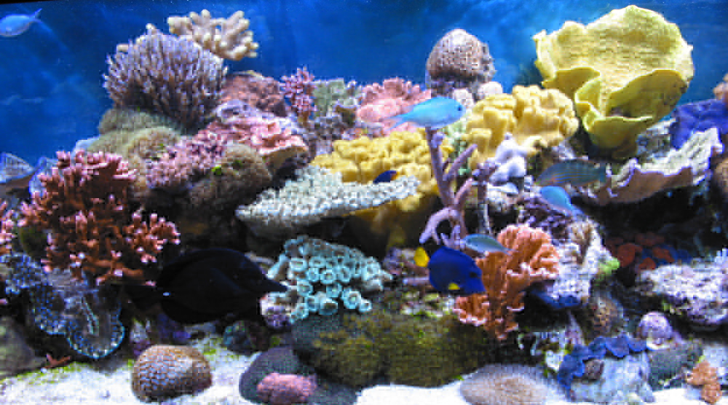
Ocean Acidification
Need Identified
  Expose students to real-world application of equilibrium topics
General Chemistry Student Learning Objectives
  Write simple hypotheses based on scientific principles and observations
  Design experimental procedures for simple lab questions
  Write equilibrium constant expressions based on chemical equations.
  Judge how changes in reaction conditions will affect the equilibrium position of a reaction
  Apply equilibrium concepts to acid/base reactions
  Calculate pH and species concentrations using equilibrium constants
Story - Death of farmed mollusks in Pacific Northwest
Additional topics covered
  Complexity of natural systems

Slide 15
Background
Pre-lab assignment
  Read a news story on the collapse of the mollusk harvest in the Pacific Northwest
  Review topics
    Scientific Method
    acid/base chemistry
    equilibrium and Le Chatelier’s Principle
  Given the most common ions in seawater, determine if they are acidic, basic, or neutral and write a balanced chemical equation to describe their interaction with water

Slide 16
Set-up
Three-part experimental case study
Each experiment relates to actual climate changes and builds on previous knowledge
  Students are guided through the process while answering questions on a worksheet:
    Identify background knowledge
    Develop a hypothesis
    Test hypothesis
    Extrapolate the new information to develop a new hypothesis for testing
    Propose new experiments

Slide 17
Experiment 1
Blow bubbles in a beaker while measuring pH
Before the experiment:
Gather Data
  What chemicals are higher in concentration in your exhale than in the ambient air?
  Write a balanced chemical equation of how this chemical reacts with water.
Develop a hypothesis: What will happen to the pH of the water?
Experiment
Record pH measurements
Modify your hypothesis as needed

Slide 18
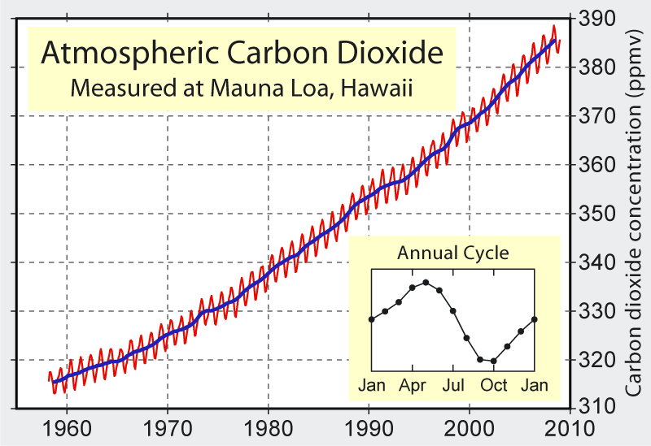
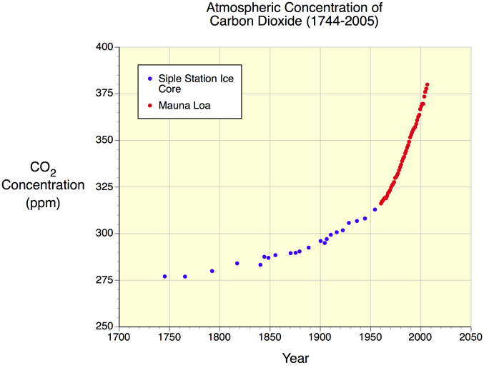
Extrapolate
Develop a new hypothesis based on your information
As the CO₂ concentration in the atmosphere increases…
What do you predict is happening to the pH of the oceans?

Slide 19
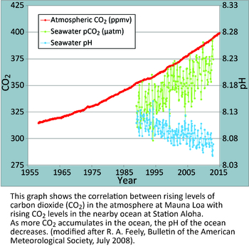
Ocean Acidification: The Other Carbon Dioxide Problem
http://www.pmel.noaa.gov/co2/story/Ocean+Acidification
Fundamental changes in seawater chemistry are occurring throughout the world's oceans. Since the beginning of the industrial revolution, the release of carbon dioxide (CO₂) from humankind's industrial and agricultural activities has increased the amount of CO₂ in the atmosphere. The ocean absorbs about a quarter of the CO₂ we release into the atmosphere every year, so as atmospheric CO₂ levels increase, so do the levels in the ocean. Initially, many scientists focused on the benefits of the ocean removing this greenhouse gas from the atmosphere. However, decades of ocean observations now show that there is also a downside — the CO₂ absorbed by the ocean is changing the chemistry of the seawater, a process called OCEAN ACIDIFICATION.

Slide 20
Experiment 2
Dissolve antacid tablets in three solutions of varying pH (2, 7, 10)
Before the experiment:
Gather Data
  What is the active ingredient in the tablets? (CaCO₃)
  Given the K_{sp} (10⁻⁹ at pH 7, 20 ºC), do you expect CaCO₃ to dissolve?
  What is the chemical difference between the three solutions?
Develop a hypothesis: Predict a solubility trend for the solutions.
Experiment
Record observations – how do you know it is dissolving
Modify your hypothesis as needed.

Slide 21
Extrapolate
Recap…
Increasing CO₂ concentrations in the atmosphere raises the H⁺ concentration in the ocean, lowering ocean pH.
⬆[CO₂]_{atmosphere} → ⬆[H⁺]_{ocean} → ⬇pH_{ocean}
Lower pH increases solubility of calcium carbonate.
⬇pH_{ocean} → ⬆ solubility CaCO₃
Given
Coral reefs are diverse underwater ecosystems held together by calcium carbonate structures secreted by corals. -WIkipedia
Shells of mollusks, such as oysters, are held together by calcium carbonate structures.
How do you predict ocean acidification will affect coral reefs and ocean mollusks?

Slide 22
In the news…
“Oregon State researchers trace oyster larvae die-off to increasing ocean acidity”
  – oregonlive.com/pacific-northwest-news, The Oregonian, April 12, 2012
“Ocean acidification is the main suspect as some farms report mortality rates as high as 90%”
  ‘Mystery surrounds massive die-off of oysters and scallops off of B.C. coast’ The Globe and Mail, Feb 27, 2014
“the oyster [larvae] need to exert more energy for shell building and have less for swimming and getting food…these tiny oysters just sink in the water and stop swimming.”
  ‘Ocean acidification causing Pacific oyster die-off’, news.discovery.com, Dec 16, 2014

Slide 23
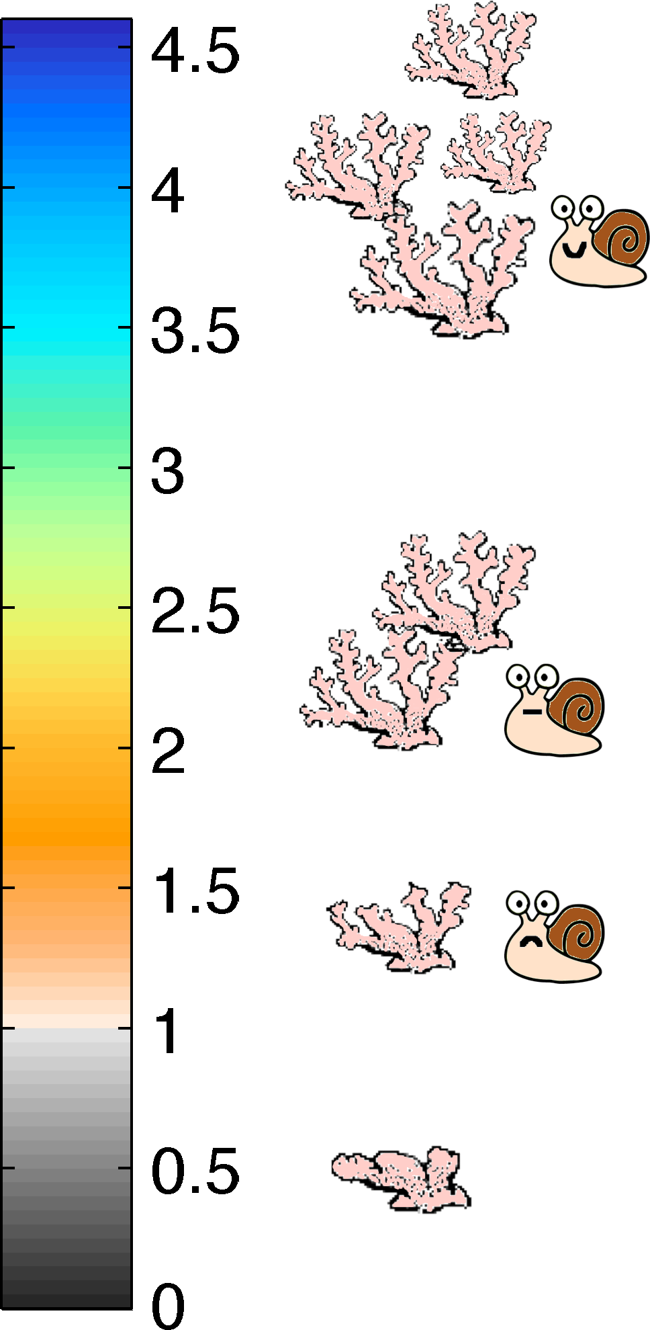
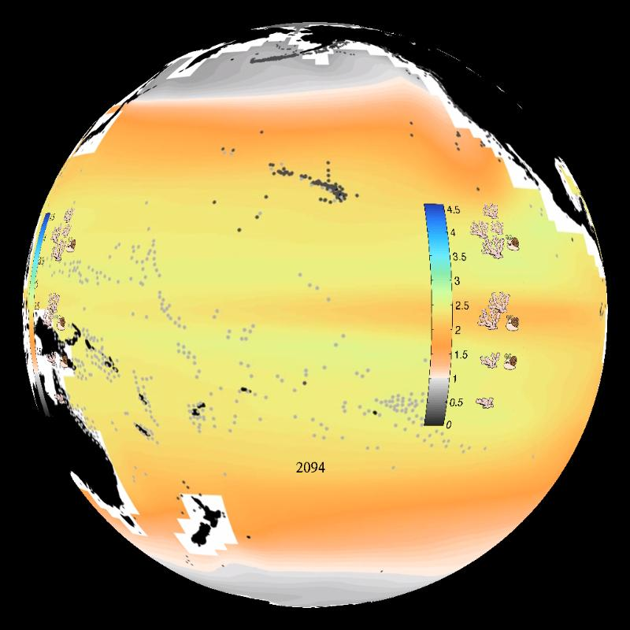
Ocean Acidification and CaCO₃ Saturation
Interactive Sphere: http://sos.noaa.gov/Datasets/dataset.php?id=173#

Slide 24
Experiment 3
Beaker A – sea shells soaked for a week in tap water
Beaker B – sea shells soaked for a week in vinegar
Develop an experiment to perform with the shells.
Work in small groups:
Gather Data
  What do you already know that might affect the shells?
Develop a hypothesis: What difference may exist between the shells in the different beakers?
Develop an experiment outline to test your hypothesis.
Discuss the proposed experiments – Instructor picks one/two
Instructor has some initial data:
- initial mass of shells - initial pH of solutions
- initial volume of solutions - initial mass of beakers

Slide 25
Gulf Oil Spill
Need Identified
  Unused GC - TCD
  ‘Gentle’ introduction to wet labs in Gen Chem II
  Practice deriving conversion factors from lab procedures
General Chemistry Student Learning Objectives
  Use laboratory procedure to determine appropriate conversion factors.
  Identify the intermolecular forces experienced between molecules
  Describe how intermolecular forces affect boiling point
  Apply scientific knowledge to a real world situation.
Story - 2010 Deepwater Horizons oil spill
Additional topics covered
  Chromatography

Slide 26
Set-up
Contaminants (xylenes and naphthalene) are doped into the sand before lab.
Sand samples taken from Gulf Coast are extracted for contaminants and analyzed by gas chromatography during lab.
During analysis, students gather information online to predict relative levels of contamination.
  Ocean currents
  Wind currents
  Reports on clean-up activities

Slide 27
The Chemistry
The chromatogram is presented as 8 ppm concentration of xylenes and naphthalene.
Students predict which peak corresponds to which contaminant.
When sample analysis is complete, students must convert the peak area for each contaminant:
Peak 1 Area = 0.107
Peak 2 Area = 0.090
Peak area → sample concentration → sand concentration
using conversion factors from their laboratory procedure.
Soil concentrations for each sample are compared to EPA limits.
Relative soil concentrations for each sample are compared to confirm/modify hypothesis from student research.

Slide 28
Results
Students prefer the case studies.
Case studies lead to interesting results…students find science a creative endeavor.
My students are better able to write about chemistry applied to broader contexts.
Explain how a swamp cooler works on a molecular level.
Explain why fog forms in the bosque in the fall.
I prefer case studies!

Slide 29
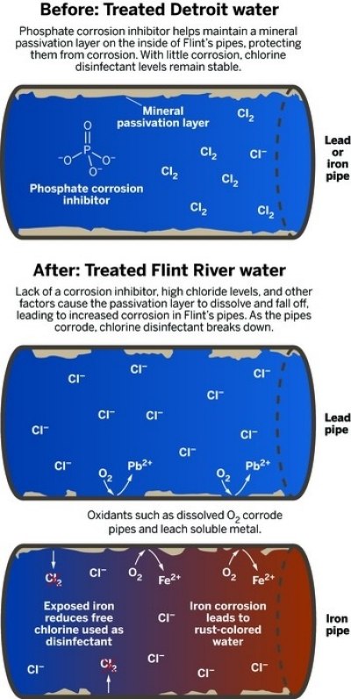
Future Case Study Ideas
Flint Water Crisis
  Chemical reaction classifications
  Balanced chemical equations
How lead leached into the city’s water
by Michael Torrice
C & E News, Feb 15, 2016, p. 26

Slide 30
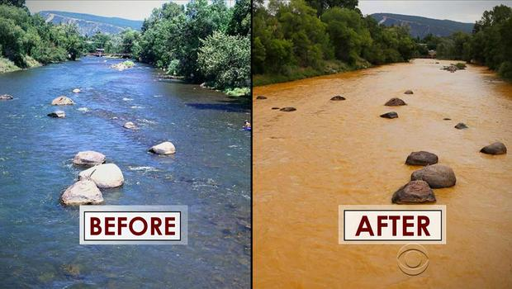
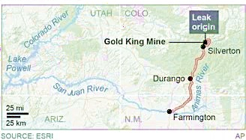
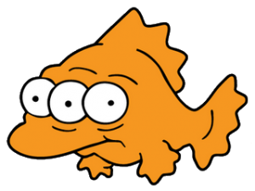
Future Case Study Ideas
2015 Gold King Mine Spill in Animas River, CO
  Demonstrate metal identification methods using atomic emissions from various rock types
CBS News images of Animas River

Slide 31
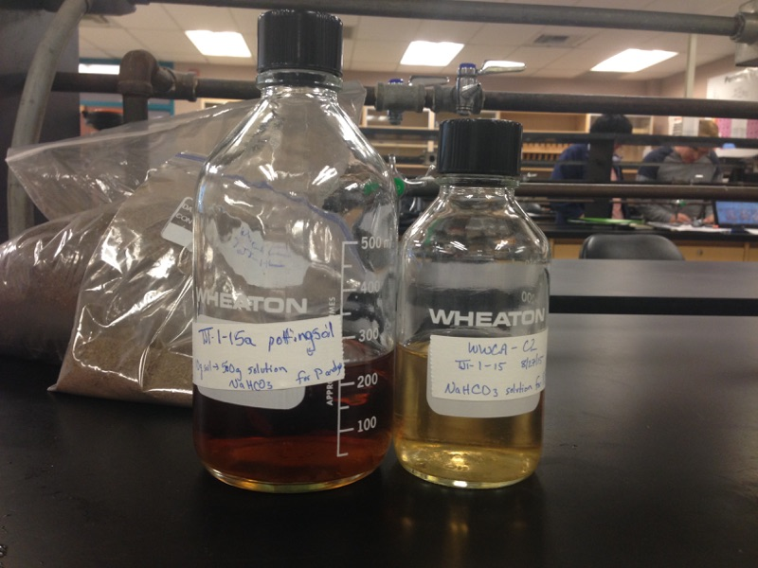
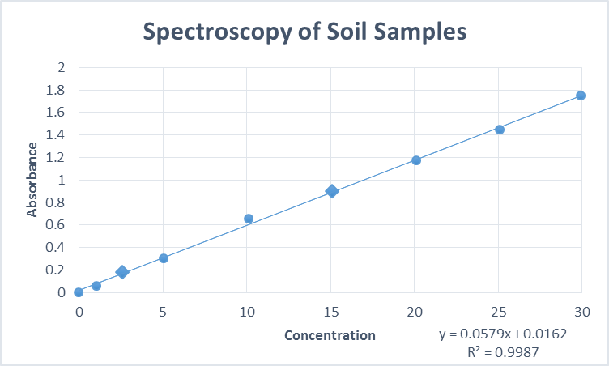
Future Case Study Ideas
Dead zones caused by fertilizer runoff from farms
  Modification of existing phosphate analysis laboratory assignment
  Let students bring in their own soil samples to analyze for phosphate content before/after fertilizing or rain

Slide 32
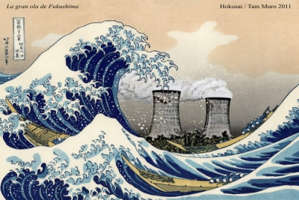
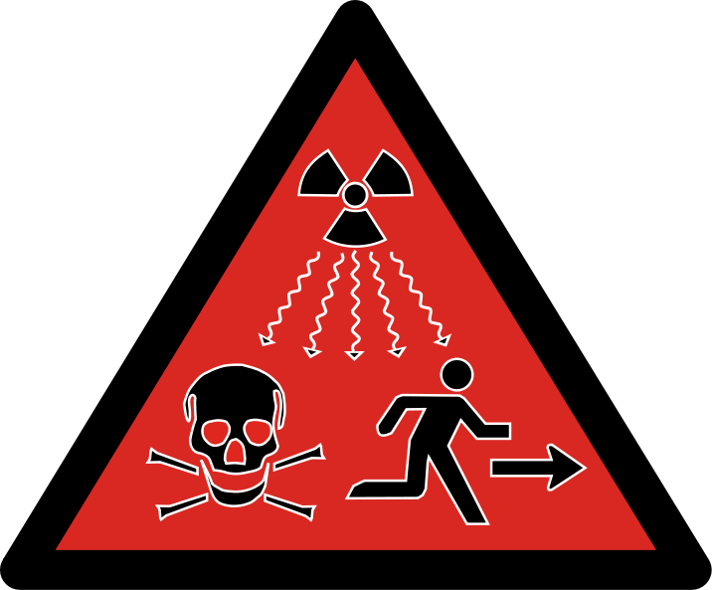
Future Case Study Ideas
Nuclear Chemistry
  Use local resources
    National Museum of Nuclear Science
    Sandia National Laboratory
    Los Alamos National Laboratory
  Possible stories:
  1986 Chernobyl disaster
  2014 WIPP radiation leak in NM
  Effects of uranium mining on Navajo Nation
  Uranium alternatives for nuclear energy
  2011 Fukushima disaster

Slide 33
  Development & Implementation of Case Studies in Undergraduate Chemistry Courses
  Jack Eichler at UC Riverside
  National Center for Case Study Teaching in Science (NCCSTS)
  http://sciencecases.lib.buffalo.edu/cs/
  For more information on the case studies presented here:
  tjterry@unm.edu

Slide 34
References
“Start With A Story: The Case Study Method of Teaching College Science” Ed. By C. F. Herreid, NSTA, 2013.
Chowdhurry, M. A. J. Chem. Educ. 2013, 90, 866-872.
Frerichs, V. A. J. Chem. Educ. 2013, 90, 268-270.
Lord, T. J. Coll. Sci. Teach. 2007, 37, 14-17.
Herreid, et. al. J. Chem. Educ. 2013, 90, 256-257.

Slide 35
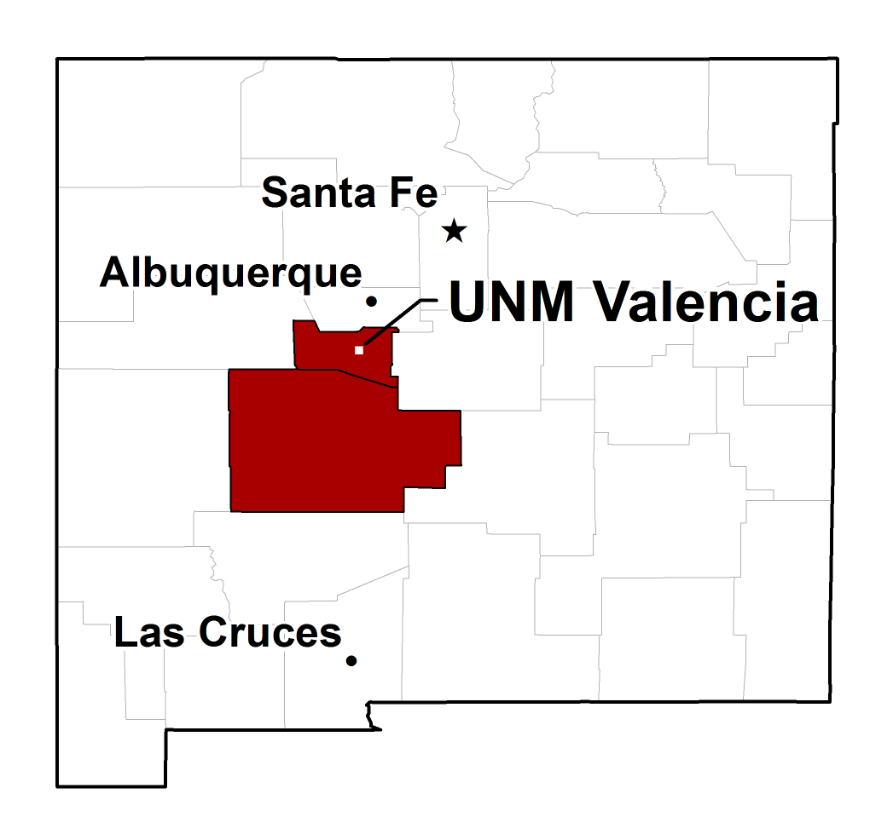
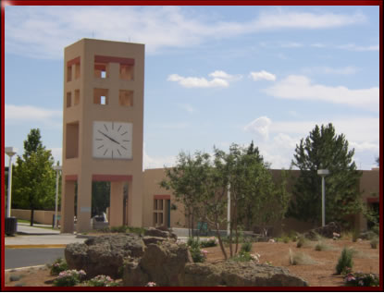
UNM-Valencia
Rural area
~35 full-time faculty
~60 part-time faculty
Open admission policy
~2,000 students enrolled
65% part-time
65% Hispanic
60% first generation college

