Slide 1
REFLECTIVE JOURNALS In Chemistry Classes
Olga Katkova
Chemistry Instructor
Truckee Meadows Community College
MARCH 11th, 2016 at 213th 2YC3 Conference,
San Diego City College, San Diego, CA

Slide 2
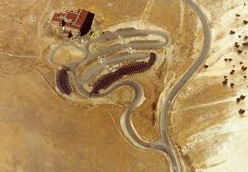
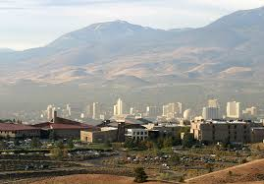
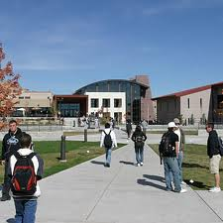
Truckee Meadows Community College TMCC
TMCC is a comprehensive community college
Located in Reno, Nevada, and is part of the Nevada System of Higher Education
Serves more than 28,000 students each year in credit and non-credit programs at 5 educational sites and more than 20 community locations
TMCC offers over 40 programs of study that lead to more than 100 degree, certificate and other completion options, university transfer, convenience, flexible schedules and affordability.

Slide 4
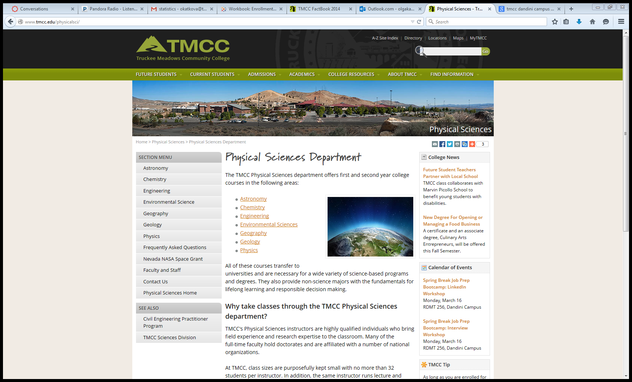

Slide 5
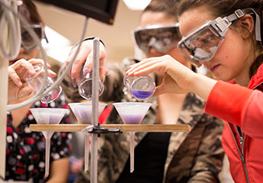
Chemistry at TMCC
Chemistry classes at TMCC support degree programs in
physical sciences and biology
also in nursing, dental hygiene, radiological technology,
and those looking for careers in medicine, biotechnology, engineering and fire sciences.
An Associates of Science Emphasis in Chemistry provides the first two years towards a Bachelor’s Degree in Chemistry at most major universities.

Slide 6

General Chemistry CHEM 121
CHEM 121
General Chemistry I
First Semester chemistry for biology, engineering, allied health, environmental science, and pre-med majors.
Pre-Req: MATH 120
Taught: Fall, Spring, Summer
Fall 2014 : 10 sections = 280 students
Spring 2015 : 9 sections = 252 students
Summer 2015 : 1 section = 28 students

Slide 7

PREPARE YOUR MIND TO RECEIVE

Slide 8

General Education Objectives
Communications: Includes the ability to listen, speak, and write competently so as to gain skills to interact effectively with others; and to read with comprehension.
Critical Thinking: Includes the ability to grasp complexities, relationships, similarities and differences; to draw inferences and conclusions; to identify and troubleshoot problems; to collect and identify data to formulate and test solutions; and to identify how individual values and perceptions influence decision making.
Information Literacy: Includes the ability to understand information technology; use applications as tools; and to evaluate the applicability and validity of information.
Personal/Cultural Awareness: Includes the ability to develop a broad understanding of linguistic, political, social, environmental, religious, and economic systems; to attain skills to function effectively as responsible, ethical community members; and to learn to value, respect and critique the aesthetic and creative process.
Quantitative Reasoning: Includes the ability to use scientific reasoning skills including induction and deduction; to discern bias and subjectivity; to perform appropriate calculations; and to understand, evaluate, model and effectively use data.

Slide 9
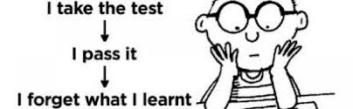
The Major Goal is to provoke the students to think about what they are learning in the class.

Slide 10
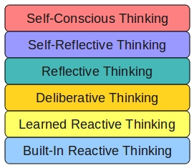
Good Learners tend to be Reflective Thinkers

Slide 11
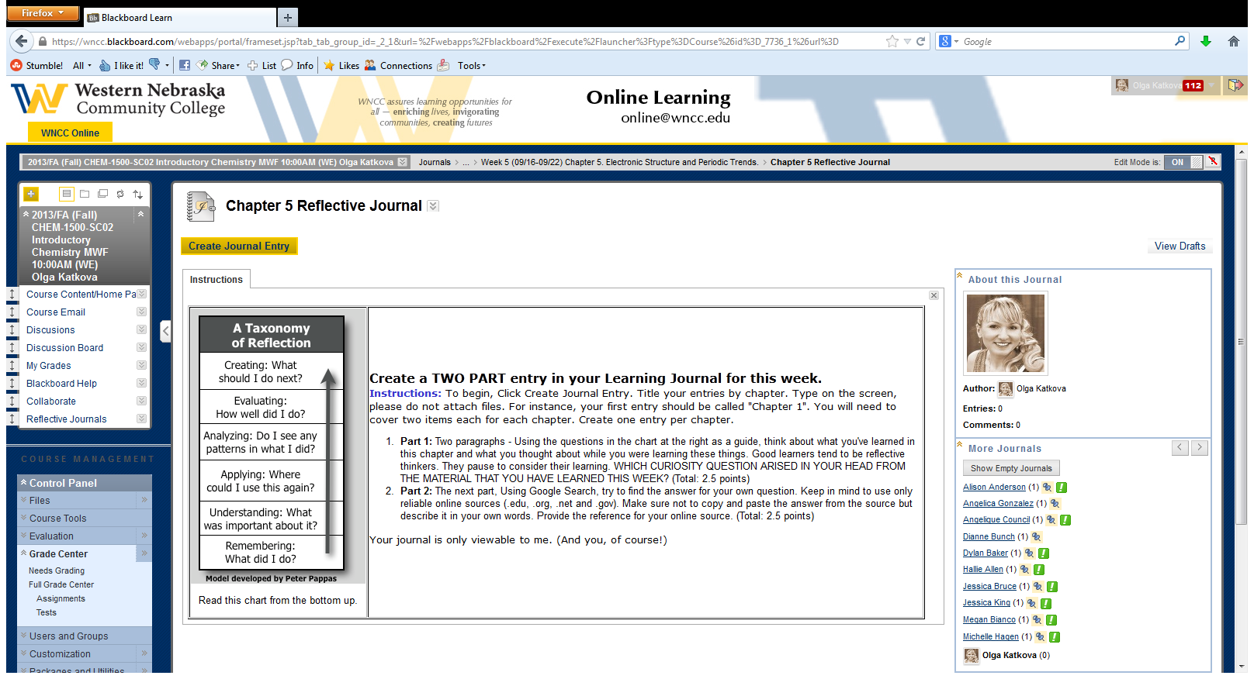

Slide 12
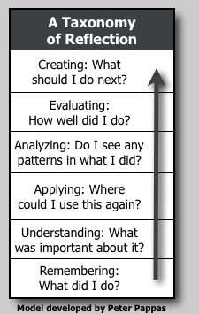
TAXONOMY CHART
Levels of Critical thinking
CREATING
EVALUATING
ANALYZING
UNDERSTANDING
REMEMBERING

Slide 13
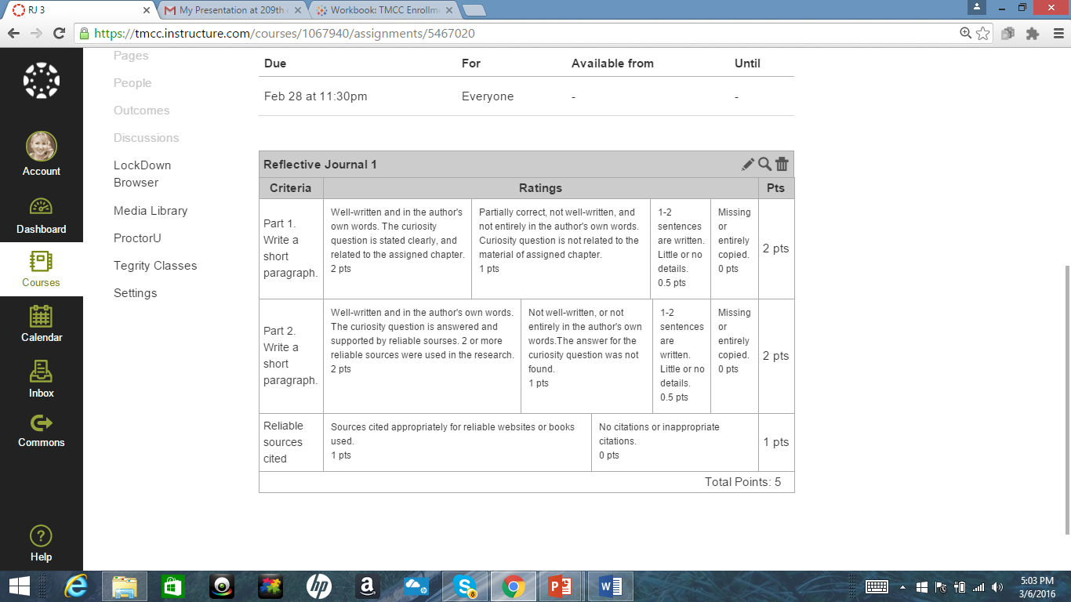

Slide 14
Example #1(Chapter 2, Mass and Weight)
The question that arose in my mind during this past chapter of study was regarding mass.
I understand that mass and weight are not the exact same thing, but I don't understand the explanation for what makes them different. The textbook defines the mass of an object as "the quantity of material it contains" and it defines weight as "a measure of the gravitational pull on an object measured at a specific location". I mentally assent to these explanations, but I still don't quite grasp the difference well enough to explain it in my own words.
In searching for an answer, I came across three points that helped clarify these two terms for me. The first was that mass is an intrinsic property of a body and is independent of any external factor, whereas weight depends on the mass of the object attracting it and the force with which it is being attracted. Explaining it that way helped me to picture in my mind the forces being discussed. The second helpful point was that mass is measured in kilograms in SI and weight is measured in Newtons in SI. That point mainly helps a reminder of how to determine which is which at a glance. The third, building on the other two, is that mass can never be a zero, but weight can. This makes sense, since mass is quantity of material an object contains, zero mass would mean there was zero object. Zero weight, however, is completely logical and possible because it simply denotes the absence of gravity.
It makes sense to me now! I feel much more confident in my understanding of mass and weight and therefore also my understanding of how to measure them.
http://farside.ph.utexas.edu/teaching/301/lectures/node47.html

Slide 15
Example #2 (Chapter 3, Chemical Properties)
As we were covering this chapter, I found myself going back to the question of why do nails rust. I have often wondered about this because my dad built the house that I grew up in and I saw rusted nails from time to time. I remember asking my dad why the nails weren't all the same and he replied that they were out in the weather. As a small child I took it for what it was worth. So, now I am going to find out the real reason this happens. I must say that this journal writing is sure solving many questions I have had. Now, back to the question at hand.
I found some very interesting information. Nails are made of steel, which contains iron. Rust is oxidation that forms on iron when it comes into contact with oxygen in the air. The rate of oxidation increases with moisture, salt, acids, or other chemicals. I also found this interesting, that the oxidation of silver causes a darkened oxidation layer to form. This is commonly know as tarnish, this can easily be wiped of, but it will keep returning, even though it returns slowly.

Slide 16
I have to say that the most interesting results I found would have to be the Statue of Liberty. I often wondered why it was green and what made it that way. So, as I was looking up the rusting of nails this was also in the reading so I killed two birds with one stone, as the saying goes. My children are well informed on these topics as we discuss this daily as I do my assignments. I now have a better understanding of why things are the way that they are and not just wondering why it is the way that it is.
Works Sited:
www.ask.com
www.KnowsWhy.com
www.cson.edu
www.nuffieldfoundation.org

Slide 17
Example #3
Reflective Journal 2
Not really any questions again for this chapter. It was all pretty straightforward information about conversions from one system of measurement to the other.
Reflective Journal 4
So when you think of acid, one seems to think of something bad. For example, I asked my mom what she thought of when I said the word acid. She laughed and thought of the bad acid that "people throw people." I asked my girls and they thought of the acid that the Joker used to disfigure faces on the movie Batman. I decided to ask them this question because when I read the ingredients to Gold Bond Body Powder my husband uses and one of the ingredients is salicylic acid. After reading this, I read the ingredients of the bottle next to his powder, which was his contact solution and one of the ingredients in this was boric acid. I went into my kitchen and the first thing I grabbed was my bread machine yeast and one of the ingredients was ascorbic acid. The second thing I grabbed was chicken bouillon and one ingredient was citric acid. I came to the conclusion that there is acid in a lot of products and ingredients that we use in our everyday lives. My question is what constitutes something to become an acid.
I went onto the website, http://www.sciencebuddies.org (Links to an external site.) and find out that acids have to do with the hydrogen ions. Acids happen when a substance gives up a hydrogen ion. That is all there is to it. It seems very simple. This question ended up being a lot simpler than I expected, but over all it was very fascinating to learn.

Slide 18
Example #4

Slide 19
Example #5

Slide 20
Example #6
In this chapter, we learned the basics of chemistry by discussing what elements and compounds were and how to classify them. This section was very interesting to me, and it got me thinking about if there was anything in my daily life that involved these changes. I already knew many examples of physical and chemical changes like boiling water or combustion of wood, but I wanted to research something that I didn’t know about yet. That’s why one morning when I was mouth washing, I came up with my curiosity question, which is this: Does using mouthwash involve chemistry and any physical or chemical changes, or does it deal only with the biological side of things?
After much research, I discovered that though mouthwash contains chemicals and alters the composition of our saliva, unless you take a specific substance within our mouths, it is impossible to say whether it is a physical or a chemical change. Mouthwash does, however, relate to another section of what we learned this chapter, involving chemical compounds. Mouthwash contains various chemical compounds which are disinfectants for organic bacterium found in our mouths. A few of these disinfecting compounds include methyl salicylate (C₆H₄COOCH₃), thymol (C₁₀H₁₃OH), and hydrogen peroxide (H₂O₂). After studying this chapter and how compounds work, I am able to know that these chemicals are mixtures of elements that are bonded together through chemical means. As disinfectants in mouthwash, these chemicals do generate changes within our mouths, which would be closer to physical changes rather than chemical, because they kill bacteria that inhabit our oral cavities. Knowing that chemistry is involved in my daily life is a fact of solace, as I continue through this semester recognizing that the things I learn in this class will be used throughout my life.

Slide 21
Questionnaire to Measure the level of thinking in Reflective Journals

Slide 22
Questionnaire to Measure the level of thinking in Reflective Journals

Slide 24
Habitual

Slide 25
Understanding

Slide 26
Reflection

Slide 27
Critical Thinking

Slide 28
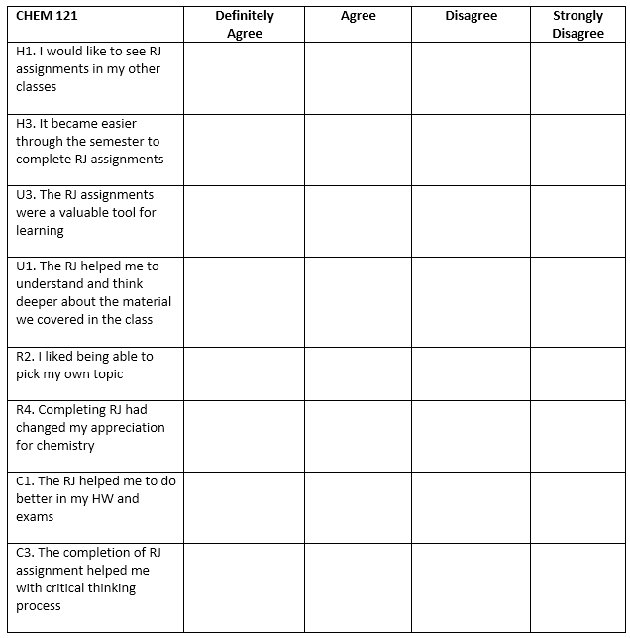
TMCC Survey Spring 2015 CHEM 121
75 students

Slide 29
Results:

Slide 30
Results:

Slide 31
Results:

Slide 32
Results:

Slide 33
Results:

Slide 34
Results:

Slide 35
Results:

Slide 36
Results:

Slide 37
Feedback:
“This is my last reflective journal in this class. It has been very interesting and I have learned a lot. Writing the journals has inspired me to be more curious and to try to find answers for everyday things I come across. “
“I must say that this journal writing is sure solving many questions I have had.”
“Knowing that chemistry is involved in my daily life is a fact of solace, as I continue through this semester recognizing that the things I learn in this class will be used throughout my life.”
“Completing this assignment allows me to think deeper about the material we covered in class. Now I am constantly coming up with curiosity questions and try to find answers online. Although now I make sure that the answers are provided by reliable sources. You cannot believe to everything you find online.”
“It took me a long time to pick up on this assignment. Once I figured it out I enjoyed to complete them for sure. “

Slide 38

“Student Success: Headed to the Workplace”
Soft Skill #1: Communication
Soft Skill #2: Enthusiasm & Attitude
Soft Skill #3: Teamwork
Soft Skill #4: Networking
Soft Skill #5: Problem Solving & Critical Thinking
Soft Skill #6: Professionalism
By United States Department of Labor
http://www.dol.gov/odep/topics/youth/softskills/

Slide 39
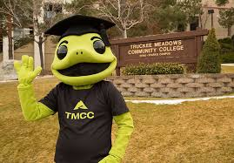
Questions?

Slide 40

Mark Your Calendar
March 31st-April 1 st, 2017
216th 2YC3 conference
Truckee Meadows Community College,
Gorgeous Reno, Nevada

Slide 41

THANK YOU !

