Slide 1
Periscoping Your Way Through General Chemistry and a Few Other Things
Ashton T. Griffin MA, MEd, MSSE
Lead Chemistry Instructor
Wayne Community College
Goldsboro, NC 27534

Slide 2
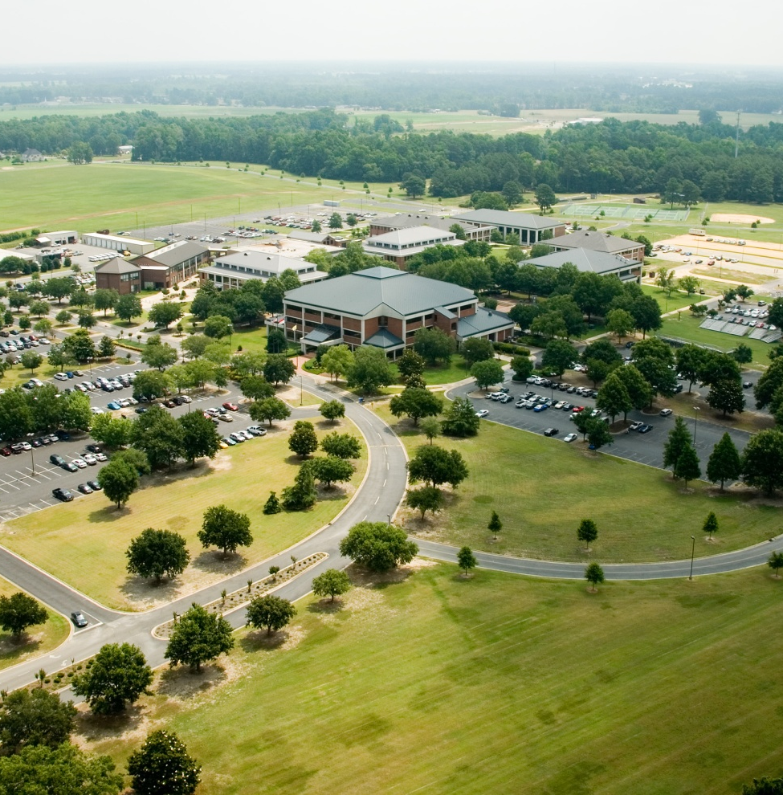
Aerial View of Wayne Community College
Located in Goldsboro, NC and serving over 4000 students; we are located approximately 60 miles southeast of Raleigh, NC. Goldsboro is also home to Seymour Johnson Air Force Base – Home to the F15E Strike Eagles.

Slide 3
SO WHAT IS PERISCOPE?
e
Periscope is a “live video streaming platform” or app that is available through the Apple Store or through the Google Play store.
Initially released in late March 2015 by the folks at Twitter. Developed by Kayvon Beykpour and Joe Bernstein.

Slide 4
SO WHAT IS MY PERISCOPE STORY?
e
In late March of 2015, I was recovering from left hip replacement at a local Rehab Center.
So with lots of time on my hands, I discovered the Periscope App.
But How Could I Use It in my Chemistry Classes?

Slide 5

THE PERISCOPE APP

Slide 6
PERISCOPE IN ACTION
My Equipment Needs:
An iPad Mini
A HoverBar 3 for iPad ~$100.00
An Internet Connection
Versus the Equipment Required to Use Mediasite

Slide 7
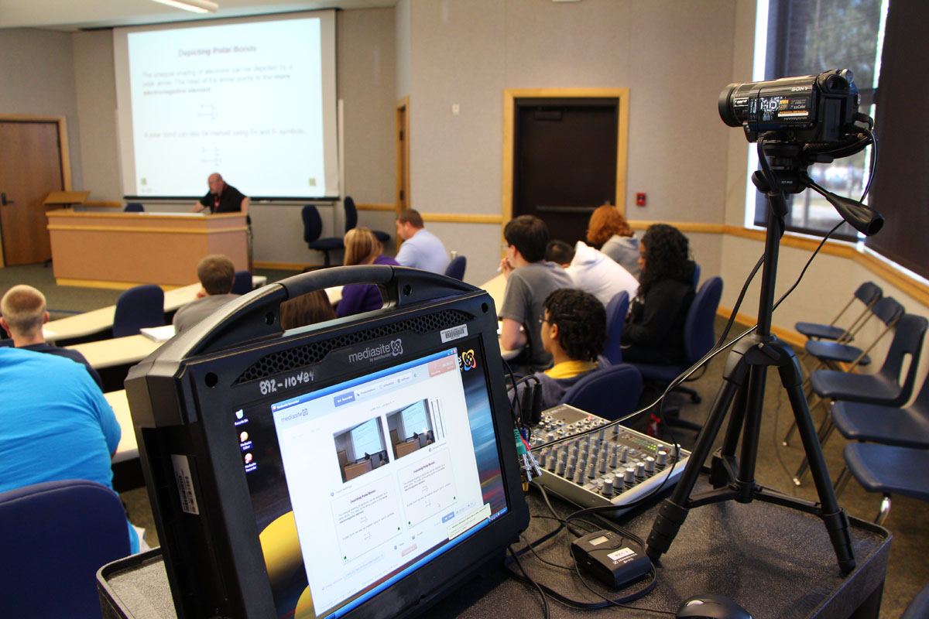
Mediasite Recording Equipment in Use in Walnut 101.

Slide 8
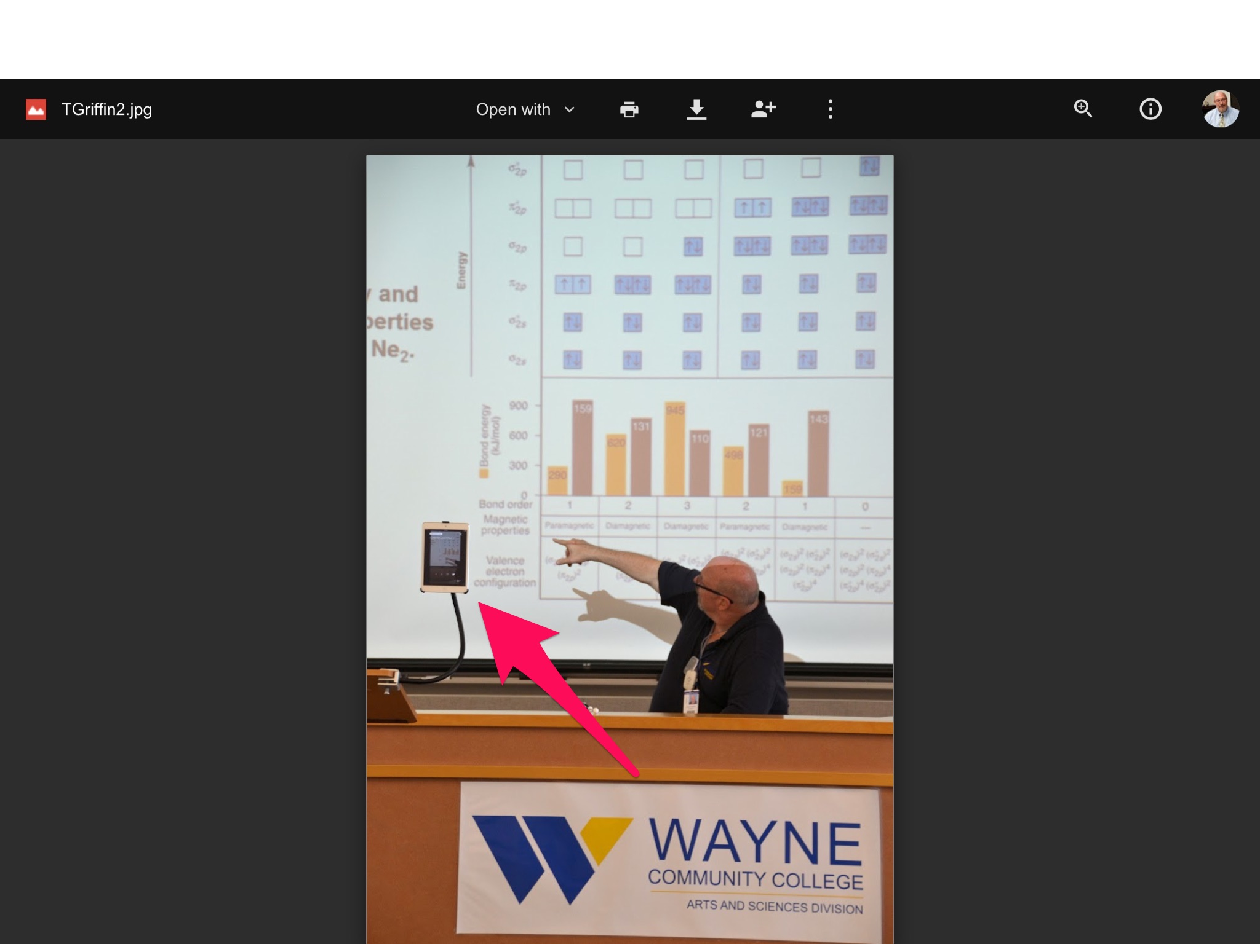

Slide 9
PERISCOPE IN ACTION
Advantages:
Easy to Set Up – Does not Require Help or Equipment from IT
Available to Students on Twitter or Google Classroom
Class Material is Current – Not from last Semester or longer

Slide 10
PERISCOPE IN ACTION
Some Interesting Periscopers:
Scott Williams – How to Build a Periscope Audience
Julia H. Majors, PhD – Physics on Periscope
Claire Waddington – Tours of Paris, France on Periscope
John M. M. Blake – SE North Carolina Weather, Sunrises & Sunsets

Slide 11
PERISCOPE IN ACTION
Some Interesting Educators Using Periscope:
Rachel Glazener & Donnell King @ Pellissippi State Community College Knoxville, TN
Ashton T. Griffin @ Wayne Community College Goldsboro, NC

Slide 12
PERISCOPE IN ACTION
Rachel Glazener: @GlazenerChem
Classroom Lecture Videos
Lab Demos and Videos
Demonstrating the Use of Google Cardboard
Tips for Successfully Using Periscope

Slide 13
PERISCOPE IN ACTION
Ashton T. Griffin: @Chem_Coach
Classroom Lecture Videos
Tips for Successfully Using Periscope
Katch.me https://katch.me/chem_coach
Pairing GoogleClassroom with Periscope

Slide 14
PERISCOPE SUCCESS TIPS
Periscope Success Tips from: @ProfDonnKing
Use your Twitter Account or Set Up a Periscope Account
Give Your Video a Descriptive Name
Periscope Uses Lots of Bandwidth – Plan for It
Have a Well-Charged Mobile Device

Slide 15
PERISCOPE SUCCESS TIPS
Periscope Success Tips from: @chem_coach
Periscope Uses Lots of Bandwidth – Plan for It – I teach in a large classroom with ~50 students using computers and mobile devices during class using the school’s Wi-Fi. IT had to give me my own separate Wi-Fi so Periscope would work.
Use Some Type of Support Device for Tablet or Phone

Slide 16
PERISCOPE & KATCH.ME
Katch.me Tips from: @chem_coach
Katch.me Allows Me to Save Periscope Broadcast for Longer than 24 Hours
I have ~90 Achieved Periscope Broadcast @ https://katch.me/chem_coach

Slide 17
FUTURE USES OF PERISCOPE
Face to Face Chemistry Classes
Classroom Demonstrations
Prelab Introductions
Classroom Discussions
Distance Education
Any Type of Group Discussions or Interactions
Notes:
m

Slide 18
PERISCOPE & GOOGLE CLASSROOM
GoogleClassroom Tips from: @chem_coach
I use GoogleClassroom & Periscope in Place of Moodle or Blackboard.
I am Able to Give Classroom Announcements or Assignments.
I am Able to Easily Attach Files, Links, YouTube Videos and Material from My Google Drive to Students

Slide 19
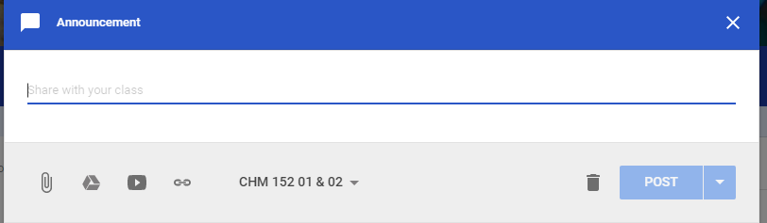
AN EXAMPLE OF GOOGLE USEFUL CLASSROOM LINKS

Slide 20
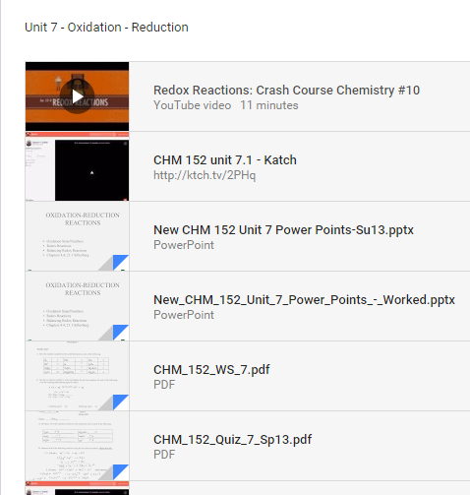
GOOGLE CLASSROOM ANNOUNCEMENT

Slide 21
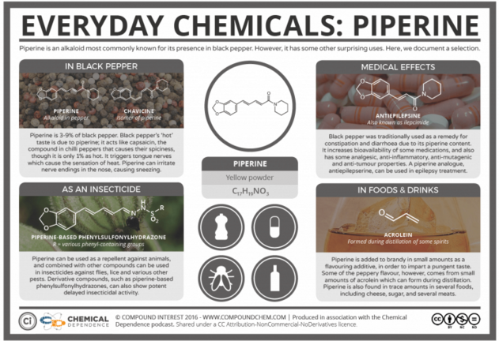
Google Classroom Link Example

Slide 22
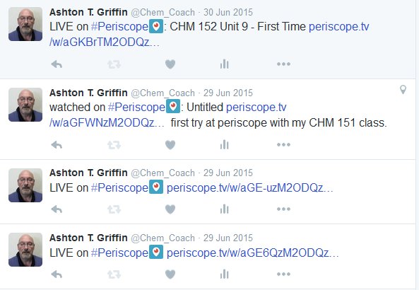
MY FIRST PERISCOPE BROADCAST – JUNE 29th & 30th, 2015

Slide 23
PERISCOPE EVEN GOT ME ON LOCAL TELEVISION
In late October 2015, WRAL – TV in Raleigh, NC came to my chemistry classroom to see how I was using Periscope with my students.
They interviewed me and one of my students who kept up with my chemistry class via periscope while he was home in Los Angeles, CA.
WRAL Periscope Story

Slide 24
CHEMIO – An Interactive Chemistry App
With an Interactive periodic table, solubility table, molar mass calculator and the 3D widget for designing electron configuration of atom. The most necessary chemical references for students in the one neat app.

Slide 25
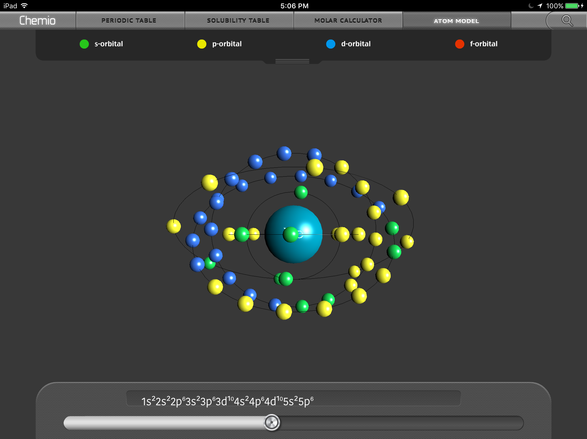
CHEMIO – An Interactive Chemistry App

Slide 26
TWITTER – ONE OF MY FAVORITE APPS SINCE SEPTEMBER 2009
Twitter is an online social networking and microblogging service that enables its users to send and read text-based posts of up to 140 characters. A growing number of educators are discovering the networking power of Twitter.

Slide 27
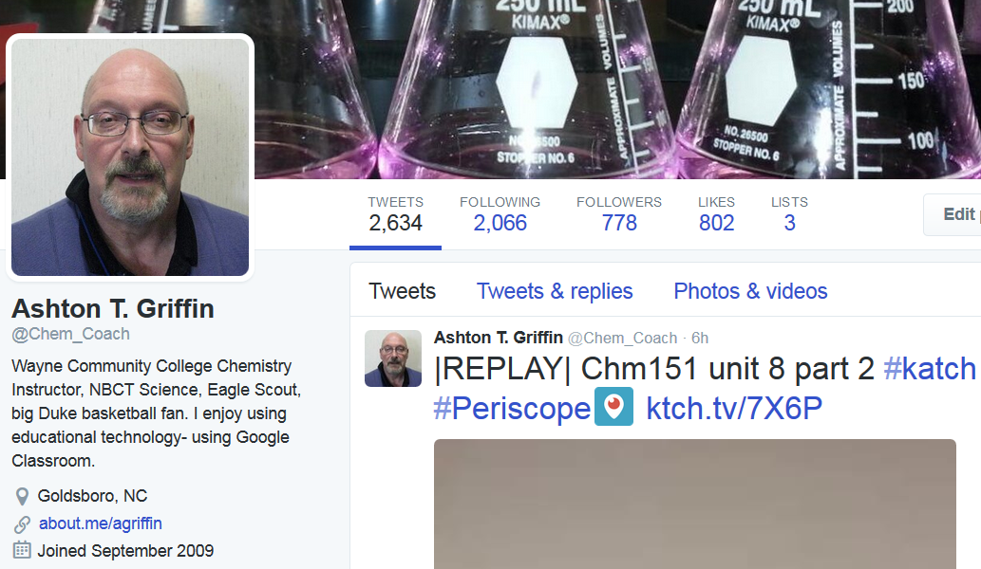
TWITTER – IN ACTION

Slide 28
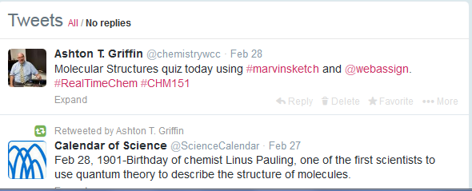
TWITTER IN ACTION WITH HASHTAGS (#)

Slide 29
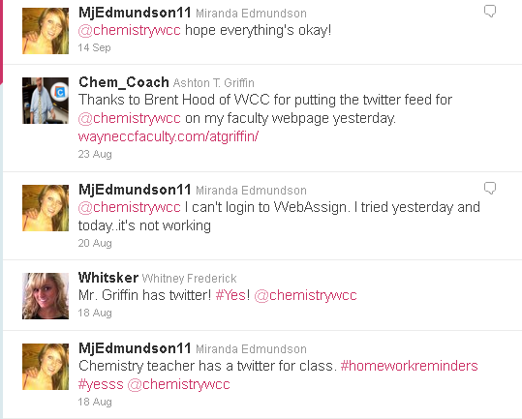
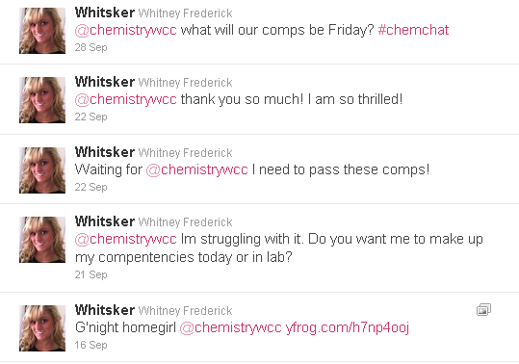
EXAMPLES OF STUDENT INTERACTION ON TWITTER @CHEMISTRYWCC

Slide 30
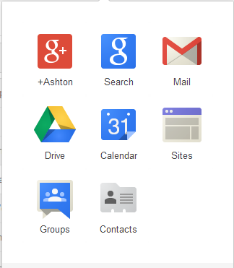
THE GOOGLE SUITE OF APPS

Slide 31
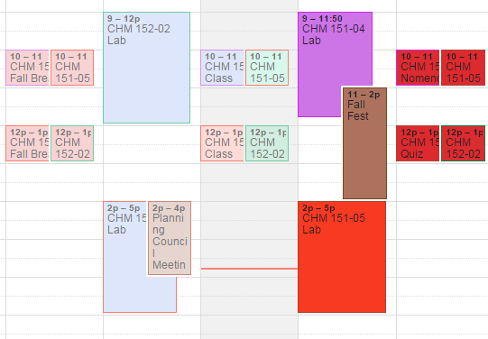
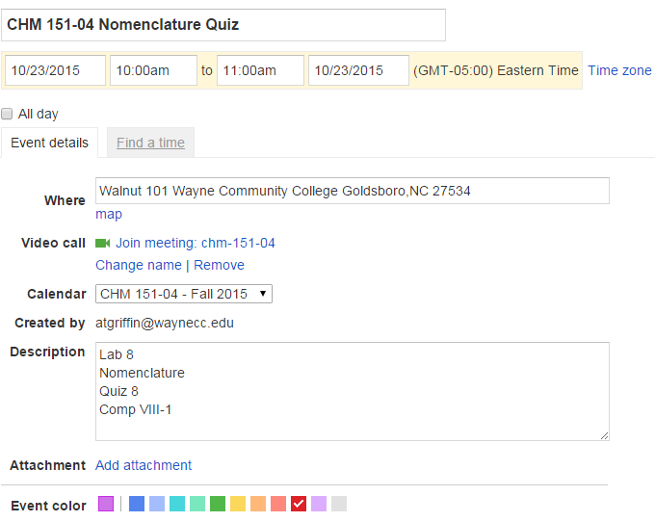
USING GOOGLE CALENDAR & CONTACTS TO CREATE A CLASS CALENDAR

Slide 32
COMMUNICATING WITH STUDENTS
When I need to communicate with my students, I have several choices:
Email – both personal and WCC’s.
Moodle – I can send group emails to my classes.
WebAssign – “Ask your Teacher” – I use this to answer questions about homework and prelabs.

Slide 33
COMMUNICATING WITH STUDENTS
Four years ago, I had to cancel class at the last moment. I sent out a message on Moodle and WebAssign, and I tweeted those students who were on Twitter. But was this the best way?
Most all of my chemistry students “text”. But how do I text them without giving out my cell phone number?

Slide 34

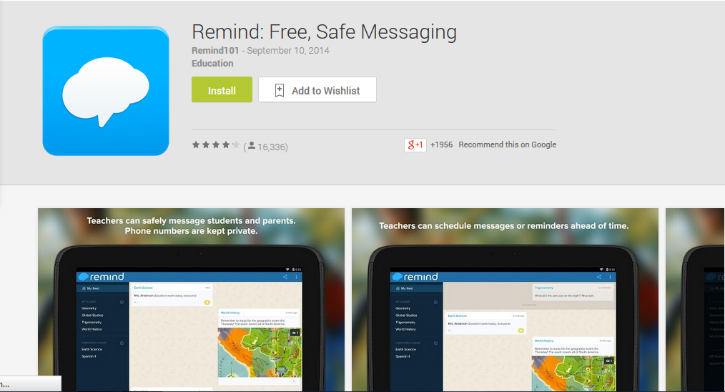
MY SOLUTION IS REMIND SINCE SEPTEMBER 2011

Slide 35
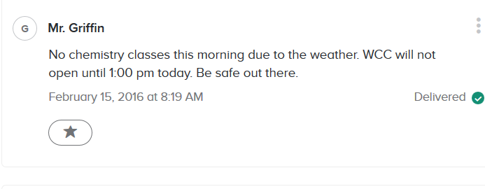
REMIND MESSAGES IN ACTION

Slide 36
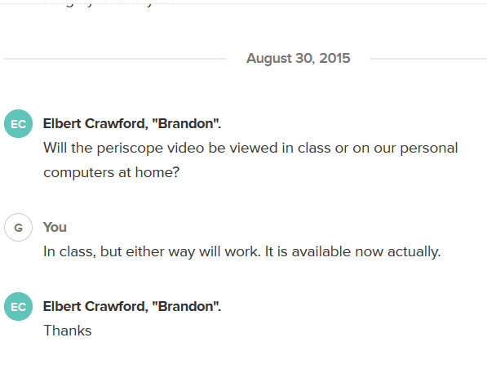
REMIND CHAT IN ACTION

Slide 37
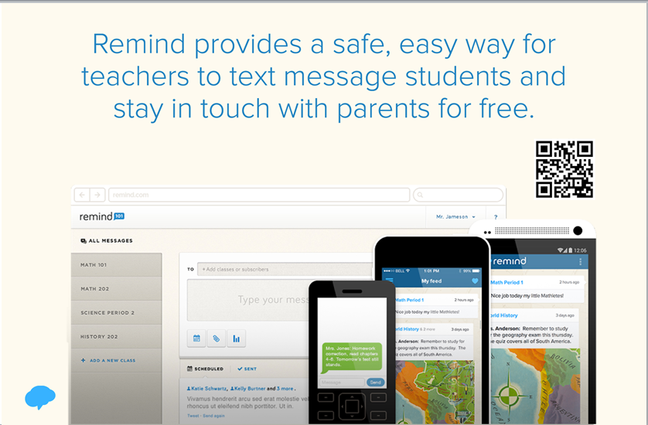
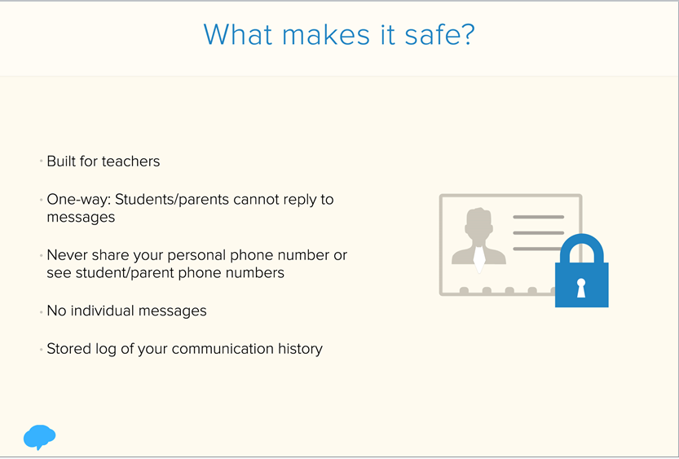
SOME OF REMIND’S USEFUL FEATURES

Slide 38
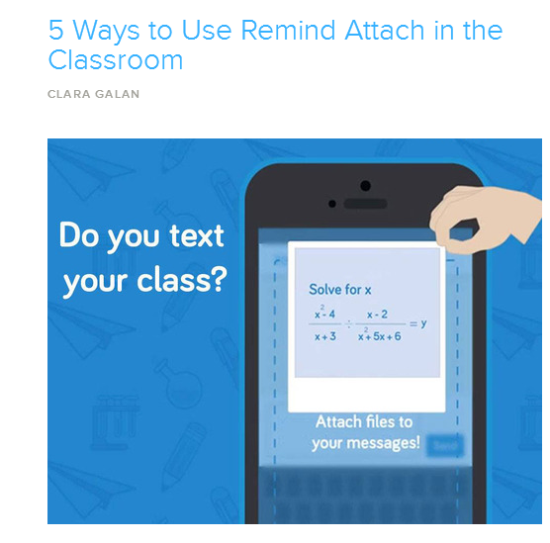
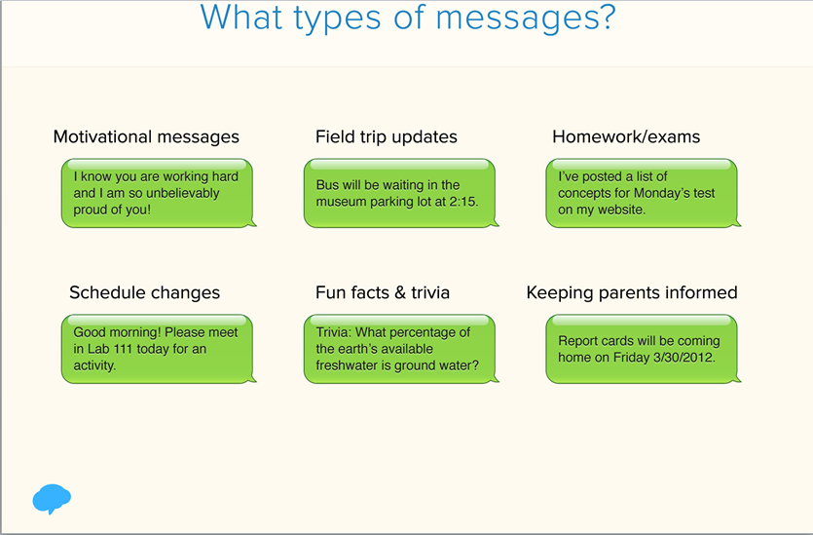
SOME OF REMIND’S USEFUL FEATURES

Slide 39
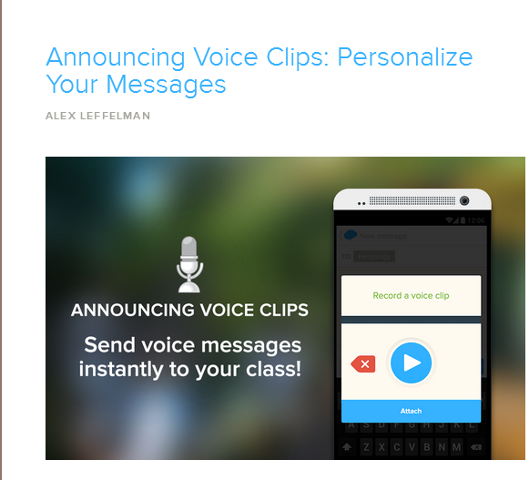

SOME OF REMIND’S USEFUL FEATURES

Slide 40
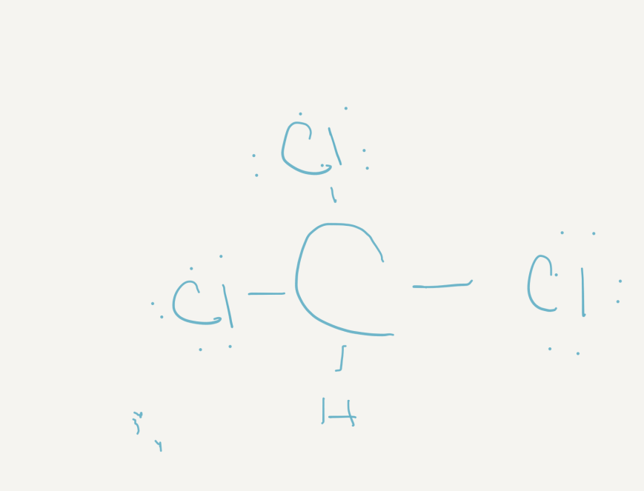
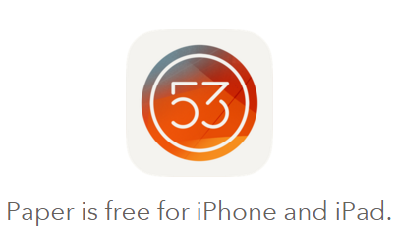
Paper APP BY 53 WITH Pencil BY A CHEMISTRY INSTRUCTOR

Slide 41


Google Drawings BY A CHM 151 STUDENT

Slide 42

LIFEHACKER’S – “HOW I WORK” SERIES IS A GREAT WAY TO LEARN ABOUT NEW APPS

Slide 43
ACKNOWLEDGEMENTS / THANKS
Julie Marciel-Rozzi & Ken Jones – for their assistance with this presentation
My wife – Paula Griffin.
My Spring 2016 Chemistry students - for making this semester, so far, an enjoyable one

Slide 44
MY CONTACT INFORMATION
Ashton T. Griffin
Lead Chemistry Instructor
Wayne Community College
3000 Wayne Memorial Drive
Goldsboro, NC 27534
Phone - 919-739-6859
Email – atgriffin@waynecc.edu
Twitter – chem_coach – personal

