Slide 1

The benefits of undergraduate research as a teaching tool from students’ perspectives
213th 2YC₃ Conference
V. Flaris, H.Siccardi, R. Josman, R. Rivas, R. Matos, C. Seaks
March 11, 2015

Slide 2
About Bronx Community College
One of seven community colleges within the City University of New York (CUNY)
Founded in 1957 to meet the growing need for access to higher education in the borough of the Bronx
30+ academic programs that prepare students for careers and to continue their education at four-year colleges
Approximately 11,500 students
Hispanic Serving Institution (HSI), with students representing approximately 100 countries

Slide 3
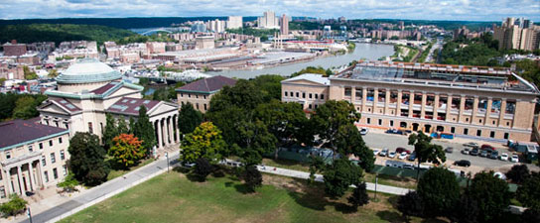
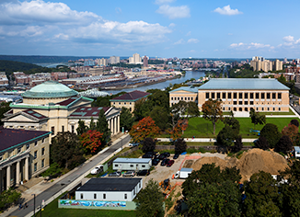
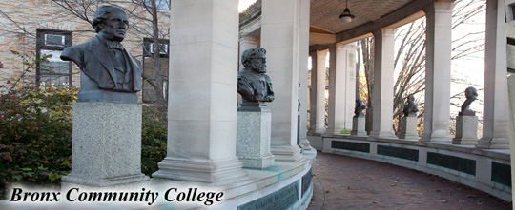
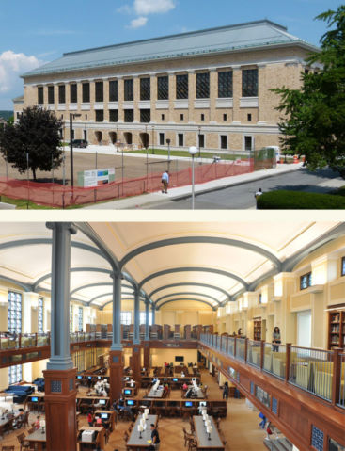
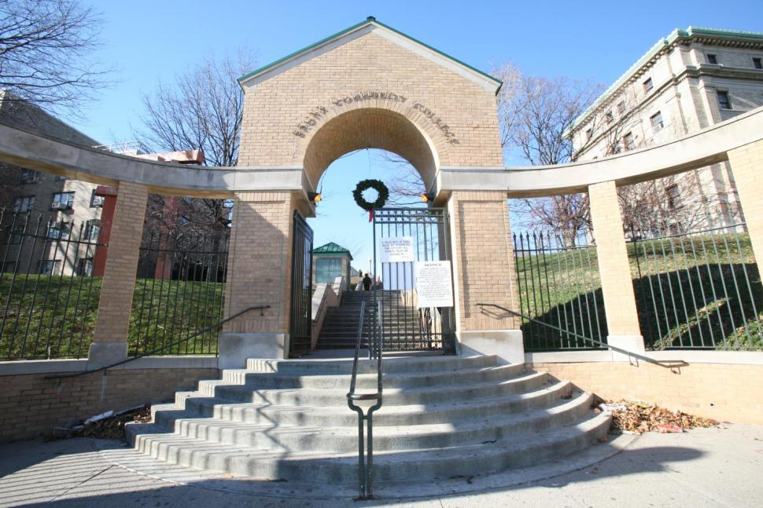

Slide 4
A Professor’s Perspective
Feel more confident in communicating
Superior understanding of scientific method
Better persuasive argument skills due to ability to analyze data
Diverse undergraduate research team improves problem-solving capabilities.
  Ethnicity and Disciplines

Slide 5
Benefits of Research
Providing opportunity to minority and socioeconomically disadvantaged students
Positive research outcomes
Growth beyond curriculum
Development of research and professional skills
Further education and professional benefits
Institutional benefits

Slide 6
Minority and Disadvantaged Students’ Involvement
BCC racial diversity outlook
  Latino/Hispanic: 61%
  Black: 32%
  White/Caucasian: 3%
  Asian: 4%
BCC gender diversity outlook
  Female: 57%
  Male: 43%

Slide 7
Minority and Disadvantaged Students’ Involvement cont…
Our team’s integrated ethnic makeup.
  Every continent represented (except Antarctica)
50/50 gender split.
Interdisciplinary make-up.
  Biology, pre-med, chemistry, nuclear medicine, medical laboratory technology, physics, chemical & mechanical engineering, history, and political science.
First-generation college students.
“Non-traditional” student pathways.

Slide 8
Minority and Disadvantaged Students’ Involvement cont…
Research provides unique benefits to underserved students
  Provide guidance where previously there was little.
  Improved self-esteem and academic sense of belonging.
  Interaction within a complex and heterogenous society.
  Promotes encouragement to pursue higher levels of education than previously imagined (i.e. graduate school)
  Improved scientific literacy and articulation.
  Social and academic pride.

Slide 9
Positive Research Outcomes
Meaningful, applied research inspires students’ participation and enthusiasm.
15 papers published and presented at numerous educational and professional conferences.
Attendance and presentation at 14 distinct conferences (since 2012).
Scholarships, awards, internships, and fellowships.
  LSAMP, CSURP, CUNY RSF, Capital One, SPE NY

Slide 10
Positive Research Outcomes cont…
Leadership Opportunities
  On-campus involvement in clubs and activities.
Travel enhances a global perspective
  Las Vegas, Barcelona, India, Boston, Cincinnati, Orlado, Hawaii, and San Diego!
Collaborative efforts with international labs.
  Australia, Germany, Greece

Slide 11
Growth Beyond the Curriculum
Reinforcing material and concepts learned in classes.
Applying said concepts to real-world problems.
Improved outlook on class attendance and increased in-class engagement.
Interdisciplinary development through exposure to multiple subjects.
Improved student learning and retention rates.

Slide 12
Retention of STEM students and career paths.
Increased recruitment to STEM fields.
  Providing unique, interesting opportunities.
Dedication to project offers reason to remain enrolled.
Encourages students to pursue scientific careers.
  M.D./Ph.D
  Engineering
  Medical Laboratories

Slide 13
Retention of STEM students and career paths.
Large shortage of STEM in certain sectors.
  Software engineers, petroleum engineers
  Expected 600,000 job shortage
Opportunities below a Bachelor’s level.
  Machinists, operators, and technicians
Randall’s Island (New York City).
  $4.4 billion

Slide 14
Development of Research & Professional Skills
Laboratory safety skills.
  The TFA incident.
Use of new and cutting-edge equipment.
  Atomic Force Microscope, Scanning Electron Microscope, Drop-Shape Analyzer, aseptic techniques.
Performing tasks scrupulously and improving attention to detail.
Students are forced to problem-solve and think critically.

Slide 15
Development of Research & Professional Skills cont…
Networking opportunities provide real professional interactions.
Participation assembling proposals and grants.
Navigating professional “politics” within the team and on campus.
Exposure to setting with non-graded expectations and merit based responsibilities.
Independence and self-accountability.

Slide 16
Further Educational and Professional Benefits
Acceptances to four-year institutions.
Academic recognition on campus.
Mentorship and guidance.
Job opportunities.
Building a professional network.

Slide 17
Institutional Benefits
Local, national, and international name recognition.
  Positive reception at conferences.
Pioneering among two-year colleges.
Bringing grant money to institutions.
Enhanced educational environment.
  Model students
  Word-of-mouth
  Student-student interactions.

Slide 18
Challenges
Process conflict in work groups.
Task content and execution.
Delegation of resources.
Productivity disparities.
Self-segregation.
Prioritizing responsibility.
  Students with classes, jobs, and familial obligations.

Slide 19
Overcoming Challenges
Engaging in conflict leads to better decision making.
Informational diversity improves work group performance when tasks are complex rather than routine.
Interdependent tasks demand smooth interactions amongst group members.
Gauged and early interventional communication.
Fair mediator.

Slide 20
Students’ Anecdotes
Robert Josman
Henry Siccardi
“There is nothing like good mentorship to create good mentors.”

