Slide 1
Tips and Tools for Teaching Online or Hybrid Chemistry
Kathy Carrigan
Portland Community College
Portland, OR Jon Gittins
Delta College
MI

Slide 2
A nagging question…
The big question: “How do I know what students know when they enter the classroom?”

Slide 3
Distance Learning at PCC
Three terms (quarters) of GOB (A General, Organic, and Biochem) course for Allied Health Majors.
An Introductory Course.
Started in Spring 2008 and offered 4 times per year (each quarter).
Except CH 106: 2 times per year to meet demand.

Slide 4
DL/Hybrid and Delta College
I have taught CHM 101 (Introductory Chemistry) for 6 years. (Students take this if they haven’t had high school chemistry before taking CHM 111, Gen Chem I.)
I started teaching the hybrid section of CHM 101 in Winter 2014 (2 years ago).
Hybrid = “lecture” online, labs on-campus

Slide 5
Distance Learning Components:
Content Modules*
Discussion Board*
On line homework program*
Quizzes and Final Exam*
Lab Report Form Dropbox
At home labs
Live Online Office Hours*
*(Shows up in hybrid course)

Slide 6
Key to Success is:
Excellent Support from
Disability Services
Distance Learning Department:
“Quality Matters Rubric”
IR (Instructional Resources) Support:
Tablets, Bamboo Pens, Live Office Hours with Collaborate
Very Patient Instructional Resource Professionals

Slide 7
Key to Student Success
Small Class size
24 is ideal
At PCC: Due to high attrition, we allow 26
At Delta: Capped at 20 (versus 25 for f2f)
More than that is very difficult to be responsive.
Standardized due dates
Send out pre-course emails:
Syllabus
Time “requirements” for an A
Info on how you will support them

Slide 8
Pre-Lecture Quiz
8 Questions that are geared toward those lower-level concepts.
This help answer the question: “How do I know what students know?”
Students used to feel like they had to know ALL of the content…
This new setup can help guide them to the most important concepts in a chapter/module.

Slide 9
“Lecture Modules”
Students enjoy the PP presentations over reading more stuff.
Tools: Camtasia, Recording over PP in Microsoft (Office Mix), Prezi, and….
Make a private youtube account, post, and they will close caption, then you can edit that!
Very Important to make your course as accessible as possible to start!
Online conference about this topic????
Team recording = fun and funny, more interesting for students.

Slide 10
What Works?
Weekly lab assignment due dates, allowing one extra week at half credit
Photos, “selfies” of students with Lab Set up.
It is most successful to be inflexible with due dates and drop assignments to prevent students from falling behind
Responding with grades in a timely manner
Writing positive and constructive comments on lab reports using student name

Slide 11
What Works?
Team Teaching;
more “office hours” and opportunity for student interaction
Faculty mentors
Technology such as Collaborate for live online office hours:
Students respond positively to the visual image of an instructor
excel for graphing
Draw chemical structures and do math

Slide 12
What Doesn’t Work?
Virtual Labs: ACS Dept of 2 Year Colleges
Teaching computer skills to students
If the Instructor does not stay on top of student progress each week
Not communicating with students, it is important to provide your availability to them
Lack of support from Administration, IR, colleagues

Slide 13
ACS Guidelines for Chemistry in Two-Year Colleges
Under the section: Maximizing the Potential of Students states:
Students in excellent two-year college [chemistry] programs have:
Hands-on laboratory experiences that involve
[synthesis of molecules and
measurement of chemical properties and phenomena].

Slide 14
Students in excellent two-year college [chemistry] programs have:
Opportunities to search and use the [chemical] literature and scientific databases and to employ computer modeling.
Opportunities to pursue original research projects that result in comprehensive written reports.
Interactions with faculty that provide effective mentoring and feedback.

Slide 15

Labs
Hands On Labs, Inc. is the company we use as our lab kit vendor.
They have a 3 million dollar liability policy to protect them and us from accidents
The student is directed to contact the lab kit company directly at http://www.holscience.com/
We tested many of the available labs and selected or wrote 10 labs that would be suitable for each course.

Slide 16
Teaching DL Science
Offering the at home lab component builds the relationship between the Teacher and the Student.
Students must prepare carefully before performing the experiment (sometimes this doesn’t happen on campus)
When students perform the experiment on their own, they cannot defer to the lab partner who “takes control”, and they can move at their own speed.

Slide 17
Teaching DL Science
Students will often ask questions before getting started, and with the use of the discussion board, this helps everyone.
Students must submit a complete lab report often containing using evidence based conclusions, researching a topic.
Faculty grade the lab reports providing another form of assessment.

Slide 18
Teaching DL Science
The combination of labs with other coursework allows me to feel comfortable in writing student recommendation letters.
Students who perform poorly on labs generally perform poorly on quizzes, and homework, so if someone is suddenly doing well in one and not in another, we can better address the situation, and remediate more quickly.

Slide 19
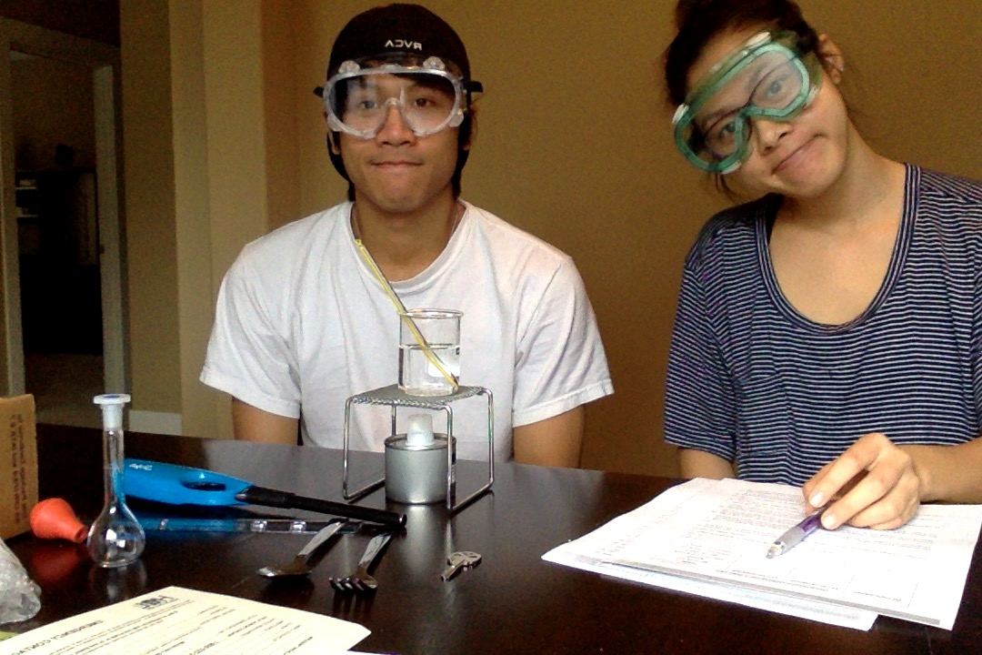
Students

Slide 20
Student Comments
I loved the home lab portion of the course, I could go at my own pace without interruption. I am hearing impaired, so I don't feel so confident in a regular class setting or laboratory
Yes, there was everything I needed (in the lab kit) to do the lab experiments at home. It was worth the cost.

Slide 21
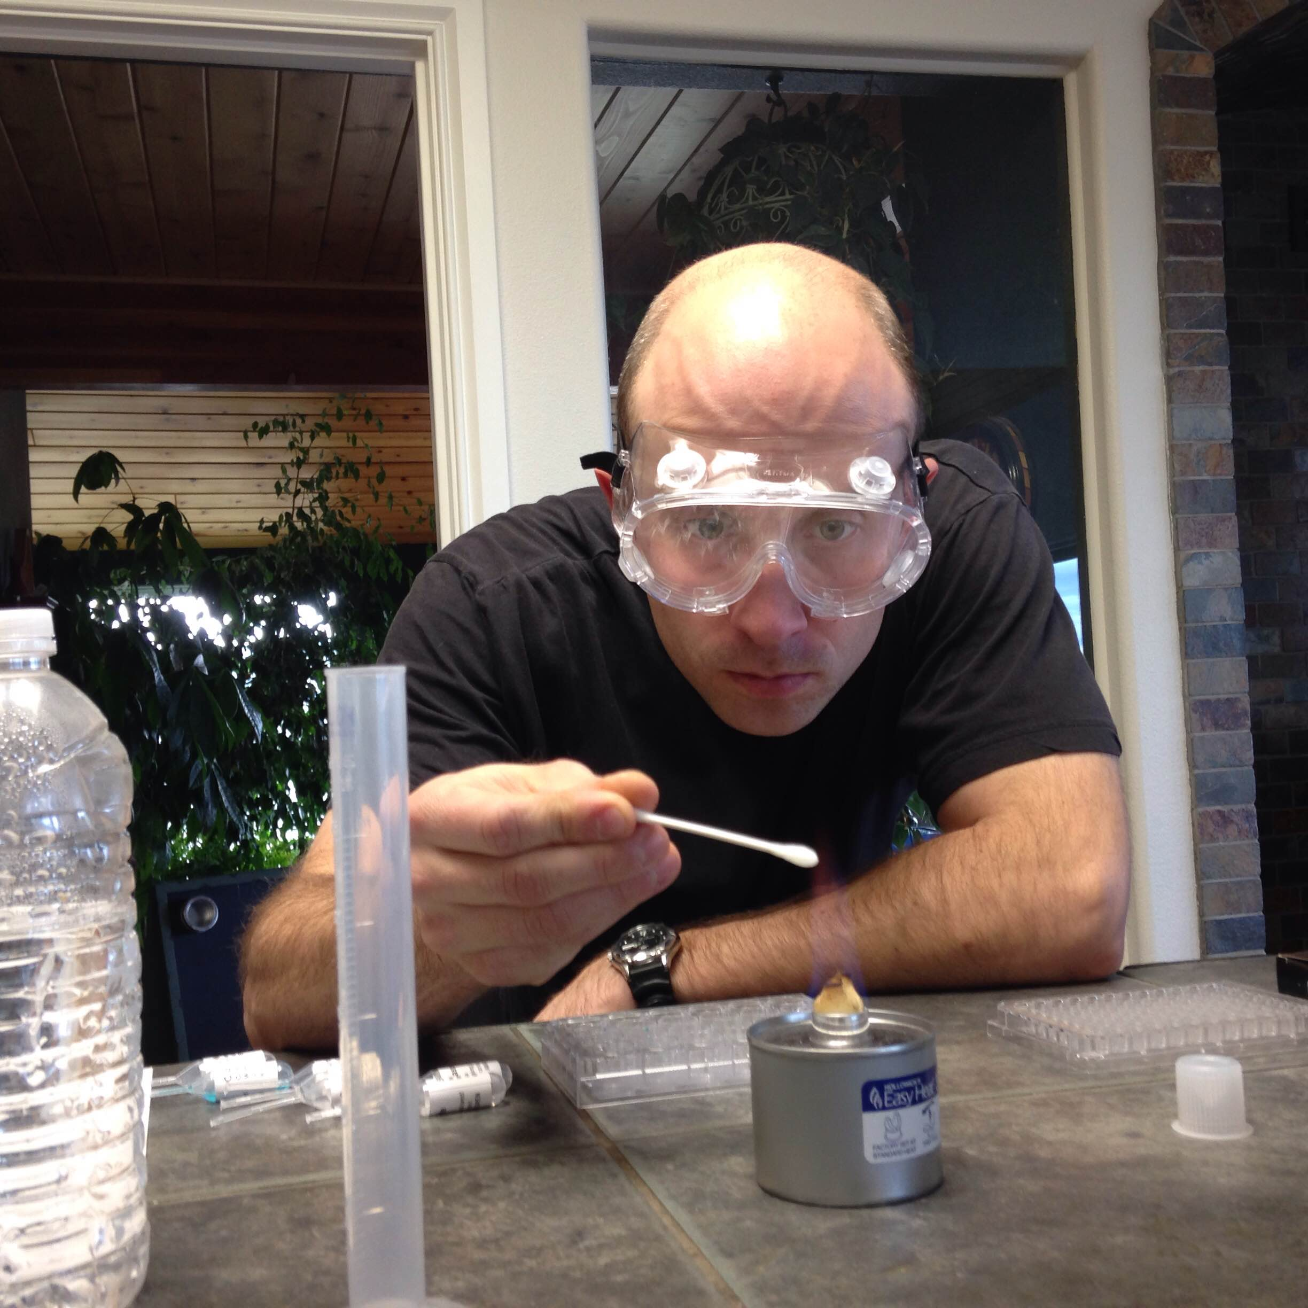
Students

Slide 22
What Works for Instructors
Perform all (ideally) the labs before you start
The lab kit should be provided to any new instructor during the training process
Each new (Adjunct) Instructor is required to perform at least 3 labs before teaching the course

Slide 23
Why Teach the DL Science Classes?
Full time faculty – we need more faculty to give this modality a try
Retired faculty – who want to teach, but not commit to a set schedule
Part time faculty – who have other commitments, young children, other jobs
We highly recommend team teaching
Italy

Slide 24


Slide 25
What we have gained:
Improved on campus Instruction
Live online “peer tutoring”
Collaboration and consistency in our DL Chemistry offerings across a rather large district because we share course shells and teach collaboratively.
Some new on campus experiments
New technology! Personally, I do not want to be that “Dinosaur” Instructor still using my acetates, (not that there is anything wrong with that?)

Slide 26
Teach from anywhere
I am teaching right now.
Ok, so I have to:
respond to emails
Grade Lab Reports
Grade Quizzes
Team teaching helps
Flexibility

