Slide 1
Chemical Weapons and Introductory Chemistry
Mark Bishop
Middlebury Institute of International Studies
Monterey Peninsula College
Chiral Publishing Company
http://preparatorychemistry.com/Bishop_2YC3_chemical_weapons_March_2016.pdf

Slide 2
Webpages
http://preparatorychemistry.com/Bishop_2YC3_chemical_weapons_March_2016.pdf
http://institutebishop.org/chemical_weapons_S&T.pdf
http://institutebishop.org/Science_PPT.htm
http://preparatorychemistry.com
http://preparatorychemistry.com/bishop_info.htm
http://preparatorychemistry.com/Bishop_Tour.html
http://preparatorychemistry.com/Bishop_Atoms_First.htm

Slide 3
Philosophy for Teaching Non-science Majors Chemistry
Instead of presenting applications to illustrate the importance of learning chemistry, I try to teach my non-science students just enough of the language and concepts of chemistry to understand current issues and evaluate what they read or see about them.
Climate change
Supersonic Transports and the ozone layer
Ocean acidification
Acid rain
Reprocessing of nuclear fuel
Chemical weapons

Slide 4
What I skip
To allow time to do this, I’ve eliminated much of what is traditionally taught in non-science majors courses.
No math
Only the most basic chemical nomenclature
I expect my students to be able to interpret chemical equations but not write them (no balancing equations)

Slide 5

NASA and Supersonic Planes
29 February 2016 - NASA has given the go-ahead for preliminary design of a “low-boom” supersonic passenger plane that could one day fill the gap left by the retirement of the Concorde jet.
https://www.theguardian.com/science/2016/mar/01/next-concorde-nasa-kickstarts-quesst-for-new-supersonic-passenger-jet

Slide 6
Ozone Destruction
1969 - Paul Crutzen discovered NO_{x} catalytic cycle.
NO(g) + O₃(g) → NO₂(g) + O₂(g)
NO₂(g) + O(g) → NO(g) + O₂(g)
net reaction
NO catalyst
O₃(g) + O(g) 2O₂(g)
1971 – Harold Johnston calculates that NO_{x} from SST's could double the rate of depletion of the ozone layer.
http://science.sciencemag.org/content/173/3996/517.short

Slide 7
Chemical Weapons as Examples
To understand the structure and behavior of chemical weapons, students must learn about
atomic structure (chlorine)
orbital diagrams (chlorine)
covalent bonding (chlorine)
Lewis structures (chlorine, sulfur mustard, sarin)
oxidation-reduction reactions (chlorine, HCN)
protein structure (phosgene)
DNA structure and function (sulfur mustard)
transfer of nerve impulses (sarin)
enzyme reactions (sarin)
hydrolysis reactions (sarin)

Slide 8
Chemical Weapons and Nontraditional Topics
Attitudes toward war
International agreements (such as the Chemical Weapons Convention)
Issues associated with the production, storage, and transport of chemicals.
What’s in the news, such as what’s happening in Syria and the recent use of chemical weapons by both the Syrian military and by ISIS

Slide 9
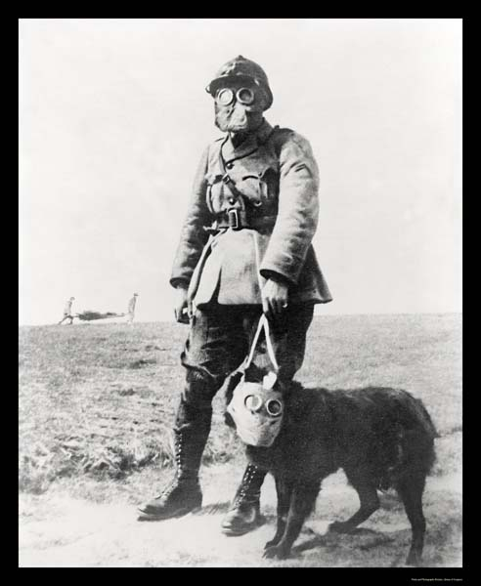
Chemical Weapons (CW)
Chemical weapons are “any toxic chemical or its precursor that can cause death, injury, temporary incapacitation or sensory irritation through its chemical action. Munitions or other delivery devices designed to deliver chemical weapons, whether filled or unfilled, are also considered weapons themselves.” (OPCW)
Special gas mask for dogs-1917

Slide 10
Classification of Chemical Weapons
Lethal agents – kill quickly with small quantities
Nerve agents (e.g. sarin and VX)
Blood agents (e.g. hydrogen cyanide)
Incapacitants
Choking agents (e.g. chlorine or phosgene)
Blistering agents (e.g. sulfur mustard)
Tearing agents (e.g. CS)
Opiate-like agents ( e.g. fentanyl)
Psychochemical Incapacitants (e.g. BZ)

Slide 11
Choking Agents
Diphosgene, phosgene, chlorine, chloropicrin
Mode of Action: Inhalation
Physiological Effects
Victim can die of oxygen deficiency via different mechanisms
Form When Disseminated: Gas
Required Defensive Gear: Protective Mask
Notes:
Choking agents were among the first CW agents developed and were used extensively during World War I. These gases are relatively heavy compared to air, which meant they tended to remain close to the ground and fill depressions -- a characteristic particularly well suited to the trench warfare that dominated the battlefield at that time. The Germans used choking agents for the first time at Ypres in 1915, when they released 150 tons of chlorine along a four-mile front and inflicted 20,000 French and British casualties, including 5000 fatalities. Chlorine and Phosgene (used, most recently, in a 1995 terrorist attack in a Yokohama, Japan subway) are the best known members of this group of agents, which is named for the effects of these agents on human physiology. Inhaled in sufficient quantities, these gases induce pulmonary edema and cause the lungs to fill with fluid, ultimately choking the victim with his or her own fluid.
However, despite the fact that the technology and knowledge used to make these first generation agents is widely available, they are relatively less attractive to potential proliferants since they are ill-suited to most modern chemical warfare situations, for a number of reasons. First, they have an odor and create irritation which alerts the victim to their presence and alerts personnel time to don protective masks. Second they are slow acting and require high concentrations to reach lethal levels. Finally the high volatility rate (the speed at which an agent evaporates) of most choking agents reduces their utility for many combat situations. Nonetheless, it is important to remember that these agents can still be extremely dangerous to unprotected soldiers and civilians, as the first use at Ypres illustrated.

Slide 12
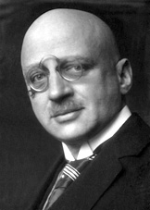
Chlorine and WWI
During peace time a scientist belongs to the world, but during war time he belongs to his country.
Fritz Haber
In 1914-15, WWI, which was expected to end quickly, was bogged down in trench warfare, so each side was looking for ways to break through the lines.
Fritz Haber, who won the Nobel Prize for chemistry in 1918, suggested loading projectiles with chlorine and shrapnel.

Slide 13
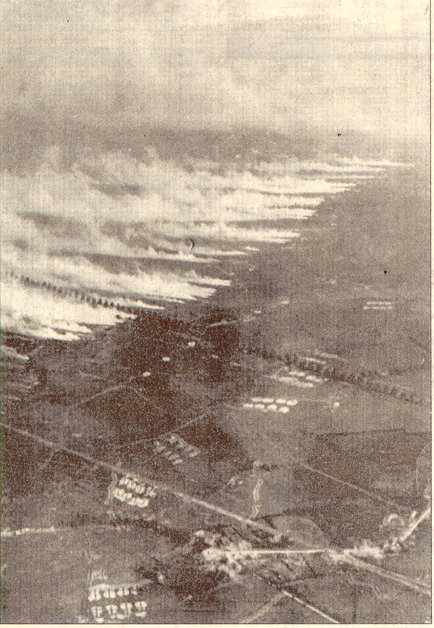
Chlorine as a Chemical Weapon
Shortage of artillery shells led to use of chlorine from pressurized gas cylinders.
Used against French near Ypres, Belgium, April 22, 1915.
Wind conditions had to be in the correct direction, strong enough to move the gas to the enemy lines, but not too strong to disperse the gas too quickly.

Slide 14
Chlorine as a Chemical Weapon
Reacts with water to form hydrochloric acid and hypochlorous acid, which damage tissues in the lungs and draw water into the lungs.
Cl₂ + H₂O → HCl + HClO
HClO, which is an oxidizing agent, reacts with a variety of biomolecules, including proteins (crosslinking), DNA, RNA, and fatty acids.

Slide 15
Chlorine Lethality
Death can come from asphyxia due to several possible mechanisms
May replace oxygen in lungs.
Chlorine is more than twice as dense as air.
Oxidative injury to the airways and lungs.
“Dry-land drowning” from fluid buildup in lungs
Cardiac toxicity leading to cardiac dysfunction.

Slide 16
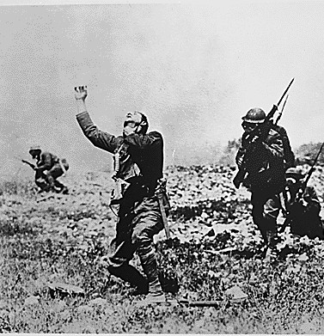
Reluctance Overcome by Perceived Necessity
I must confess that the commission for poisoning the enemy, just as one poisons rats, struck me as it must any other straightforward soldier; it was repulsive to me. If, however, the poison gas were to result in the fall of Ypres, we would win a victory that might decide the entire campaign. In the view of this worthy goal, all personal reservations had to be silent. So onward, do what must be done. War is necessity and knows no exception.
Berthold von Deimling
Commander of the German XV Army Corps at Ypres

Slide 17
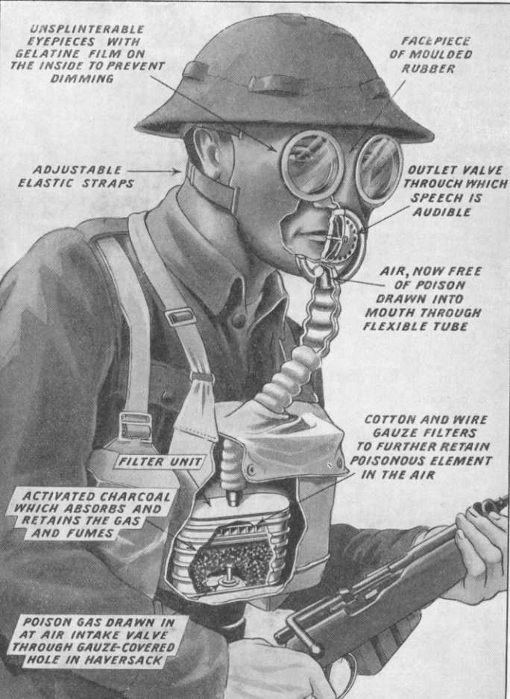
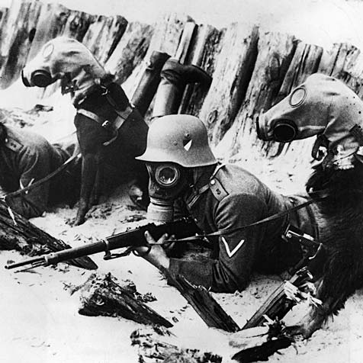
Personal Protection (Military)

Slide 18
Ways to Obtain Chlorine, Cl₂
Produce it or capture it from production plant
Divert it during transportation
From water treatment plant

Slide 19
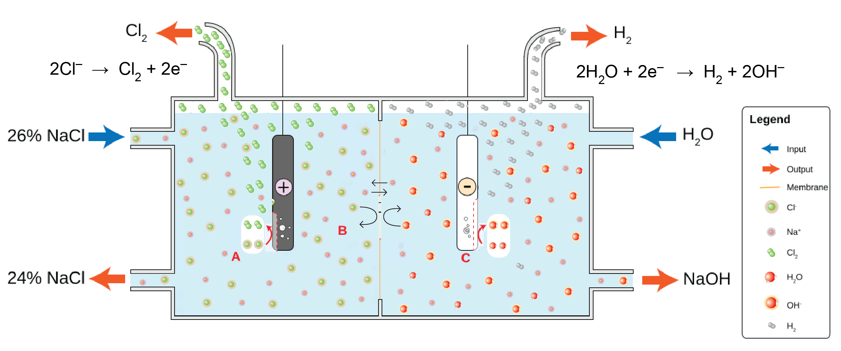
Production of Chlorine
Relatively easy to make by electrolysis of sodium chloride (table salt) in water
2NaCl(aq) + 2H₂O(l) → Cl₂(g) + H₂(g) + 2NaOH(aq)

Slide 20
Chlorine from Captured Production Plant
December 2012 – a chemical plant east of Aleppo was taken by rebel fighters from the Al-Nusra Front. The factory produces chlorine among other chemicals.
http://www.france24.com/en/20121208-syria-warns-rebels-may-resort-chemical-weapons-assad-united-nations-islamists/

Slide 21
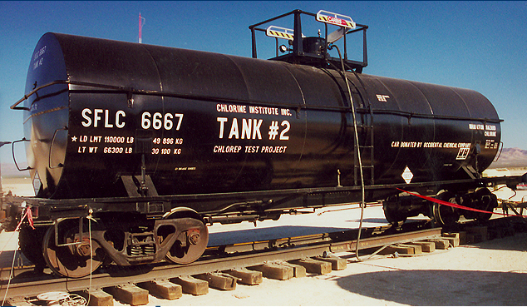
Transportation of Chlorine
By rail in tank cars
By highway in cargo tanks and cylinders
By barge

Slide 22
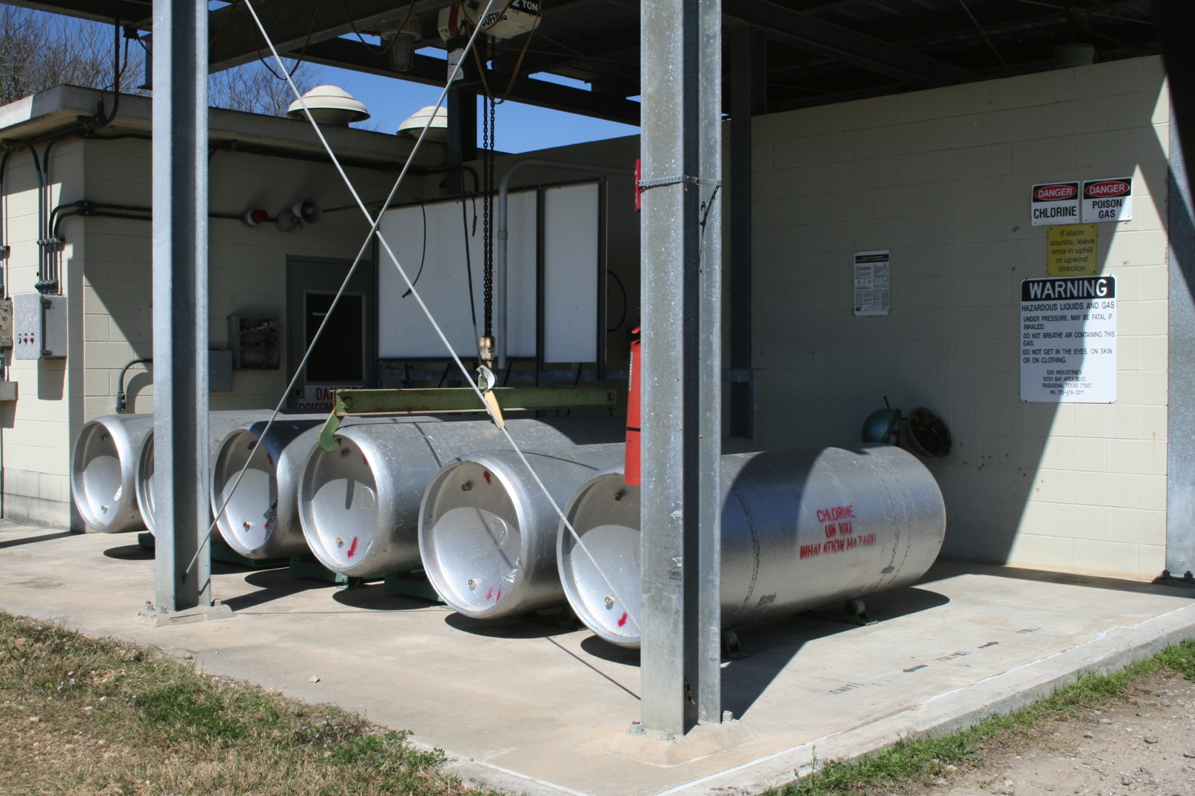
Chlorine in Water Treatment Plant
Commonly in one-ton containers

Slide 23
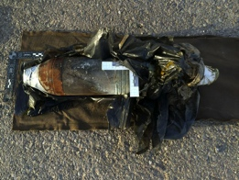
Ways to Disperse Chlorine, Cl₂, as a CW
Stationary device, e.g. pressurized gas tanks
Car or truck bombs
Drop containers from planes or helicopters that will burst on impact (barrel bombs)
Roadside bombs
Projectiles
A 120-millimeter mortar shell struck fortifications at a Kurdish military position near the Mosul Dam in June, arms experts said, sickening several Kurdish fighters who were nearby.
Credit
Conflict Armament Research and Sahan Research
http://www.nytimes.com/2015/07/18/world/middleeast/islamic-state-isis-chemical-weapons-iraq-syria.html

Slide 24
Islamic State and Chlorine Gas
There is some evidence that the Islamic State has used chlorine gas in roadside bombs.
http://www.bbc.com/news/world-middle-east-31847427
http://www.rt.com/news/198796-isis-chlorine-attack-report/
http://www.telegraph.co.uk/news/worldnews/middleeast/syria/11978627/Chemical-weapons-experts-confirm-Islamic-State-use-of-mustard-gas-in-Syria.html
http://www.ibtimes.com/what-isis-chemical-weapons-stockpile-islamic-state-group-has-recruited-experts-across-2192871

Slide 25
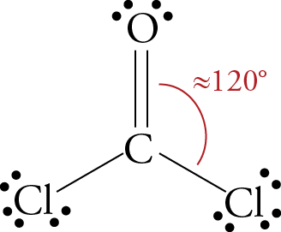
Phosgene, COCl₂
More difficult to make than chlorine. Produced by passing purified carbon monoxide and chlorine gas through a bed of porous activated carbon, which serves as catalyst. The reactor must be cooled to prevent phosgene from decomposing.
CO + Cl₂ → COCl₂
18 times more toxic than Cl₂
It causes suffocation by reacting with proteins in the lungs to disrupt the blood-air barrier.
Smells like new-mown hay
Less irritating than Cl₂, so soldiers were slower to put on their gas masks

Slide 26
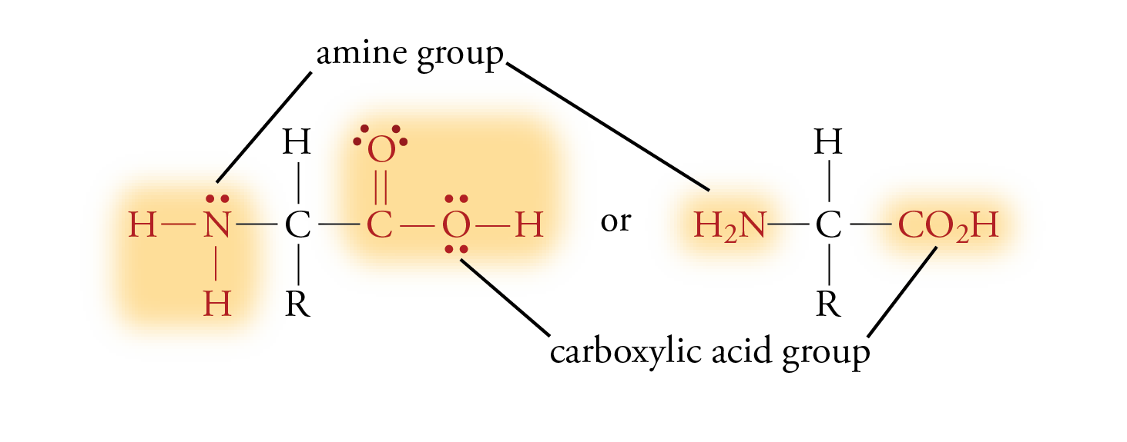
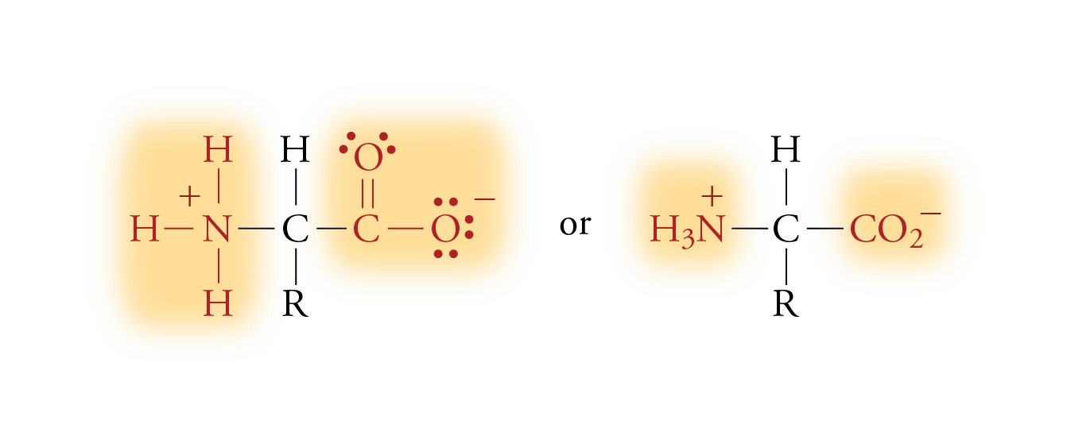
Amino Acids

Slide 27
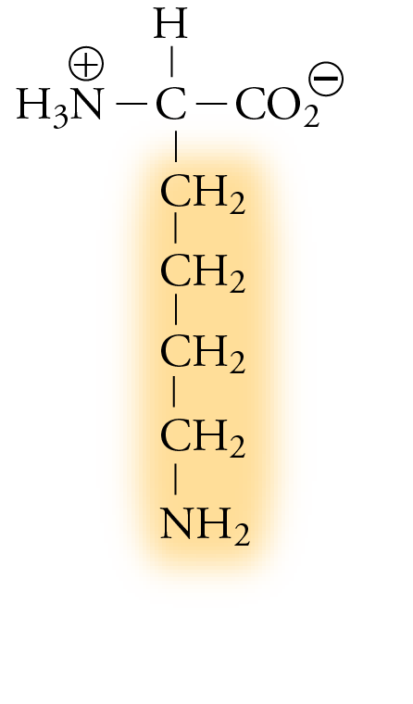
Lysine

Slide 28
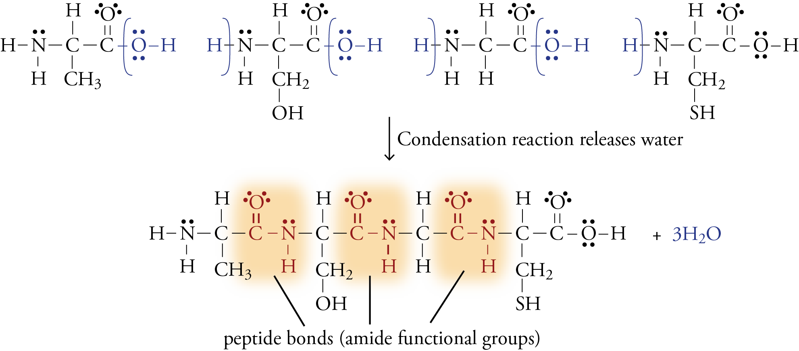
Formation of Ala-Ser-Gly-Cys

Slide 29
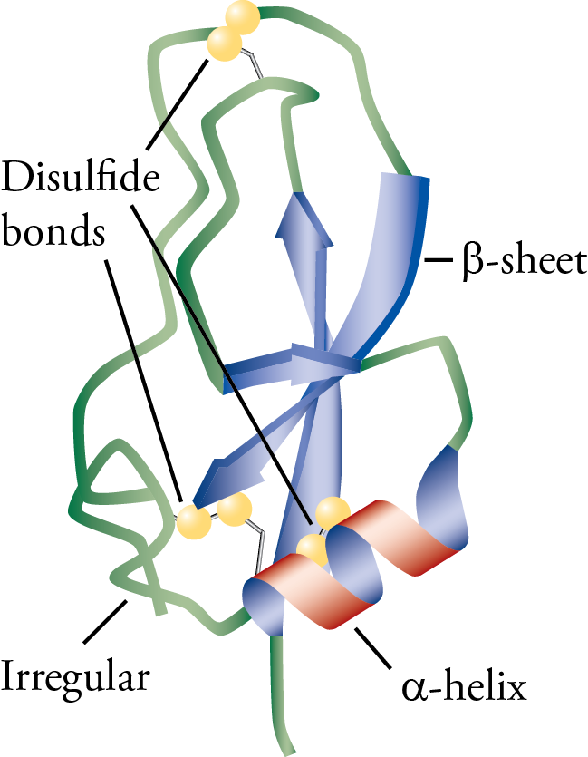
The Ribbon Structure of the Protein BPTI

Slide 30
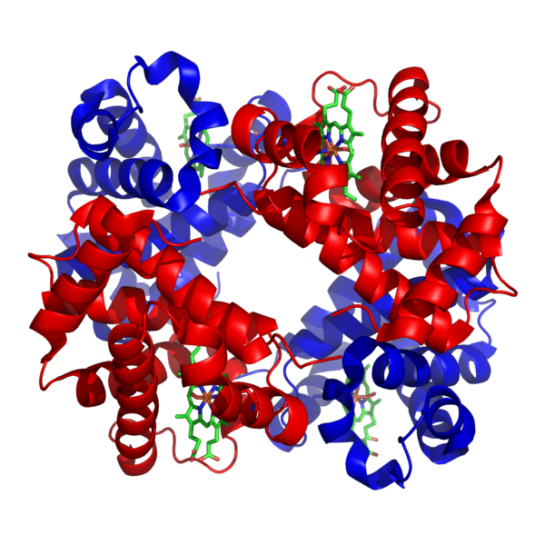
Hemoglobin
The protein hemoglobin carries oxygen in the blood.

Slide 31
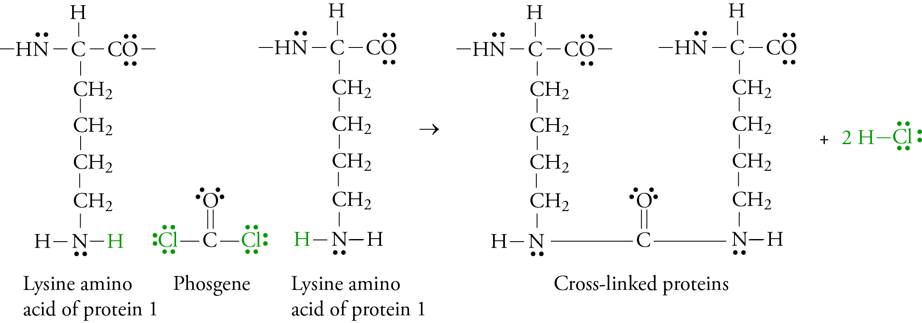
Phosgene Reaction with Protein
Phosgene reacts with proteins in the lungs to disrupt the flow of oxygen to the tissues.
It reacts with the amines of the proteins, linking protein together.
The cross-linked proteins no longer function in their normal way.

Slide 32
Dual Use
A small-scale malicious chemical program can easily be hid behind a normal industrial/research chemistry front.
Chlorine is used for water purification and to make many other compounds.
Phosgene is used to make important compounds, including pharmaceuticals and plastics.

Slide 33
Blister Agents (Vesicants)
Sulfur mustard, nitrogen mustard, phosgene oxime, Lewisite
Mode of Action: Inhalation, Skin Contact
Physiological Effects
Burns skin, mucous membranes, and eyes, causing large water blisters on exposed skin
Causes damage to upper airways
Primarily used to cause medical casualties, but can be lethal when large amounts are inhaled
Form When Disseminated: Liquid, Aerosol, Vapor, Dust
Required Defensive Gear: Protective Mask & Clothing

Slide 34
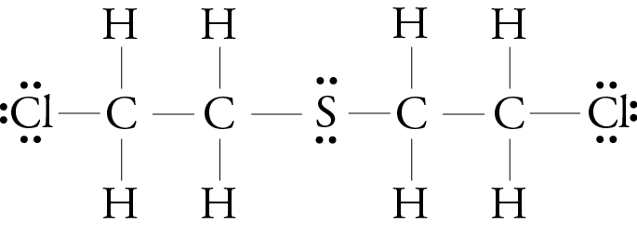
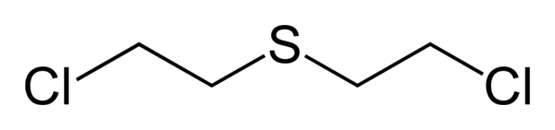
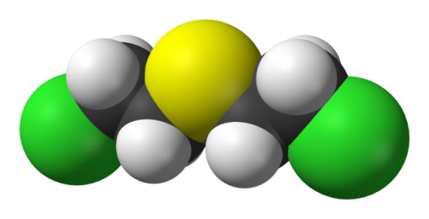
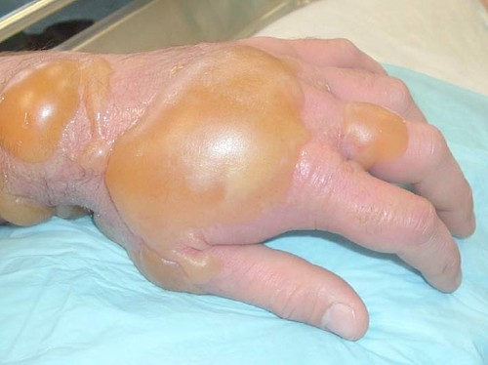
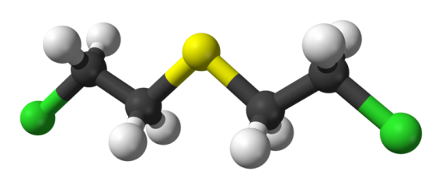
Sulfur Mustard, H or HD
Called “mustard” because of its horseradish- or garlic-like smell.
It is fat-soluble, so it dissolves in the oils in the skin, causing severe chemical burns and blisters.

Slide 35
Ways to Describe Organic Compounds
Lewis structures
Condensed Formulas, ClCH₂CH₂SCH₂CH₂Cl
Line Drawings

Slide 36
Effect of Sulfur Mustard on DNA
Sulfur mustard forms a sulfonium ion, which attaches to the guanine nucleotide of DNA, disrupting cell division and function. This can lead to cellular death or cancer.
a “sulfonium” cation

Slide 37
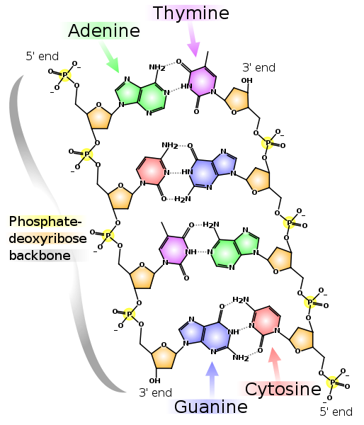
DNA Segment

Slide 38

Production of Sulfur Mustard
Relatively easy to make and conceal.
Thiodiglycol and concentrated hydrochloric acid react to form sulfur mustard.
(HOCH₂CH₂)₂S + 2 HCl → (Cl-CH₂CH₂)₂S + 2 H₂O
Thiodiglycol (CWC Schedule 2 Part B)
Used to make many things, including pen inks, plastics, pesticides, dyes, and photographic developing solutions
Produced in several countries, including Germany and the UK.
Many firms purchase it.
Does not require sophisticated equipment.
Distillation leads to improved purity, which allows longer storage.
Plant cost of $5-10 million

Slide 39
Chemical Weapons Convention (CWC)
An arms control agreement that bans the production, stockpiling, transferring, and use of chemical weapons.
Approved by the U.N. General Assembly in November, 1992.
Open for signature in 1993
The U.S. ratified CWC in 1997.
http://www.cwc.gov/
http://www.opcw.org/chemical-weapons-convention//
http://www.opcw.org/news-publications/publications/history-of-the-chemical-weapons-convention/

Slide 40
CWC General Obligations
1. Each State Party to this Convention undertakes never under any circumstances:
(a) To develop, produce, otherwise acquire, stockpile or retain chemical weapons, or transfer, directly or indirectly, chemical weapons to anyone;
(b) To use chemical weapons;
(c) To engage in any military preparations to use chemical weapons;
(d) To assist, encourage or induce, in any way, anyone to engage in any activity prohibited to a State Party under this Convention.

Slide 41
CWC General Obligations (cont.)
2. Each State Party undertakes to destroy chemical weapons it owns or possesses, or that are located in any place under its jurisdiction or control, in accordance with the provisions of this Convention.
3. Each State Party undertakes to destroy all chemical weapons it abandoned on the territory of another State Party, in accordance with the provisions of this Convention.
4. Each State Party undertakes to destroy any chemical weapons production facilities it owns or possesses, or that are located in any place under its jurisdiction or control, in accordance with the provisions of this Convention.
5. Each State Party undertakes not to use riot control agents as a method of warfare.

Slide 42
CWC Schedule 1
http://www.opcw.org/chemical-weapons-convention/annex-on-chemicals/a-guidelines-for-schedules-of-chemicals/
Schedule 1 chemicals have few or no uses other than as chemical weapons agents or to arm chemical weapons.
Examples include the nerve gases, sulfur mustards, nitrogen mustards, and lewisite
They are the most highly regulated of all chemicals.
http://www.cwc.gov/index_chemicals_sch1.html

Slide 43
CWC Schedule 2
Schedule 2 chemicals are chemicals that could be used as weapons or to make weapons, but also have legitimate small-scale uses.
Examples include Amiton (a V-series nerve gas) and BZ.
http://www.cwc.gov/index_chemicals_sch2.html

Slide 44
CWC Schedule 3
Schedule 3 chemicals have large-scale uses other than chemical weapons.
Chemical plants producing more than 30 Mg per year must report to the Organisation for the Prohibition of Chemical Weapons (OPCW).
The plants can be inspected, and there are restrictions on export to countries that have not signed the CWC.
Phosgene and hydrogen cyanide are examples.
http://www.cwc.gov/index_chemicals_sch3.html

Slide 45
CWC Parts A and B
Each schedule is divided into
Part A – the offending chemicals themselves
Pat B – their precursors (chemicals used to produce the offending chemicals)

Slide 46
Organisation for the Prohibition of Chemical Weapons (OPCW)
Intergovernmental organization located in The Hague, Netherlands
“…implementing body of the [CWC]…given the mandate to achieve the object and purpose of the Convention, to ensure the implementation of its provisions, including those for international verification of compliance with it, and to provide a forum for consultation and cooperation among States Parties.”
http://www.opcw.org/about-opcw/
http://www.opcw.org/

Slide 47
Organisation for the Prohibition of Chemical Weapons (OPCW)
Model of multilateralism - 192 member states that contain 98% of the world’s population.
4 nonmember states
Signatory states that have not ratified the CWC
Israel
States that have neither signed nor ratified the CWC
Egypt
North Korea
South Sudan

Slide 48
OPCW Tasks
Bringing suspected chemical weapons possessors into CWC
Verifying the destruction of declared chemical weapons, including those in abandoned CW weapons
Verifying the destruction or conversion of CW plants
Monitoring future compliance with CWC

Slide 49
Australia Group
Established 1985
“The Australia Group (AG) is an informal forum of countries which, through the harmonisation of export controls, seeks to ensure that exports do not contribute to the development of chemical or biological weapons. Coordination of national export control measures assists Australia Group participants to fulfill their obligations under the Chemical Weapons Convention and the Biological and Toxin Weapons Convention to the fullest extent possible.”
http://www.australiagroup.net/en/index.html

Slide 50
Ways to Circumvent Export Controls on Precursors
Substitute uncontrolled chemical for controlled one.
Purchase relatively small quantities from multiple sources
Produce precursors from simpler, uncontrolled substances.
There are at least 9 ways to make sulfur mustard documented in the chemical literature, and some of these involve uncontrolled substances.
http://www.cwc2013.info/RG2013-by-doc/6/AG-precursors.pdf

Slide 51
Iraqi Mustard Program
Back-Integration = synthesizing precursor compounds from simpler ones that are not export controlled or are available from domestic sources
thiodiglycol
sulfur mustard
Embargo placed on this by Western Countries in early 80’s
Thionyl chloride
Schedule 3 Part B
Ethylene oxide
not controlled
sulfur mustard
Notes:
In fact, there are 9 production processes for sulfur mustard which have been
documented in the published chemical literature.
(4) The fourth possibility is to manufacture precursor chemicals from simpler compounds whose
export is not controlled or that are available from domestic sources. This is called “back-integrating.”
Iraq, for example, applied back-integration to mustard gas production in the early 1980s. Unable to
make thiodiglycol indigenously, it ordered the precursor from foreign sources. However, when an
embargo threatened the supply from Western countries, Iraq developed an indigenous production
capability based on reacting ethylene oxide with hydrogen sulfide.
thionyl chloride -- used in herbicides, surfactants, drugs, vitamins, and dyestuffs

Slide 52
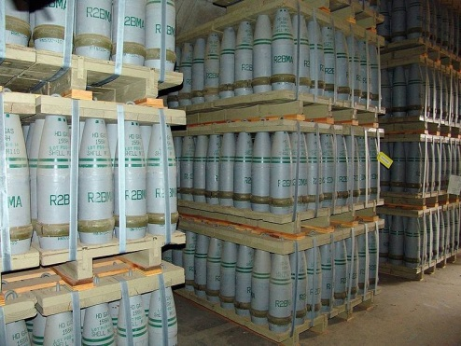
Sulfur Mustard (cont.)
“H” usually refers to an impure form of sulfur mustard with 20-30% impurities…has short shelf-life. It is relatively easy to make.
“HD” refers to a more pure form (96% pure) that can be stored longer.
It can remain on the ground for weeks, making the area dangerous long after its dispersal.
155 mm artillery shells that contained "HD" (distilled sulfur mustard agent) at Pueblo chemical weapons storage facility

Slide 53
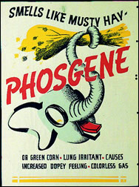
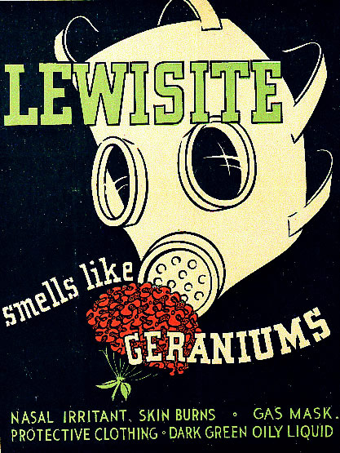
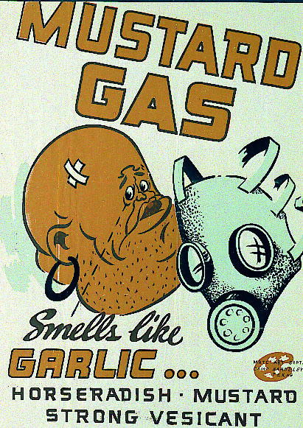
Description of Toxicity
LD₅₀ (median lethal dose) = the dose expected to kill 50% of the population exposed; typically in mg/kg of body mass
800 mg/kg (ppm) 30 mg/kg (ppm) 100 mg/kg (ppm)

Slide 54
Blood Agents
Hydrogen cyanide, cyanogen chloride, and arsine
Mode of Action: Inhalation
Physiological Effects of Cyanide
Destroys ability of tissues to utilize oxygen
Form When Disseminated: Gas
Required Defensive Gear: Protective Mask

Slide 55

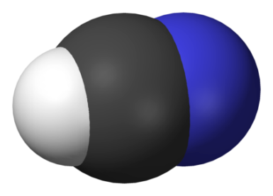
Hydrogen Cyanide, HCN
Volatile liquid – boiling point 26 °C (79 °F)
Used in industry to make many important chemicals
Fatal at concentrations as low as 300 mg/m³ in air.
According to OPCW, there are no confirmed uses as CW, but may have been used by Iraq against Iran and the Kurds.
Schedule 3, Part A of the CWC

Slide 56
Hydrogen Cyanide, HCN
Disrupts cellular respiration (the conversion of nutrients and oxygen into carbon dioxide, water, and energy) by inhibiting an enzyme (cytochrome oxidase) in mitochondria.
Binds to iron in enzyme.
Leads to dizziness, vomiting, loss of consciousness, and death
Most made from the following reaction at 1200 °C over a platinum catalyst.
2CH₄ + 2NH₃ + 3O₂ → 2HCN + 6H₂O
Converted into sodium cyanide, NaCN, and transported in water solution.

Slide 57
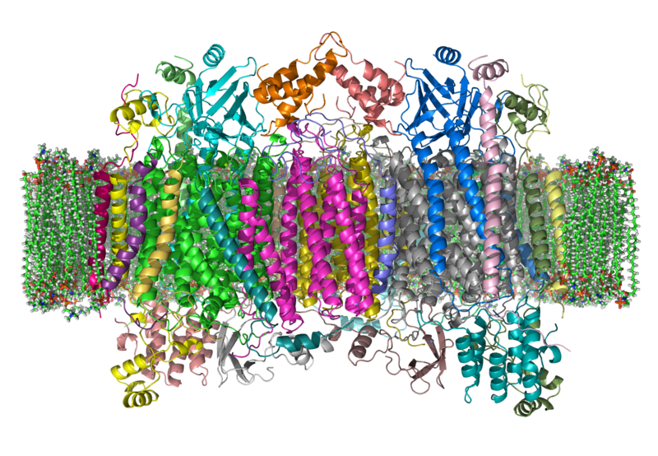
Cytochrome c Oxidase in cell membrane

Slide 58
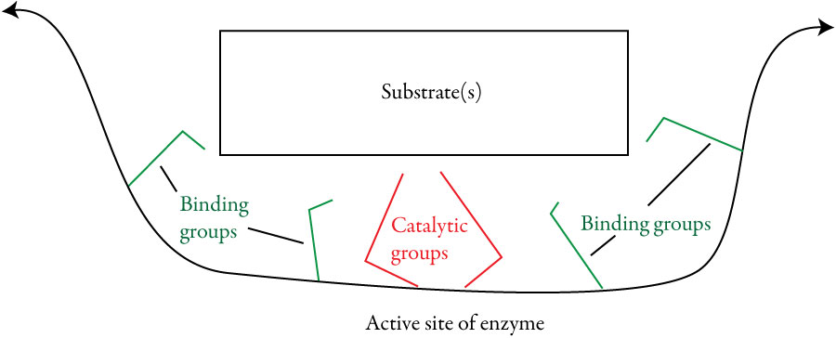
Enzymes
Enzymes are naturally occurring catalysts, primarily composed of protein. Catalysts speed chemical changes without being permanently altered themselves.
The chemicals that they act on are called substrates.

Slide 59
Enzymes
Very specific due to
Substrate shape – “Lock and Key”
Positions of binding groups, which attract substrates to the active site.
Positions of the catalytic groups that speed the reaction.
Speed chemical reactions because
Provide a different path to products that has more stable intermediates and therefore requires less energy.
Give the correct orientation every time.

Slide 60
Nerve Agents
Tabun, sarin, soman, cyclosarin, VX, Novichok
Modes of Action: Contact, Inhalation
Physiological Effects
Disrupt the mechanism by which nerves transfer messages to organs
Causes seizures and loss of body control
Exhausts muscles, including heart and diaphragm
Lethal dose can cause death from respiratory failure in five minutes
Form When Disseminated: Liquid, Vapor, Aerosol
Required Defensive Gear: Protective Mask & Clothing

Slide 61
Nerve Agents – Two Series
G-series
Produced by Germans
1936 – GA (tabun)
1939 – GB (sarin)
1944 – GD (soman)
1949 – GF (cyclosarin)
GA and GB less persistent after dispersal
V-series
More persistent after dispersal
Five well-known members
VX most important…first produced by the British in the 1950s

Slide 62
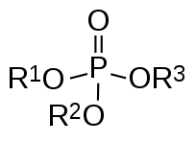
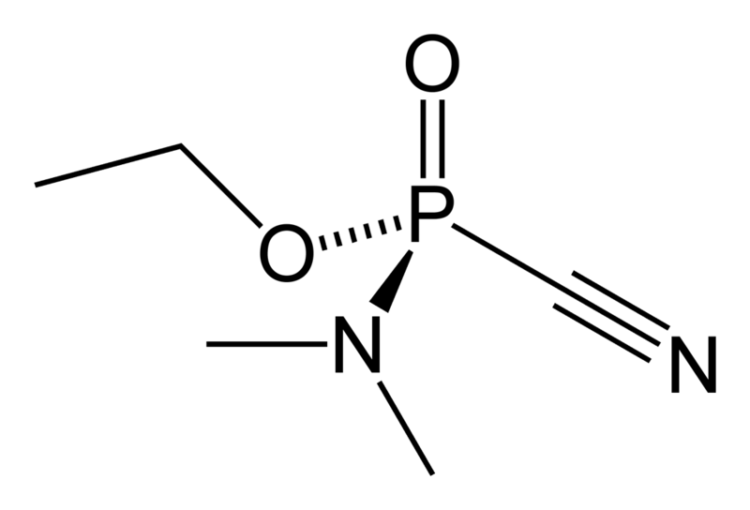
Nerve Agents
Discovered accidentally by German chemists developing pesticides.
Germany had the world’s most advanced chemical industry.
Searching for new organophosphate pesticides
Made many variations of the structure and tested them for potency.
One compound found to be very dangerous and therefore considered “taboo” (tabu in German)…called Tabun.
Notes:
Nerve agents are the CW agent of choice for most countries pursuing chemical weapons programs because they are the most lethal agents and can be produced from chemical processes very similar to those used to make pesticides and fertilizers. Nerve agents kill by repressing human brain centers responsible for managing respiration, thereby causing the body’s muscles to become constricted. This paralysis of the pulmonary musculature first induces spasms, to include vomiting and bodily excretions, and then death.
G-series CW agents such as Tabun (GA), Sarin (GB), and Soman (GD) and GF produce their incapacitating effects through both inhalation and contact. These are so-called “second-generation” agents that are very similar to pesticides and were, in fact, discovered in the 1930s by German chemists seeking new types of pesticides. G-series agents act rapidly (within seconds of exposure) and may be absorbed through the skin or the respiratory tract. However, some of these agents, particularly GA and GB, tend to be relatively nonpersistent and consequently present less of a skin hazard than a vapor hazard. in sufficient concentration, the ultimate effect of these agents is paralysis of the respiratory musculature and subsequent death. Exposure to a lethal dose may cause death in as little as several minutes. These less persistent agents are used to cause immediate casualties and to create a short-term respiratory hazard on the battlefield. Persistent G-series nerve agents such as GS and GF would present more of a skin hazard.
V-series nerve agents, including VE, VG, VM, VS, and VX, are compounds similar to, but more advanced than G-series nerve agents. Developed in the 1950s by the British, these agents tend to be more toxic and more persistent than G-agents. They present a greater skin hazard and are used to create long-term contamination of territory. Compared to most G-agents, VX, is primarily employed as a liquid, and it takes effect slightly less rapidly than aerosol nerve agents. The production process for nerve agents is widely known and requires only moderate manufacturing and chemical engineering capabilities. In order to gain some appreciation of the lethality of nerve agents, 10-15 mg of VX in contact with unprotected skin can kill an average man in just a few minutes. This means that if it were possible to deliver only that dosage to one person and no more, one gallon of VX could theoretically kill 382,000 people.

Slide 63
One Way to Do Science
Trial-and-error based on previous experience.
Steps taken by the German Gerhard Schrader working for the IG Farben chemical company and trying to make new pesticides.
Fluorine compounds are known to be toxic, so synthesized many different organic compounds with fluorine and tested them for toxicity to insects and safety for humans.
After no luck, tried adding first sulfur, then phosphorus, making a series of “organophosphate” compounds with promising characteristics.
To make the organophosphates more toxic, he added the cyanide group, which was known to be toxic, leading to tabun.
Noticed the adverse effects on himself after making it in the laboratory.
Notes:
Nerve agents are the CW agent of choice for most countries pursuing chemical weapons programs because they are the most lethal agents and can be produced from chemical processes very similar to those used to make pesticides and fertilizers. Nerve agents kill by repressing human brain centers responsible for managing respiration, thereby causing the body’s muscles to become constricted. This paralysis of the pulmonary musculature first induces spasms, to include vomiting and bodily excretions, and then death.
G-series CW agents such as Tabun (GA), Sarin (GB), and Soman (GD) and GF produce their incapacitating effects through both inhalation and contact. These are so-called “second-generation” agents that are very similar to pesticides and were, in fact, discovered in the 1930s by German chemists seeking new types of pesticides. G-series agents act rapidly (within seconds of exposure) and may be absorbed through the skin or the respiratory tract. However, some of these agents, particularly GA and GB, tend to be relatively nonpersistent and consequently present less of a skin hazard than a vapor hazard. in sufficient concentration, the ultimate effect of these agents is paralysis of the respiratory musculature and subsequent death. Exposure to a lethal dose may cause death in as little as several minutes. These less persistent agents are used to cause immediate casualties and to create a short-term respiratory hazard on the battlefield. Persistent G-series nerve agents such as GS and GF would present more of a skin hazard.
V-series nerve agents, including VE, VG, VM, VS, and VX, are compounds similar to, but more advanced than G-series nerve agents. Developed in the 1950s by the British, these agents tend to be more toxic and more persistent than G-agents. They present a greater skin hazard and are used to create long-term contamination of territory. Compared to most G-agents, VX, is primarily employed as a liquid, and it takes effect slightly less rapidly than aerosol nerve agents. The production process for nerve agents is widely known and requires only moderate manufacturing and chemical engineering capabilities. In order to gain some appreciation of the lethality of nerve agents, 10-15 mg of VX in contact with unprotected skin can kill an average man in just a few minutes. This means that if it were possible to deliver only that dosage to one person and no more, one gallon of VX could theoretically kill 382,000 people.

Slide 64
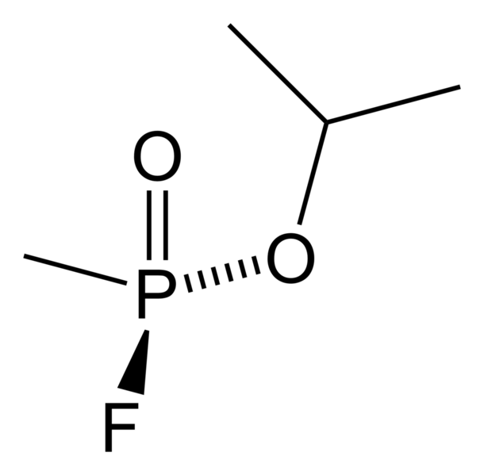
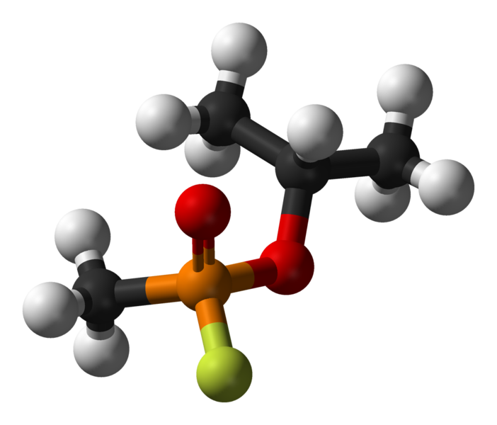
Sarin (GB)
Developed by the Germans in 1939
Named for four scientists who were important in its discovery…Schrader and Ambros of IG Farben and Rudiger and Linde or the German Army Ordinance Office
Highly toxic
Odorless
Volatility similar to water
Adopted as the standard nerve agent for the U.S. in 1948.
Hard to make
http://chemapps.stolaf.edu/jmol/jmol.php?model=FP%28%3DO%29%28OC%28C%29C%29C

Slide 65
Sarin (GB)
If sarin does not have a high purity, it degrades fairly rapidly.
Its shelf-life can be extended with stabilizers.
A very large amount of sarin has been made, but very little of it has been used.
Iraq used sarin against Iran and the Kurds in the 1980s.
Used in the Tokyo Subway attack by Aum Shinrikyo
Used in Syria in 2013

Slide 66
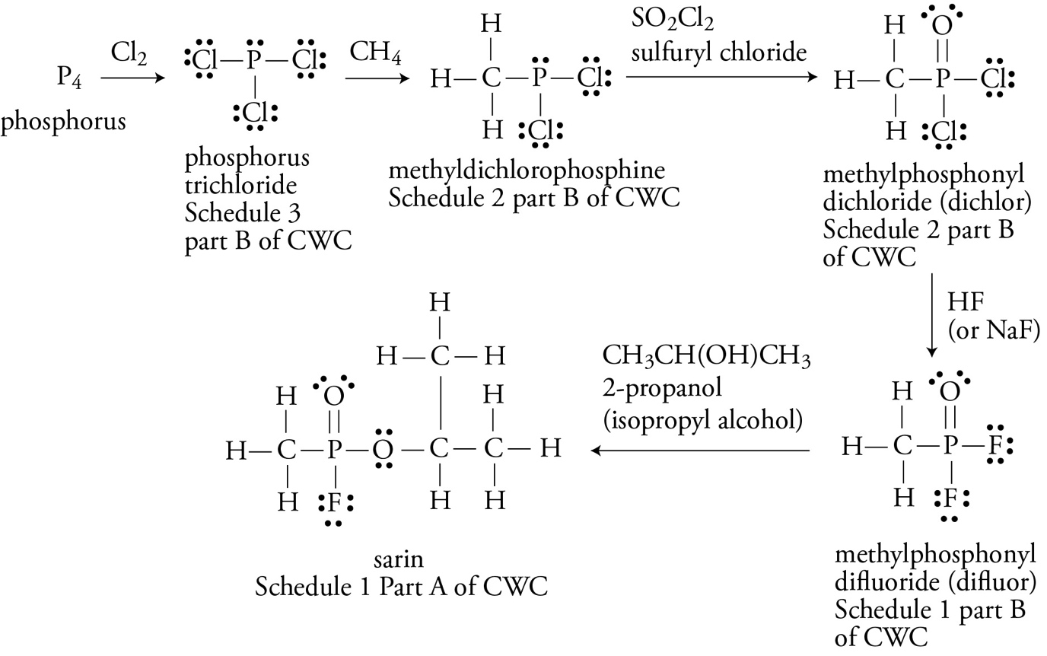
Rough Steps in Production of Sarin

Slide 67
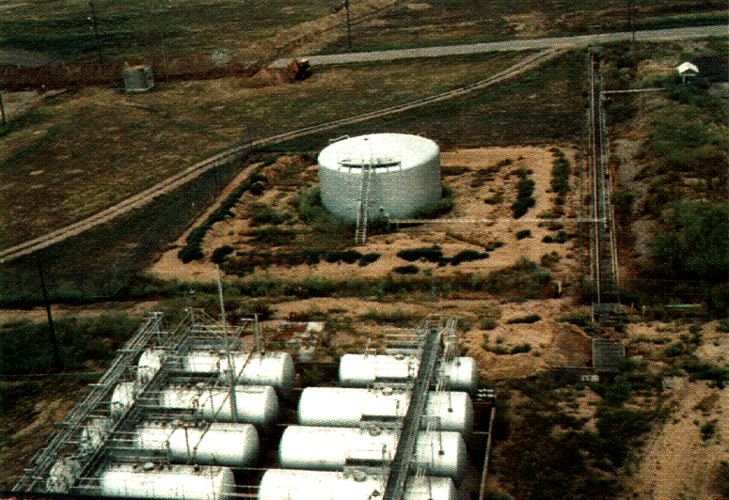
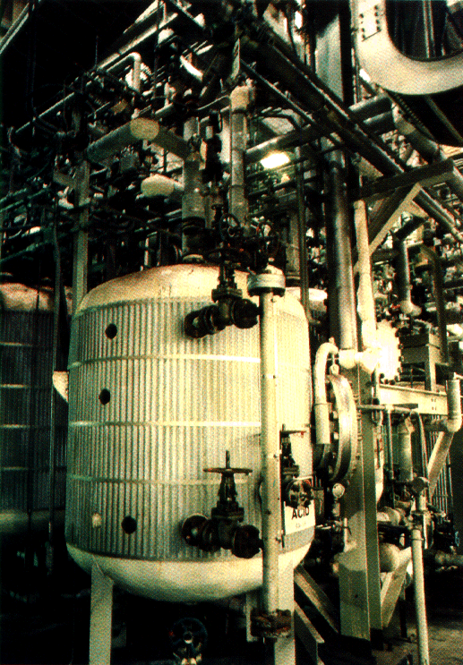
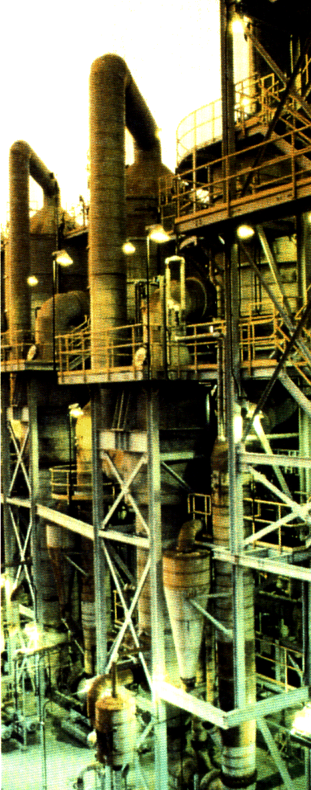
Production Process (Simplified)
Piped to
chemical
processing
area
Combined in
reactor under
controlled
conditions, often
with catalysts
Precursors stockpiled
Precursors react to form new compounds
Agents are stored until filled into munitions
Distillation & filtration separates & purifies agents and byproducts
Notes:
This slide depicts, in a very simplified form, a typical production process for chemical warfare agents. Many CW agents, especially older agents, are relatively simple to produce. They are often based on technology that is at least 80 years old and sometimes older, putting them well within the reach of virtually any country with a chemical industry that wants them. Newer agents, especially nerve agents, are more difficult to produce; however, much of the technology for these agents is widely available in the public domain.

Slide 68
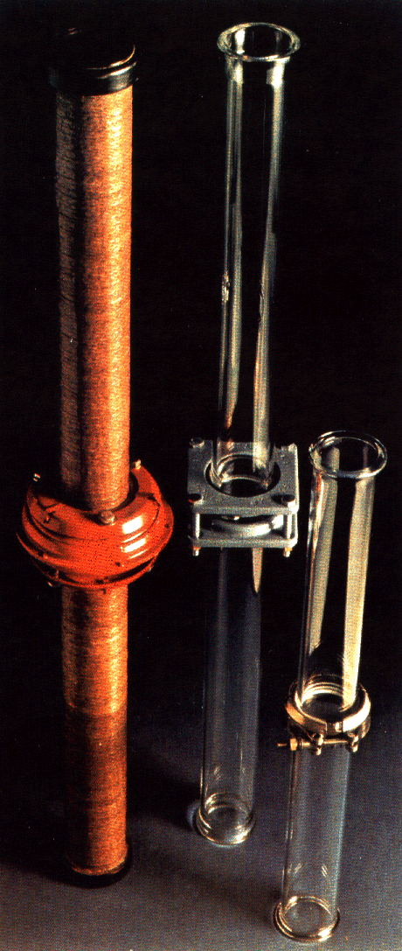
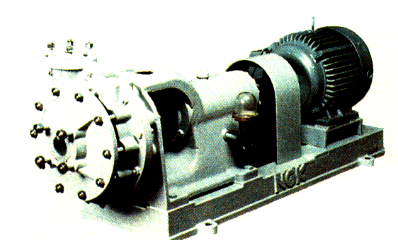
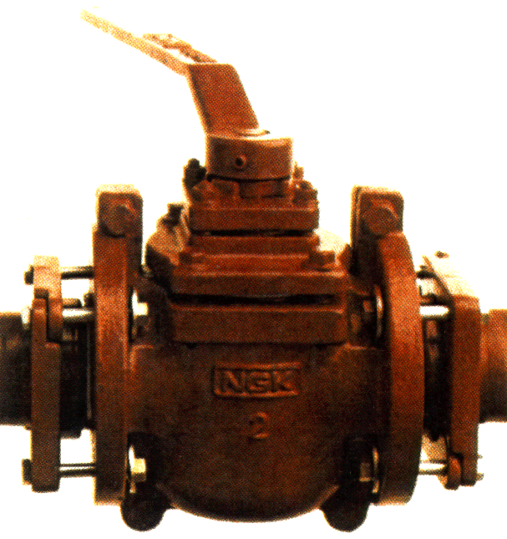
Equipment
Standard chemical process equipment could be suitable for a clandestine CW program, but specialized equipment is preferable.
corrosion resistance (high nickel content)
equipment designed for handling extremely toxic substances (e.g. double seal pumps)
Safety equipment (incinerators, toxic gas monitors, etc.) also has dual-uses.
Glass lined pipes
Hastelloy pumps & valves
Notes:
In many ways, production of CW agents is like that of legitimate commercial compounds. Both involve use of standard chemical process equipment, including reactor vessels, in which production actually occurs; heat exchangers, to control temperature; and various pumps, pipes, valves, and other items that control the movement of chemicals throughout the plant. (The greatest similarities occur between pesticide and nerve agent production units because these agents are so closely related.)
So, standard chemical process equipment could be suitable for a clandestine CW program. However, specialized equipment is preferred. Equipment that is resistant to corrosion - such has Hastelloy and other high nickel alloys- has important applications in CW because of the highly corrosive compounds encountered in CW agent production. Double-seal pumps and other equipment that is designed to handle exceptionally toxic compounds are also preferred.

Slide 69
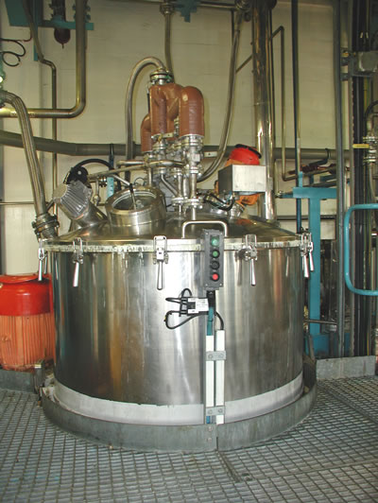
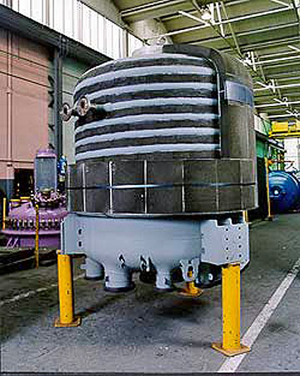
Large-Scale Chemical Reactors

Slide 70
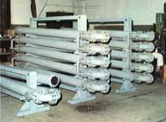
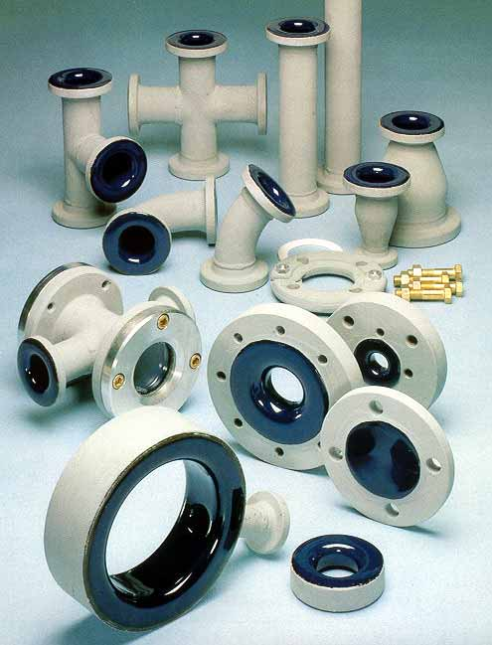
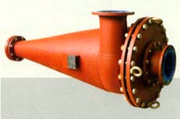
CW Agents Production Equipment
Jacketed Pipe Heat Exchanger-
keeps reactions at proper temps
Glass Lined Pipe & Fittings-
Good for corrosive chemicals
Glass Lined Steel Cyclones – used to separate large batches of chemicals
Notes:
Recognition of Biological Equipment Detection/Identification
In the upper left are heat exchanger pipes for maintaining the appropriate temperature. In the upper right are many glassed lined fittings for use in a highly corrosive environment. A cyclone is a type of centrifugal separator that is used in the Chemical Process Industry. They are designed for the separation of gas/liquid and gas/solid mixtures, where the solid or liquid generally consists of fine particles (a dust/powder, or a mist).

Slide 71
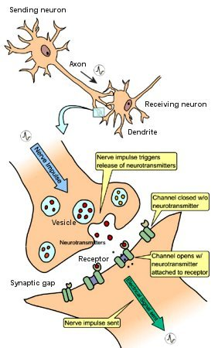
Neurotransmitters
Neurotransmitters cause nerve cells to fire.
From http://universe-review.ca/R10-16-ANS.htm

Slide 72

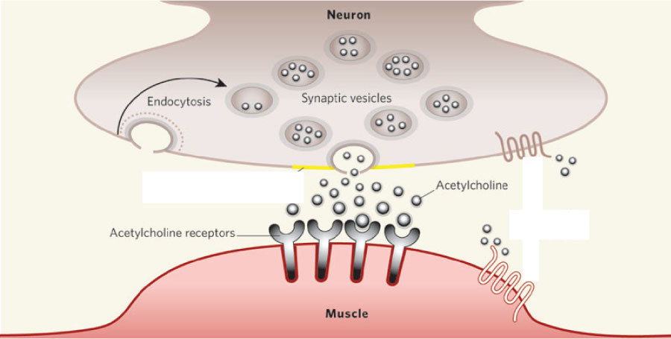
Acetylcholine and Muscle Contraction
Among other things, the neurotransmitter acetylcholine stimulates nerve cells that cause muscle contraction.
From Nature 436, 473-474 (28 July 2005)

Slide 73
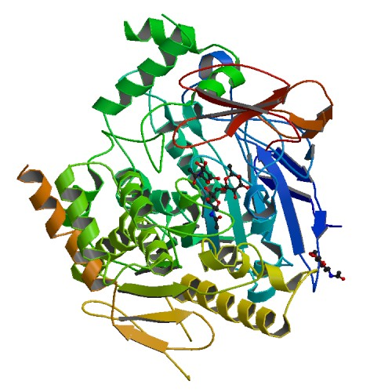
Acetylcholine, Acetylcholinesterase, and Transfer of Nerve Information
Normally, acetylcholine is broken down in the active site of an enzyme, acetylcholinesterase.
Each enzyme molecule converts about 25,000 molecules of acetylcholine per second.
Acetylcholine-acetylcholinesterase - like an on-off switch for muscles

Slide 74
Sarin and Acetylcholine-Acetylcholinesterase
Sarin forms a covalent bond to a serine side chain in the active site of acetylcholinesterase, deactivating it.
If acetylcholinesterase is deactivated, the acetylcholine levels remain high, and the switch gets stuck in the “on” position.
http://preparatorychemistry.com/nerve_agent_sarin.html

Slide 75
Effects of Nerve Gases
For skeletal muscles: uncontrolled spasms, followed by paralysis
For involuntary muscles: pupil contraction, excessive salivation, intestinal cramps, vomiting, and constriction of bronchial tubes
For central nervous system: overstimulates the brain, causing seizures
Causes glands to be overactive, secreting excess nasal mucus, saliva, and sweat
Causes death by asphyxiation through constriction of bronchial tubes, suppression of the respiratory center of the brain, and paralysis of the breathing muscles

Slide 76

Nerve Gas Antidotes - Atropine
Standard antidote for organophosphate poisoning
Used in ancient Greece to dilate pupils (to make women's eyes prettier)
Competes successfully with one type of acetylcholine receptors. This type of receptor is found in smooth muscles and glands.
Helps relax muscles
Stops the symptoms from nerve agent poisoning, not the cause

Slide 77


Nerve Gas Antidotes - PAM
Pralidoxime (2-pyridine aldoxime methyl chloride,) or 2-PAM
Removes the nerve agent from the active site of acetylcholinesterase, restoring the enzyme to more normal levels
Too slow to work well alone
Works best when administered with atropine, which acts more quickly, giving the slower-acting 2-PAM time to work.
Does not make it through the blood-brain barrier, so does not alleviate problems within the central nervous system.

Slide 78


Diazepam (Valium)
Anticonvulsant
Enhances the effect of the neurotransmitter GABA, which slows the transfer of nerve information.
Nerve firing is caused by buildup of positive ions in nerve cells.
GABA triggers movement of Cl⁻ ions into nerve cell, slowing the buildup of positive charge and slowing the firing of the cells.
Valium and other benzodiazapines make it easier for GABA to work.

Slide 79

Diazepam (Valium)

Slide 80

Treatment for Nerve Agent Exposure
An individual who is known to be exposed to a nerve agent or who exhibits definite signs or symptoms of nerve-agent exposure should have an immediate injection of the antidotes atropine and pralidoxime (2-PAM) and a sedative/antiepileptic drug, such as diazepam or Valium.
Can be administered with an autoinjector, such as the United States military Mark I NAAK and CANA (Convulsive Antidote, Nerve Agent).
Remove as much of the nerve agent as possible before moving to a non-contaminated area.
Rinse with household bleach and rinse with water.
Remove contaminated clothing and rinse skin again.

Slide 81

Hydrolysis of Sarin
Each arrow represents the movement of a pair of electrons as covalent bonds are broken and made.

Slide 82
Detection of Sarin Use
The product of the first step in the hydrolysis of sarin, isopropyl methylphosphonic acid (IMPA), is a chemical that is not commonly found in nature, so if it is found at the site of a chemical weapons attack, it’s an indication of the use of sarin.
The final products of the hydrolysis of sarin are formed from the hydrolysis of other organophoshates.

Slide 83



VX
One of several similar substances that were considered “venomous” and called V-agents.
First produced in England in 1954
Odorless liquid, slightly more dense than water, with a viscosity similar to motor oil.
http://chemapps.stolaf.edu/jmol/jmol.php?model=CCOP%28C%29%28%3DO%29SCCN%28C%28C%29C%29C%28C%29C

Slide 84
VX
Three times more toxic that sarin when inhaled and a thousand times more toxic when absorbed by the skin. A small drop on the skin could kill an adult in fifteen minutes.
Dispersed as an airborne mist or course spray.
Clings to whatever it hits
When sprayed on the ground, remains lethal for up to three weeks, so it is an area denial weapon.

Slide 85
Dosage Units
LD₅₀ = dose of chemical expected to kill 50% of an exposed population…typical units = mg/kg of body weight
LCt₅₀ = concentration of a chemical (in vapor phase) expected to kill 50% of a population exposed for a specified period of time…often expressed as the product of chemical’s concentration in air (mg/m³) and the duration of exposure (min)…units = mg•min/m³
ED₅₀ = dose of a chemical expected to cause a defined effect in 50% of an exposed population…typically expressed in units of mg/kg of body weight.

Slide 86
Dosage Units
ECt₅₀ = concentration of chemical (vapor phase) expected to cause a defined effect in 50% of a population exposed for a specified period of time; typically expressed as product of chemical’s concentration in air (mg/m³) and the duration of exposure (min)…typical units = mg•min/m³.
ICt₅₀ = median incapacitation concentration, concentration of chemical (vapor phase) expected to incapacitate 50% of a population exposed for a specified period of time, typically expressed as product of chemical’s concentration in air (mg/m³) and the duration of exposure (min)…typical units = mg•min/m³

Slide 87
Dosage Units
TD_{LO} = Lowest toxic dose; the lowest dose of a chemical reported to cause an observable toxic effect in test animals

Slide 88
CW Lethality: Inhalation
LCt₅₀ ; in mg•min/m³
19,000
If victim is physically stressed, these numbers drop quickly!
Ex: LCt₅₀ (Sarin; GB) resting: 70 mg•min/m³
LCt₅₀ (Sarin; GB) active: 20 mg•min/m³
Concentration
3,200
1,500
400
100
15
Chlorine
Phosgene
Mustard
Tabun
Sarin
VX
Lethality
Notes:
Most CW agents are designed to enter the body either through inhalation or contact. The mode of transmission and type of agent determine the lethality of each agent. Although all are not intended to function via inhalation, all four types of CW agent are lethal if inhaled in the proper concentrations. Typically, this lethal concentration (LC) is defined as the number of milligrams of agent per minute per meter cubed (mg-min/m³) necessary to kill 50% of an exposed population. LC figures also depend upon the breathing rate of the victim. The faster a victim breathes, the more agent he or she will inhale, thereby lowering the concentration per volume of air required for lethality. For example , the lethal concentration for troops exposed to GB and engaged in mild physical activity is approximately 70 mg-min/m³. This figure drops to 20 mg-min/m³ if those same soldiers are engaged in intense physical activity and breathing heavily.

Slide 89
Incapacitants Classification
Irritants Riot-control agents (CS, CN, etc.); pepper spray
Central nervous system stimulants (Amphetamines, cocaine, caffeine, nicotine, strychnine, metrazole)
Central nervous system depressants (Barbiturates, opioids, antipsychotics, benzodiazepines)
Psychedelics (LSD-25, psilocybin, ibogaine, harmine, MDMA…“ecstasy”, PCP)
Deliriants (Many, especially anticholinergics , such as BZ)

Slide 90
Physiological Incapacitants
CN (mace), CS, pepper spray, fentanyl
Modes of Action: Mucous membrane irritation, vomiting inducing, sleep inducing
Physiological Effects
Causes uncontrolled tearing, itching, vomiting, unconsciousness
Act immediately
Form When Disseminated: Powder, Vapor
Required Defensive Gear: Protective Mask & Clothing

Slide 91
Opiate-like Agents
Clinical data for opiate-like compounds, comparing the effective dose (ED₅₀) and the lethal dose (LD₅₀)
This varies with the health of the subject.

Slide 92
Moscow Theater Hostage Crisis
23 October 2002 – 40-50 armed Chechens seized a crowded Moscow theater and took 850 hostages
Claimed allegiance to the Islamist militant separatist movement in Chechnya
Russian forces pumped a substance thought to be carfentanyl into the building's ventilation system and raided it.
39 attackers and at least 129 of the hostages were killed.
Most of the hostages who died were killed by the toxic substance pumped into the theater to subdue the militants. It is thought that their weakened condition led to a greater risk.

Slide 93


Fentanyl and Carfentanyl
Both potent, synthetic narcotics that stimulate opioid receptors.
Fentanyl is approximately 100 times more potent than morphine.
Carfentanyl is about 10,000 times more potent.
Fentanyl
carfentanyl

Slide 94
Psychochemical Incapacitants
BZ (3-3-quinuclidinyl benzilate)
Modes of Action: Inhalation, Ingestion, Injection
Physiological Effects
Potent anti-cholinergic compound (similar to atropine)
Dose <1 mg induces hallucinations and delirium
Effects peak at 8 hours and decline over next 48-72 hours
Form When Disseminated: Aerosolized solid, possibly in solvent
Required Defensive Gear: Protective Mask, Suits

Slide 95


BZ
3-Quinuclidinyl benzilate (BZ) - military incapacitating agent.
Related to atropine
Competitive inhibitor of acetylcholine at receptor sites in smooth muscle, exocrine glands, autonomic ganglia, and the brain
Decreases the effective concentration of acetylcholine seen by receptors at these sites.
Opposite of effects in nerve agent poisoning.
Effects include stupor, confusion, and hallucinations.
Schedule 2 of the Chemical Weapons Convention

Slide 96

Physostigmine - BZ Antidote
Anticholinesterase, which temporarily raises acetylcholine concentrations by binding reversibly to acetylcholinesterase, the enzyme responsible for the breakdown of acetylcholine in the synaptic gap.

Slide 97
Toxins
A toxin is a poisonous substance produced within living cells or organisms.
Because toxins are produced by biological organisms, there is a debate about whether they should be considered chemical or biological weapons.
As modern chemistry can synthesize an ever-growing number of toxins, they fall under the purview of the CWC.
Two toxins, ricin and saxitoxin, are listed on Schedule 1 of the CWC.

Slide 98


Ricin
Naturally occurring protein.
Can be extracted from castor beans
The LD₅₀ of ricin is around 22 micrograms per kilogram in humans if exposure is from injection or inhalation.
Oral lethal dose is 20–30 milligrams per kilogram.
The major reason ricin is a public health threat is that it is easy to obtain. (More than 1 million metric tons of castor beans are processed each year.)
Low thermal stability makes it useless in munitions.
Ricin is listed as a Schedule 1 controlled substance in the CWC.
http://en.wikipedia.org/wiki/Ricin

Slide 99
Ricin Physiological Effects
Disrupts protein synthesis.
Symptoms from inhalation: respiratory distress (difficulty breathing), fever, cough, nausea, and tightness in the chest. Heavy sweating may follow as well as fluid building up in the lungs (pulmonary edema). Finally, low blood pressure and respiratory failure may occur, leading to death.
Symptoms from ingestion: vomiting and diarrhea that may become bloody. Severe dehydration may be the result, followed by low blood pressure….hallucinations, seizures, and blood in the urine. Within several days, the person's liver, spleen, and kidneys might stop working, and the person could die.

Slide 100
Ricin and ISIS
Some indications that ISIS has pursued the production of ricin.
“The laptop of Muhammed S., a Tunisian chemistry and physics student who joined the Islamic State, contains an eclectic mix of speeches by jihadi leaders, neo-Nazi screeds, and U.S. Army manuals on specific aspects of warfare”.
Includes “…instructions for how to obtain the deadly toxin ricin from castor beans.”
http://foreignpolicy.com/2014/09/09/recipes-from-the-islamic-states-laptop-of-doom/

Slide 101

Saxitoxin
Saxitoxin (STX) is the most well-known paralytic shellﬁsh toxin (PST)
STX has been found in at least 12 marine puffer fish species.
Saxitoxin is a neurotoxin that acts as a selective sodium channel blocker. It acts on the voltage-gated sodium channels of nerve cells, preventing normal cellular function and leading to paralysis.
Can potentially be produced in a chemical laboratory.
The oral LD₅₀ for humans is 5.7 µg/kg, therefore approximately 0.5 mg of saxitoxin is lethal if ingested and the lethal dose by injection is about one-tenth of the oral dose.
http://en.wikipedia.org/wiki/Saxitoxin

Slide 102
Saxitoxin
Saxitoxin is about 1,000 times more toxic than the nerve gas sarin.
The United States military isolated saxitoxin and assigned it the chemical weapon designation TZ.
U-2 pilot Francis Gary Powers was issued with a hollow silver dollar containing a tiny, saxitoxin-impregnated needle, to be used to commit suicide in case of capture by enemy forces.
Saxitoxin is listed in Schedule 1 of the CWC.
8 tons of clams to get 1 gram of toxin
http://en.wikipedia.org/wiki/Saxitoxin

