Slide 1

Textbooks in transition: It’s all about options
Mark Bishop
Monterey Peninsula College
Chiral Publishing Company
(http://preparatorychemistry.com)
Monterey Institute of International Studies
(http://institutebishop.org/)
preparatorychemistry.com/Bishop_2YC3_March_2016_textbooks.pdf

Slide 2
Bicycle Ride?
Meet 1:00 pm Sunday at Holland’s Bicycles at 977 Orange Ave, Coronado, CA 92118 (619-435-3153)
http://www.hollandsbicycles.com/articles/coronado-bike-rentals-pg62.htm
https://www.google.com/maps/dir//977+Orange+Ave,+Coronado,+CA+92118/@32.6859316,-117.2494653,12z/data=!3m1!4b1!4m8!4m7!1m0!1m5!1m1!1s0x80deaccbdf5c7475:0xf861e36ee262af40!2m2!1d-117.1794251!2d32.6859511
Route - Coastal rail-trail experiences don't get much better than this—a long, smooth, palm-tree-lined trail with stunning views of the Pacific, San Diego Bay and the downtown skyline, plus easy access to parks, tot play areas and chic cafes.
http://www.traillink.com/trail/bayshore-bikeway.aspx

Slide 3
An Introduction to Chemistry by Mark Bishop
Textbook intended for use in beginning chemistry courses that have no chemistry prerequisite…for students who are
preparing themselves for general college chemistry.
seeking to satisfy a science requirement for graduation.
in health-related or other programs that require a one-semester introduction to general chemistry.
taking high school chemistry.

Slide 4
History
Originally published by Benjamin Cummings in 2002
Now published by Chiral Publishing Company with a new model for distribution.
Traditional printed text
Two versions of the text and all of their tools are freely available on the Internet in PDF form. (preparatorychemistry.com)
WebAssign electronic text/tools/homework package
Audio version also available on the Net.
eBook for iPad, Android devices, and Kindle

Slide 5
Ways to get text
Option 1: Students who want a regular printed copy of the text can purchase one from my website for $69.95, including shipping.
Option 2: The text can be purchased from school bookstores for a list price of $79.95.
Option 3: The WebAssign electronic text/tools/homework package can be purchased for $40.

Slide 6
Ways to get text (cont.)
Option 4: Students can purchase a WebAssign/printed-text bundle for $109.95.
Option 5: Students who have easy access to the Internet and who feel comfortable viewing the text on a computer, iPad, or Android device are asked to pay $20 for that privilege.
http://preparatorychemistry.com/
Option 6: If $20 creates a significant financial hardship, the Internet versions of the text and tools can be used for free. (This is on the honor system. Students can decide on their own about whether they can afford the $20 payment.)

Slide 7
Ways to get text (cont.)
Option 7: I’m offering a 5-year unrestricted site license for the electronic version of my work. The cost is $20 times the expected annual enrollment.
For example, if a school expected 50 chemistry students a year to use the electronic book, the cost would be $1000, which would allow 250 students (50 per year for 5 years) to use the book. It includes a website DVD, an instructor CD, a regular printed textbook, and a student study guide.

Slide 8
Key Web Addresses
http://preparatorychemistry.com/
http://preparatorychemistry.com/Bishop_Tour.html
http://preparatorychemistry.com/Bishop_info.htm
http://preparatorychemistry.com/Bishop_versions.htm
www.webassign.net/bishop
preparatorychemistry.com/Bishop_2YC3_March_2016_textbooks.pdf

Slide 9
PDF Pros and Cons
Pros
Easy text searches
Identical to printed text
Easy to highlight and leave comments
Links to animations and tutorials
Objective references linked to body of text
Cons
Need a computer or tablet
Need Internet access
http://preparatorychemistry.com/Bishop_iBook.htm
http://preparatorychemistry.com/Bishop_Chemistry_First.htm

Slide 10
EPUB and Kindle Pros and Cons
Pros
Can change font size
Convenience of use on phone or tablet
Cons
Appearance different from printed text
Pagination different from printed text
Images not always with text describing it
http://preparatorychemistry.com/Bishop_iBook.htm
http://preparatorychemistry.com/Bishop_iBook_CF.htm

Slide 11
EPUB and MOBI eBooks Steps to Get It
Go to one of these links. The first link is for the atoms-first version, and the second is for the chemistry-first version
http://preparatorychemistry.com/Bishop_iBook.htm
http://preparatorychemistry.com/Bishop_iBook_CF.htm
Follow the instructions on the screen.

Slide 12
Audio Book Pros and Cons
Pros
Auditory and Visual
Good for those people who have stronger auditory skills than reading skills
Cons
Slower?
Can’t highlight or comment
http://preparatorychemistry.com/Bishop_Audio_Book.htm

Slide 13
WebAssign Book Pros and Cons
Pros
Tied to homework
Fits the way many modern students work
Cons
Discourages reading the text before attempting homework?
http://preparatorychemistry.com/Bishop_Audio_Book.htm

Slide 14
Tools for Text
Layout program and for creating EPUB (InDesign)
Photo manipulation software (Photoshop)
Drawing Program (Illustrator)
Adobe Acrobat
Web site creation software (Dreamweaver or other)
Animation software (Flash? Edge Animator?)
Video editing (Premier)
An annual subscription to all of the Adobe tools (Creative Cloud) is available for educators from the Academic Superstore for $199.99.
http://www.academicsuperstore.com/products/Adobe/Creative+Cloud/1600999

Slide 15
Royalty-free Images
Royalty-free photos
http://www.bigstockphoto.com/
http://www.istockphoto.com/

Slide 16
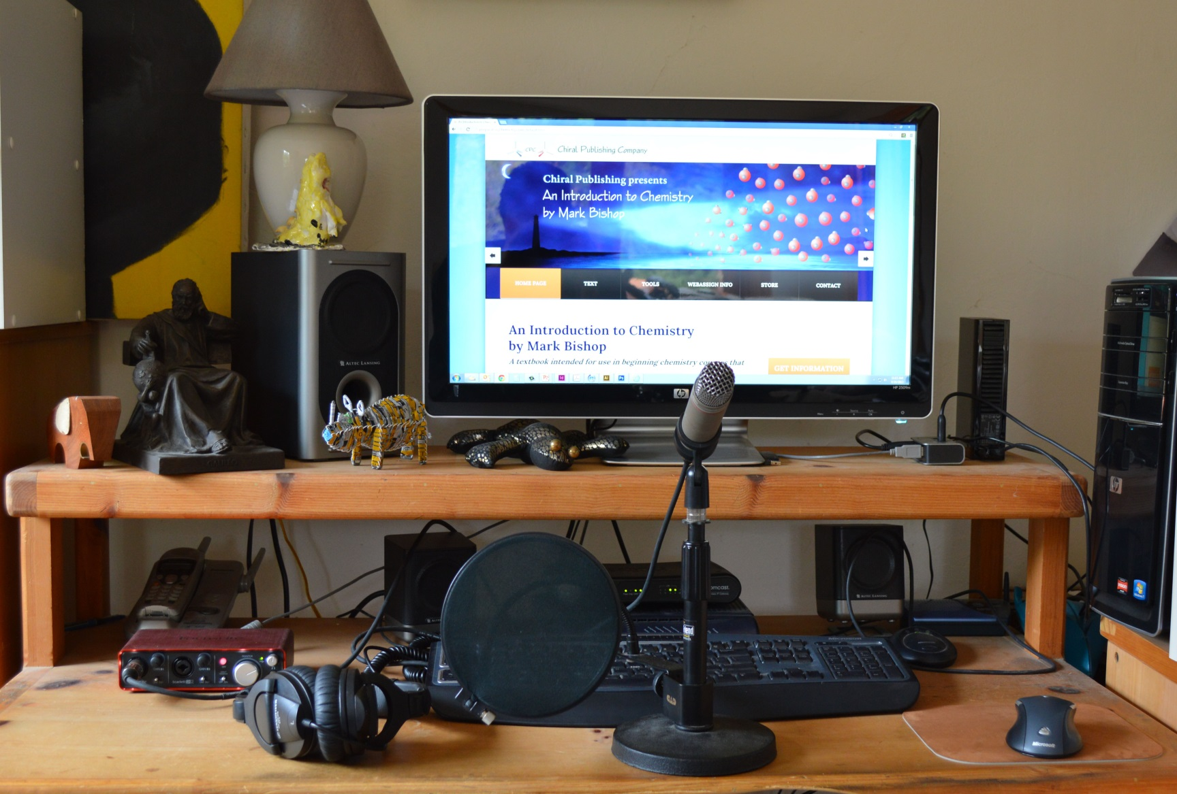
Making Audio Files

Slide 17
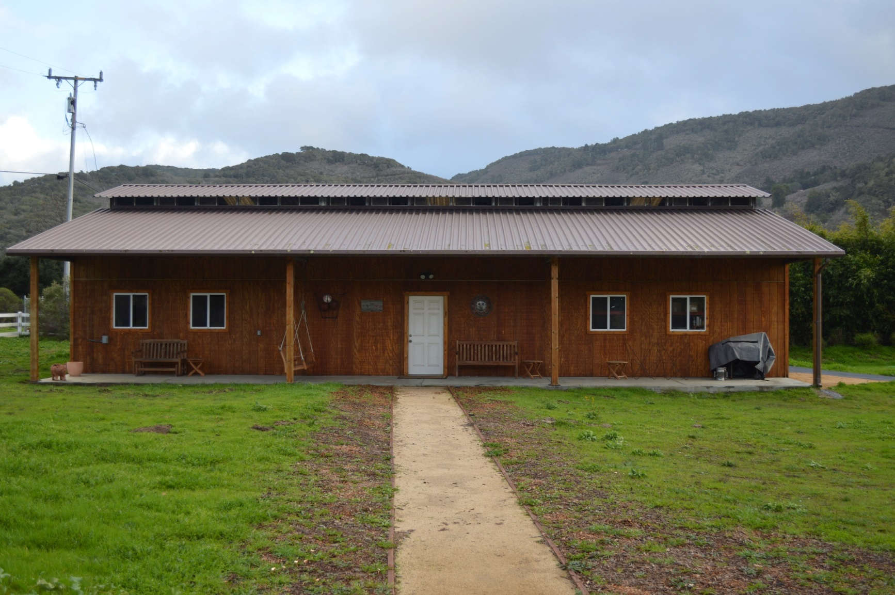
Storage

Slide 18
Tools for Audio Files
Microphone (with stand and shield)
AKG C 3000 microphone ($299 at Musician's Friend).
http://www.musiciansfriend.com/
USB audio interface and audio file manipulation software
I use Focusrite Scarlett 2i4 ($199 at Musician's Friend).
There are free audio manipulation programs http://audacity.sourceforge.net/

Slide 19
Video Screen Capture
Camtasia Studio 8
http://www.techsmith.com/camtasia.html
From Academic Superstore ($98.95)
http://www.academicsuperstore.com/product/search?qk_srch=Camtasia&x=-858&y=-54

Slide 20
More Information About My Project
http://preparatorychemistry.com/
http://preparatorychemistry.com/Bishop_Tour.html
http://preparatorychemistry.com/Bishop_info.htm
preparatorychemistry.com/Bishop_2YC3_March_2016_textbooks.pdf

