Slide 1
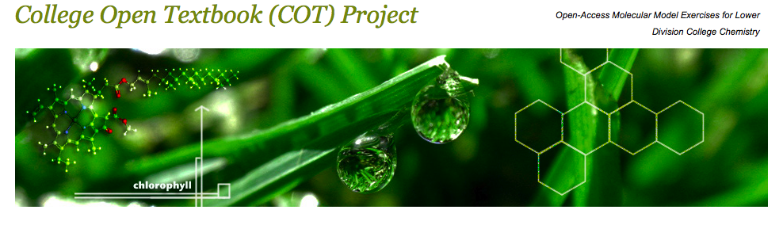
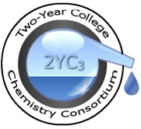

On-line 3-D Molecular Exercises, Worksheets, and Problems for Lower Division College Chemistry
http://chemconnections.org/COT/2YC3/2YC3-COT.htm
Ron Rusay
Department of Chemistry
Diablo Valley College, Pleasant Hill, CA
http://webs.anokaramsey.edu/2yc3/196/program/

Slide 2
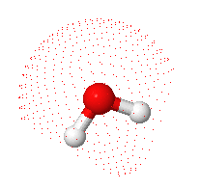
Student Visualization Skills
Spatial acuity and three-dimensional conceptualization are most important to understanding chemical structure and reactivity.
These skills are not taught formally in K-12 classrooms.
Physical models are widely used in college chemistry to help develop visual skills and molecular perception.
Digital models have also been used, but have been limited by technology, cost, and availability.
A free molecular viewer, Jmol, has made digital models easy to access through the Internet, and examine & manipulate on screen, which provides an effective alternative to physical models.

Slide 3
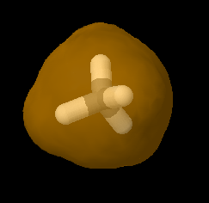
Molecular Visual Exercises
3-D exercises were developed for each semester-based course in lower division chemistry: General Chemistry (2 courses) and Organic Chemistry (2 courses).
Instructional objectives, design, and materials were guided, assisted, and tested by students, who are currently enrolled in Organic Chemistry II and had successfully completed all of the other courses .
All modules were used in at least two class sections with students ranging from 20 to 30 per section.
The instructional materials are Free, Open-Access, Web-based, employ Jmol, and enhance ChemWiki’s modules.

Slide 4
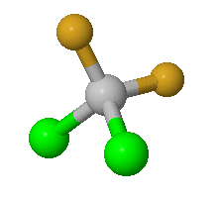
Instructional Materials
The materials are staged from three different Web sites: (1) http://chemconnections.org/COT/ (2) http://dvcchem.org/COT/ and (3) the ChemWiki: http://chemwiki.ucdavis.edu/xApproaches/COT
All three address the same content, but are not identical. The first two sites offer useable modular materials, but do not provide for changing and adapting the materials. Only the ChemWiki does.
The first URL http://chemconnections.org/COT/offers a navigation list of modules, where the dvcchem orange colored http://dvcchem.org/COT/ links include background materials linked to the ChemWiki modules and other Creative Commons resources. The blue colored are individually less expansive, but serve as the scaffolding for the completed dvcchem modules and those planned for future development .

Slide 5
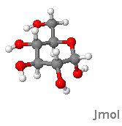
Instructional Materials
Three examples are presented to highlight module content: (1) Greenhouse Gases I, (2) Greenhouse Gases II and (3) the Diels Alder Reaction.
The three modules represent the breadth of the project from the first semester of General Chemistry to the second semester of Organic Chemistry.
They reflect a progression of spatial molecular understanding, and incorporate general chemical concepts and problems as part of their exercises and worksheets.
Greenhouse Gases I and II used chemical concepts in a series of exercises that related them in a spiral set of exercises to a broader understanding of an important contemporary scientific issue: Global Warming.

Slide 6
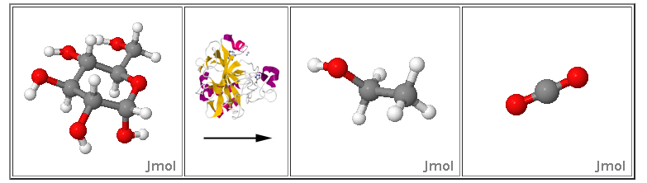
Greenhouse Gases
Part I applies a series of questions and dimensional analysis problems that relate to greenhouse gases, molar mass, gas volume & density, chemical reactions, stoichiometry, and mass calculations of their relative magnitudes in relation to some everyday activities such as driving and choices of food.
http://dvcchem.org/COT/VSEPR1/Atmos-gases/index.html
Part II advances reaction chemistry, carbon dioxide uptake and production, enzyme catalysis, photosynthesis, fermentation, combustion, how gases behave, the Ideal Gas Law, carbon budgets and cycles, and how gases relate to large scale global systems and climate change.
  http://dvcchem.org/COT/VSEPR1/CO2%20Reactions_jmol/index.html

Slide 7
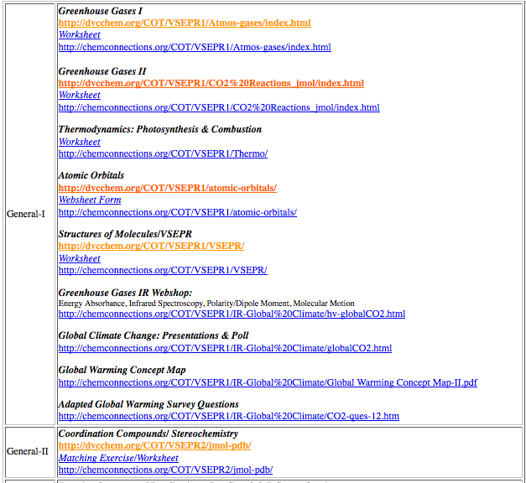
General Chemistry Modules
http://chemconnections.org/COT/
In subsequent modules, the complexity of molecular structures increase and topics include thermodynamics, atomic orbitals, covalent bonding, polarity, VSEPR, dipole moment, basic principles of Infrared Spectroscopy, coordination complexes, stereochemistry, and concept mapping. All modules are stand alone, but many can be threaded to Global Warming as an overarching theme.

Slide 8
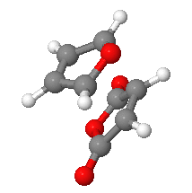
The Diels Alder Reaction http://dvcchem.org/COT/organic2/diels-alder/index.html
Accurate predictions are important objectives in scientific inquiry and research.
Molecular modeling of the Diels Alder Reaction provides a basis for testing predictions of a relatively sophisticated synthetic reaction against simple experimental results.
Two reactions are illustrated with Jmol structures for reactants, products, and transition states. They are stand alone exercises, but can be linked to small scale laboratory experiments that compare the actual products formed to those predicted through molecular modeling.
The reactions serve as a capstone for understanding how products and stereochemistry can be controlled in certain reactions by reaction time and temperature (Kinetic vs. Thermodynamic Control).

Slide 9
The Diels Alder Reaction http://dvcchem.org/COT/organic2/diels-alder/index.html
The module was tested in four sections of second semester organic chemistry: Spring 2012 (~ 80 students total).
Two sections did the exercise as an assigned stand alone worksheet and two sections did the furan-maleic anhydride synthesis plus the worksheet, and compared the laboratory results with the modeled prediction.
Student attitudinal learning surveys and cognitive assessment (graded worksheets) were highly positive.
The applied pesticide synthesis worksheet was not included in the assignment, but it was favorably appraised by the student developers as providing an interesting historical backdrop and included as an optional or bonus assignment.

Slide 10

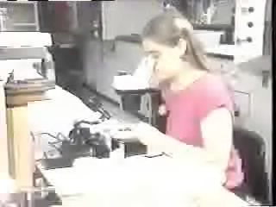
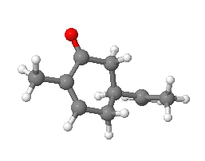
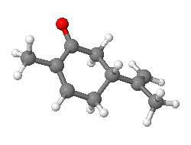
Chemical Communication: Smell / Pheromones
http://dvcchem.org/COT/chemical-communication/ChemComm.html
Insect Pheromone Synthesis
[20:40-23:51]
http://www.learner.org/resources/series61.html
http://www.learner.org/vod/vod_window.html?pid=802
Pheromone Parties

Slide 11
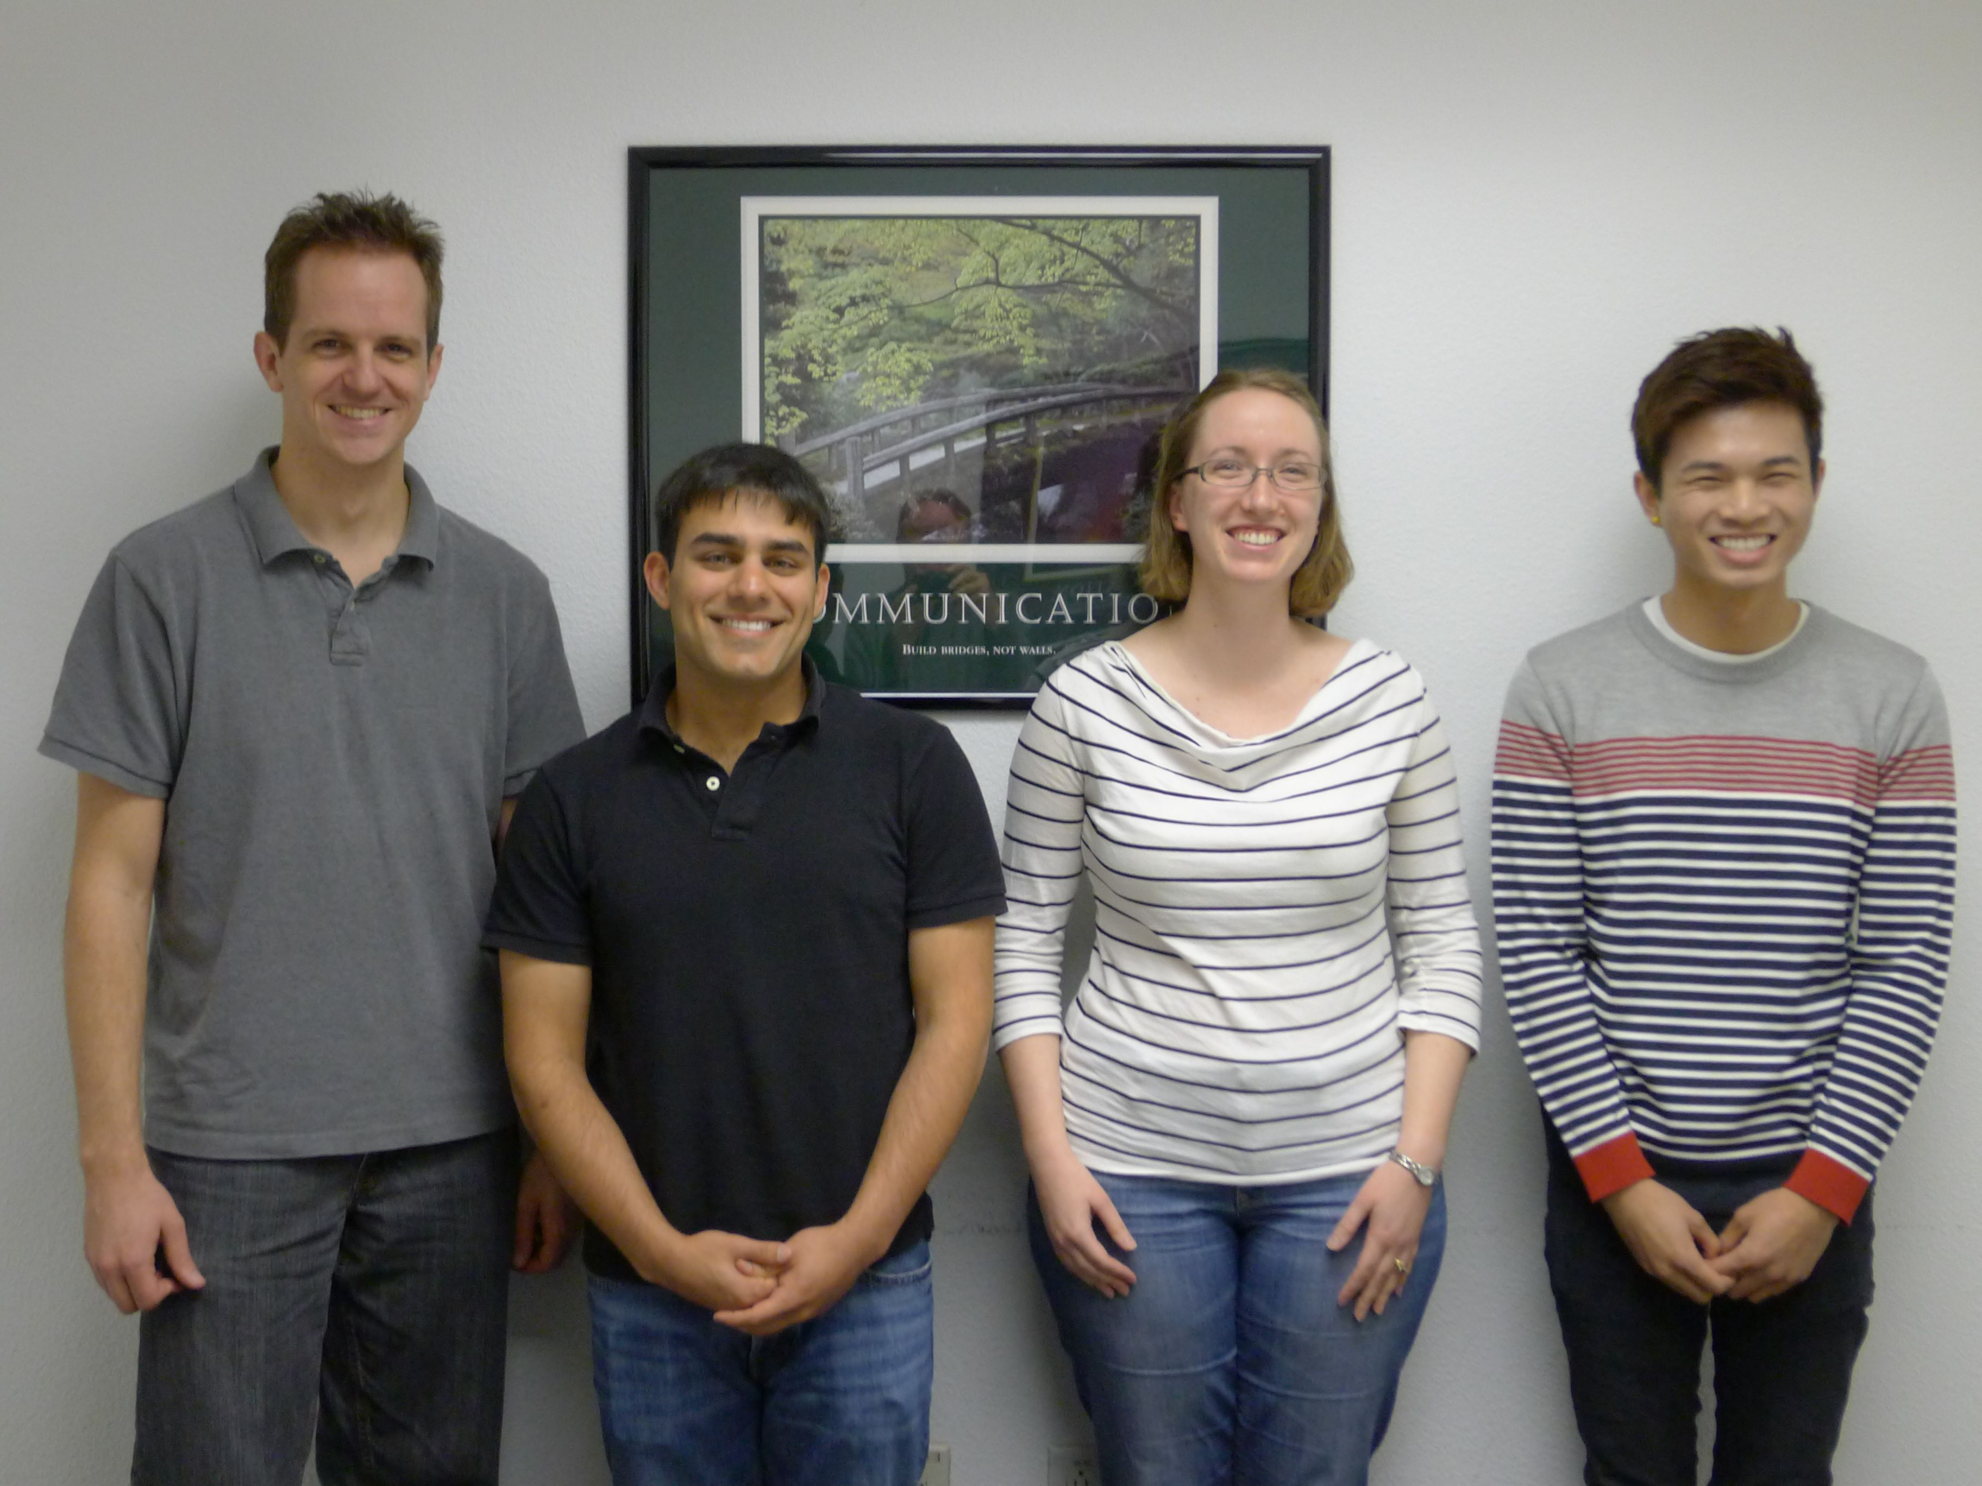
Acknowledgements
http://www.collegeopentextbooks.org/blog/
This work was supported in part by the College Open Textbook Community and the William and Flora Hewlett Foundation.
The following DVC students, Matt Steben, Akbar Maniya, Cassy Havens, and Tin Tran were co-principal contributors.
Thanks go to fellow faculty and colleagues, who advised, or revised and tested the modules: Dr. Jean Ruehl, Dr. Tish Young, Dr. Wayne Larson, & Professor Claudia Hein.
Special thanks go to collaborator and ChemWiki founder, Professor Delmar Larsen.

