Slide 1
The Dynamic Open-Access ChemWiki HyperTextbook:
Anyone, Anywhere, Anyway
Delmar S. Larsen
Associate Professor (July 1st),
Department of Chemistry
University of California, Davis

Slide 2
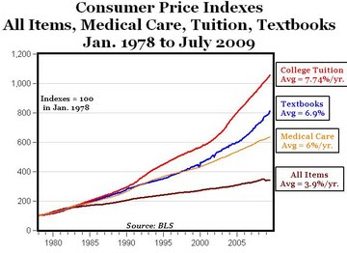
Costs, inflexibility, & wasted effort:
The Textbook Problem
College Tuition
Average: 7.7% / year
Textbooks
Average: 6.9% / year
Medical Care
Average: 6% / year
All Items
Average: 3.9% / year
The cost of college textbooks (BLS category "educational books and supplies") has risen much higher than the overall CPI since 1978, almost 7% annually on average for textbooks versus less than 4% for all goods and services. Textbook prices have increased faster than even the cost of medical care (6%).

Slide 3
The ChemWiki:
A Textbook Solution
Hypertextbook
Core Resources
Customized Wikitexts
The solution must be decoupled from large scale publishers
The solution requires flexibility
The solution requires low or no costs
The solution requires ease of adoption
The solution requires wide-spread use
The solution requires pedagogy
Hyperlinks
Hyperlinks
The
ChemWiki
Instructors’ Resource
Class Approaches
Applications
Novel Methods
SARIS
Leveling up
Student Skill Analysis
Homework
But most of all, the solution requires YOU
Hyperlinks
Enhancing Undergraduate Chemistry Education with the Online Dynamic ChemWiki Resource, Ronald J. Rusay, Michelle R. McCombs, Matthew J. Barkovich, Delmar S. Larsen, Journal of Chemical Education, 88 (6), p 840 (2011).

Slide 4

THE CHEMWIKI IS A WIKI
The Chemwiki follows the established Wiki architecture to allow contributors to add and modify content using an intuitive easy-to-use language. The most popular example of a Wiki is the Wikipedia encyclopedia project that has developed into the largest reference website on the Internet and has recently demonstrated comparable scientific accuracy to more established sources of information like the Encyclopedia Britannica.
The fundamental difficulty in using the existing Wikipedia entries as an ad hoc online textbook, with its open authorship nature, is that its information has not been validated by experts.

Slide 5
WHAT IS REQUIRED TO BE A CONVENTIONAL TEXTBOOK SUBSTITUTE?
The ChemWiki, as an open-access resource, must be:
1) free for students to use
2) sufficiently flexible to target students at multiple levels of education
3) sufficiently portable to be implemented at departments at differing academic stages
4) pedagogical by including students effort in its construction
5) effective as a constructive tool for evaluating student performance and assessment of exam and homework questions.
THE SUBSTITUTE MUST BE A LIVING RESOURCE IMPLIMENTED BY THE PEOPLE THAT USE IT

Slide 6
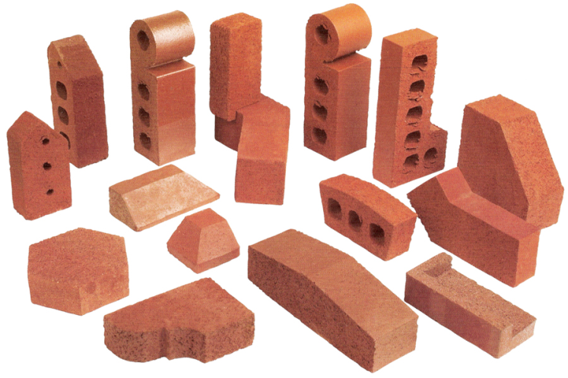
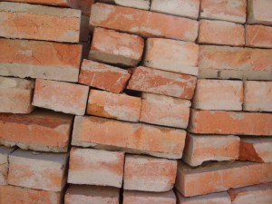
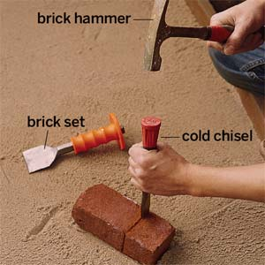
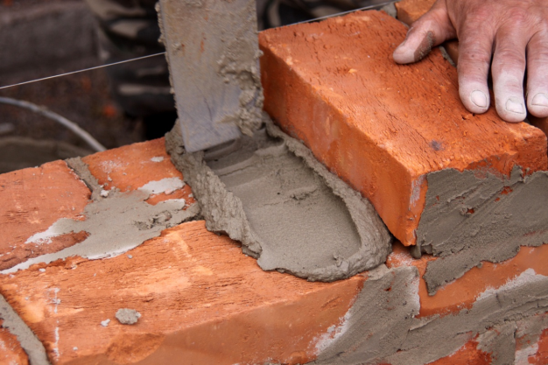
Building the Dynamic Textbook Project

Slide 7
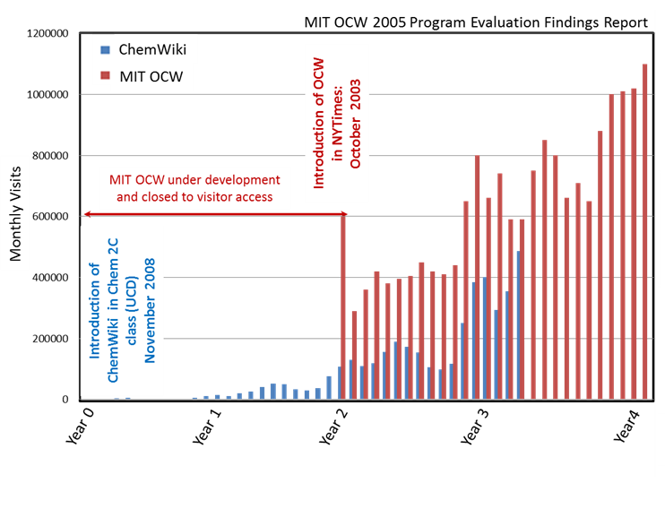
Current Impact of the ChemWiki (traffic statistics)
ChemWiki (blue) and MIT’s OpenCourseWare (red)
Current Statistics
7 M visitors annually (current)
11.4 M pagesviews annually
71,680 hours of confirmed reading & writing
358,404 hours estimated
387 hours confirmed yesterday
and 1937 hours estimated
Growing exponentially (3x per year)
Only Volunteer Effort to date
No active publicity plan (only word of mouth)
No major funding (> $5k)
Both projects are started at their respective time zero marks (2000 for MIT OCW and 2008 for ChemWiki). Dashed line is the linear extrapolation based on the last 6 months of growth for the ChemWiki. MIT did not open up the OCW to visits until 2 years into development.

Slide 8
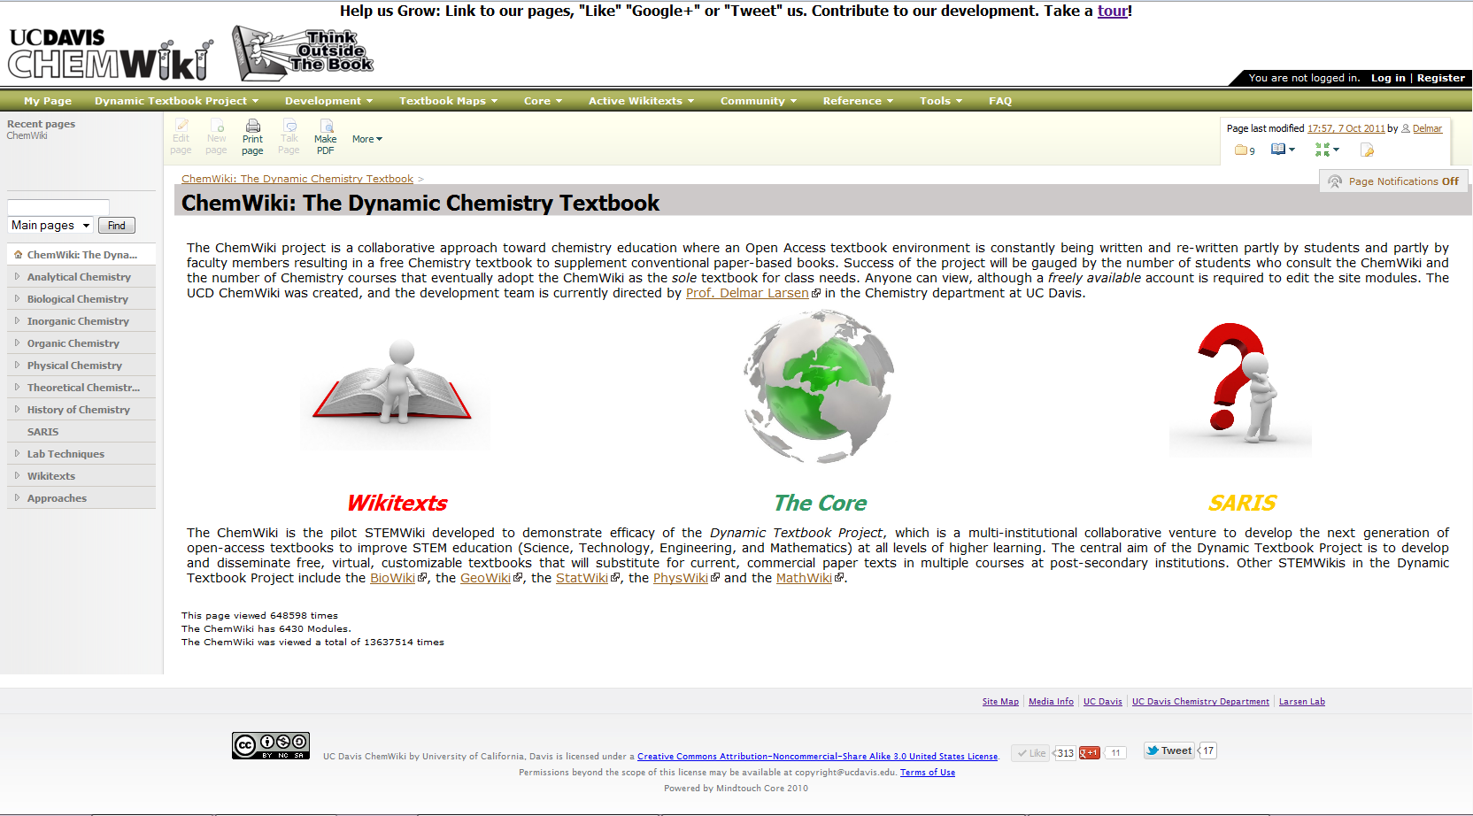
What Does the ChemWIki look like?

Slide 9
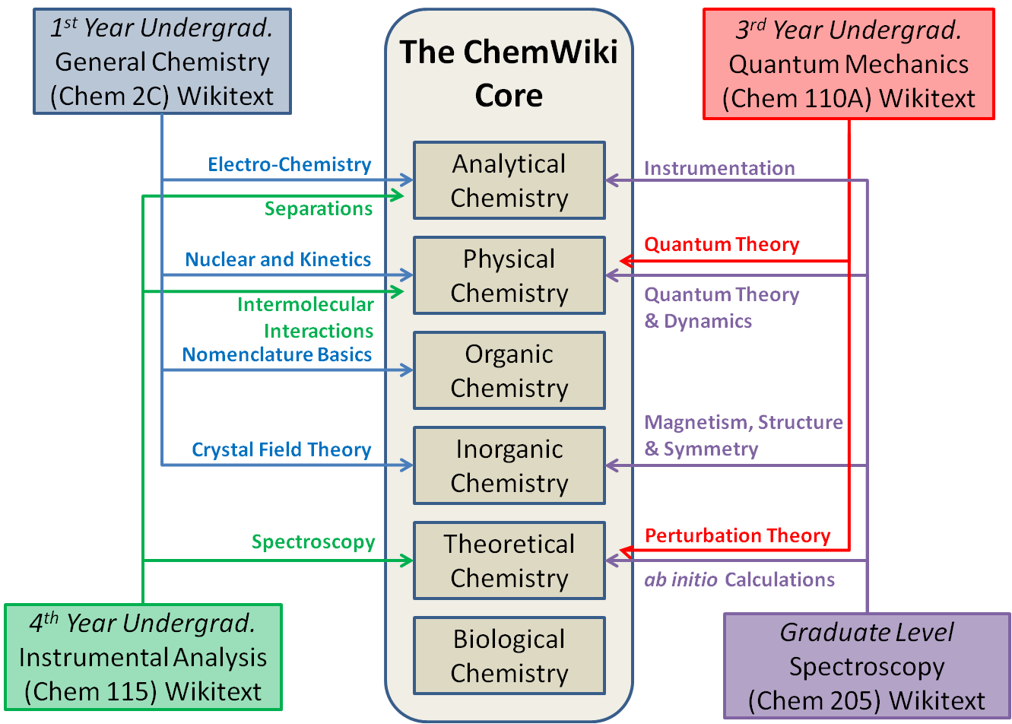
THE CORE/WIKITEXT APPROACH ENABLES FLEXIBILITY
http://chemwiki.ucdavis.edu/Wikitexts

Slide 10
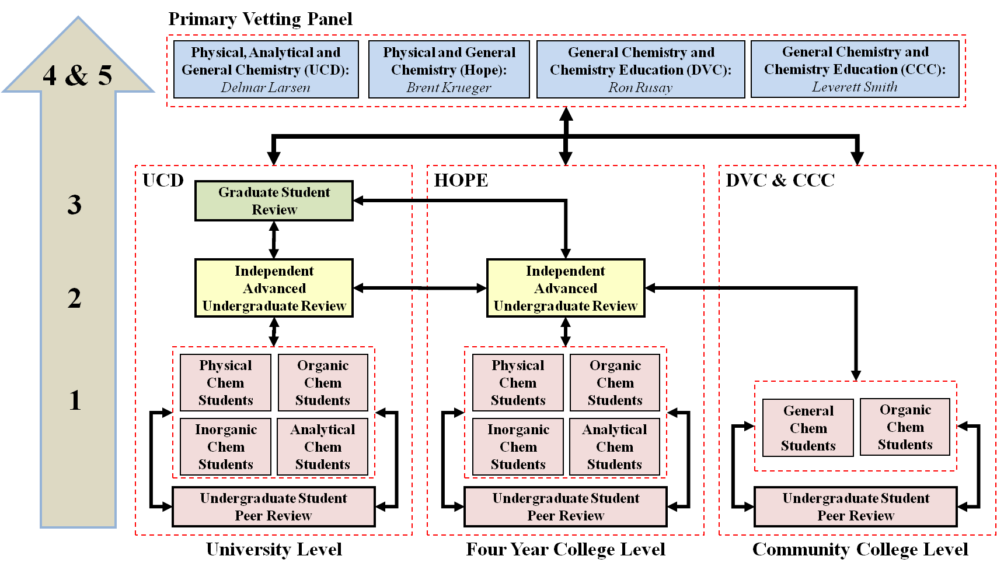
FLEXIBILITY MUST BE INTEGRATED IN CONSTRUCTION

Slide 11
THE POWER OF WIKI
The validity of the content on a Wiki is only as accurate as the contributors to the wiki
Students
  Extra Credit
  Forced Requirements
  Honor Contracts
  Extra Studying
  Undergrad Credit
Faculty
  Increased Writing
  Decreased Expenses
  Use of non-2D capabilities (e.g., orbitals and lattices)
  Movies
  Demonstrations
Non-Academic Contributors
  Company Support
  Sincere interest in the open access concept
  Review Modules
  Blogs
Trying to build a community effort toward a common goal
Notes:
Wikis are a great way to get everyone involved in learning by encouraging students to create knowledge, rather than passively absorb it. The wiki can come to be seen as an ever growing database, a review source, and a message board for the entire class.

Slide 12
CURRENTLY 3,000 CHEMWIKI AUTHORS
dlarsen (9475 edits)
rncurtis (1676 edits)
mbarko (927 edits)
dmadsen (491 edits)
Osibanjo Richard (331 edits)
krmalley (229 edits)
David Lam (214 edits)
Hua Serenus (207 edits)
Tamara Kadir (175 edits)
Wei Wei (174 edits)
Kevin MacDow (166 edits)
Benjamin Strong (139 edits)
Kelly Louie (137 edits)
Harpreet Sihota (134 edits)
Ezen Choo (131 edits)
Daniel Kim (124 edits)
Alex Ketchum (117 edits)
Stephanie Lee (111 edits)
Lance Peery (111 edits)
Anna Manis (110 edits)
Andrew Franks (108 edits)
Gee Sarah (107 edits)
Jessica Lin (102 edits)
Pwint Zin (99 edits)
Elizabeth Weidenhaft (98 edits)
Aleksandra Milman (97 edits)
Kyung Sun Park (93 edits)
Kaleb Topp (90 edits)
Anha Whiteman (87 edits)
Parminder Kaur (86 edits)
dcpearson (85 edits)
Nora Kuiper (85 edits)
Sarah Cohen (84 edits)
Gilbert Torres (84 edits)
Elizabeth Sproat (76 edits)
Adam Abudra (75 edits)
Kim Quach (74 edits)
jdfregeau (74 edits)
phtlam (72 edits)
Duyen Dao-Tran (72 edits)
Seo You Jin (71 edits)
Daniel Chong (71 edits)
Duy Dang (69 edits)
Michelle Hoang (68 edits)
Matthew McKinnell (66 edits)
Paul Navo (65 edits)
Ali Alvandi (65 edits)
Ashive Sharma (63 edits)
Joseph Chou (63 edits)
Kles Keren (63 edits)
Mustafa Rupawalla (62 edits)
Heather Voigt (60 edits)
Satish Balasubramanian (59 edits)
Minh Nguyen (58 edits)
Sukhpal Dhanjal (57 edits)
Amber Quave (56 edits)
Shivam Nand (56 edits)
Sandy Algaze (55 edits)
Wong Diana (54 edits)
Anhthu Do (54 edits)
Shravan Rao (54 edits)
Jeffrey Hu (53 edits)
Wong Ray (52 edits)
Jim Hughes (52 edits)
Tilak Koilvaram (49 edits)
Lyudmyla Demyan (49 edits)
Amandeep Bains (49 edits)
smgottlieb (49 edits)
Aimee Kindel (49 edits)
Woods Jessica (48 edits)
Jennifer Lew (48 edits)
Kirtan Patel (48 edits)
Chin Kan (48 edits)
Kristin Dittenhafer (48 edits)
Kelly Cox (47 edits)
Jeffrey Ma (46 edits)
Zifeng Tang (46 edits)
Minalie Jain (45 edits)
Kristen Perano (45 edits)
jsnijmeh (44 edits)
gmmetz (43 edits)
Sureyya Ozcan (43 edits)
Ravjot Takhar (43 edits)
Jacquelyn Lewis (43 edits)
Abel Silva (42 edits)
Townsend Troy (42 edits)
Sherie Fung (42 edits)
Peacock Kyle (42 edits)
Harpreet Chima (40 edits)
Tien Nguyen (40 edits)
Nicole Peiris (39 edits)
Albert Law (39 edits)
Dan Matheson (39 edits)
jdhosfelt (39 edits)
andyi (38 edits)
Paul Tisher (37 edits)
Elise de Gandiaga (37 edits)
Kris Restel (37 edits)
Harry Tseng (37 edits)
Skender Najibi (37 edits)
Yen Tran (36 edits)
alschmidt (36 edits)
Stevie Maxwell (36 edits)
Saul Jacob (35 edits)
Hai Le (35 edits)
Ekrim Ahmed (35 edits)
Mario Sepulveda (34 edits)
Rebecca Davidson (34 edits)
Thuy Hoang (34 edits)
Zachary White (34 edits)
kwch (33 edits)
Donglin Lao (33 edits)
Ramie Hosein (33 edits)
Katherine Barrett (33 edits)
Neele Holzenkaempfer (33 edits)
Sharmatha Devarajan (32 edits)
Vicky Vo (32 edits)
Wilder Alan (32 edits)
Steffanie Long (32 edits)
Leah Hughes (32 edits)
Galaxy Mudda (32 edits)
Jonathan Parrish (32 edits)
Gao Hong (31 edits)
Antonette Anunciacion (31 edits)
Simarjit Batth (31 edits)
Brittani Farqumarson (30 edits)
Ning Xia (30 edits)
William Sheppard (30 edits)
Eric Gobrogge (29 edits)
Roger Fan (29 edits)
Geal Ozery (29 edits)
Mario Morataya (29 edits)
Ivy Gardner (28 edits)
Huy Phan (28 edits)
bpkrueger (27 edits)
Anastasiya Kamenko (27 edits)
Busby Erik (27 edits)
Marisol Ahumada (26 edits)
Kathy Wong (24 edits)
Krystianne Yamuni (24 edits)
Kristine Der (24 edits)
sarshah (24 edits)
Devan Patel (24 edits)
Amar Patel (23 edits)
Natasha Singh (23 edits)
Trung Nguyen (23 edits)
Sarah El Mossalamy (22 edits)
Ehsan Ejaz (22 edits)
Kristen Kelly (22 edits)
Catherine Nguyen (22 edits)
Abraham Campos (22 edits)
Kelsy Horvath (22 edits)
dpland (21 edits)
Vi Nguyen (21 edits)
Parisa Pourheidari (21 edits)
Nilshita Devi (20 edits)
kcmccarthy (20 edits)
Lana Alawwad (20 edits)
Joyce Ho (20 edits)
Xu Yuntao (20 edits)
Carl Yen (19 edits)
Jenna Rowe (19 edits)
frahim (19 edits)
Justin Hosung Lee (19 edits)
Ciara Murphy (18 edits)
student2 (18 edits)
wahmad (18 edits)
Kabasakal Burak (18 edits)
Caroline Tran (18 edits)
Dherain Patel (18 edits)
thepoole (18 edits)
Bao Kha Nguyen (17 edits)
Rebecca Brotslaw (17 edits)
Jaspreet Dheri (16 edits)
Gil Levy (16 edits)
Pamela Chacha (16 edits)
Kimberley Mason (15 edits)
Laura Lan (15 edits)
Evelyn Hang (15 edits)
Thach Nguyen (15 edits)
Ashley Villanueva (14 edits)
Abhiram Kondajji (14 edits)
Christina Rabago (14 edits)
Christina Kim (14 edits)
jhgrebenkemper (14 edits)
kmreid (13 edits)
Ommaima Khan (12 edits)
Calvin Ly (12 edits)
Rohin Ambaram (12 edits)
Rebecca Shragge (12 edits)
Patrisha Reyes (12 edits)
Julie Choe (12 edits)
Jennifer Yip (12 edits)
Chris Wen (12 edits)
etdwyer (12 edits)
Kain Escobar (11 edits)
jrberg (11 edits)
Jaymar Elen (11 edits)
Huang Huang (11 edits)
Ishan Nagpal (11 edits)
Joseph Lasiter (11 edits)
ceroman (11 edits)
Charlene Lumanlan (10 edits)
Rishal Ambaram (10 edits)
Naeem Ahmad (10 edits)
Michele Salles (9 edits)
Jorge Camacho (9 edits)
Gianna Navarro (9 edits)
Erica Chen (9 edits)
Andrea Bell (9 edits)
Lloyd McCarthy (9 edits)
lduong (9 edits)
acquiroga (9 edits)
Tandis Arani (9 edits)
Amanda Gonzalez (8 edits)
Harut Ghukasyan (8 edits)
Michael Abdelnour (8 edits)
Harpreet Singh (8 edits)
Chettra Prum (8 edits)
Kelly Holt (8 edits)
Linda Tsang (8 edits)
Tinuke Fashokun (7 edits)
Sana Akhtar (7 edits)
Megan Maurano (7 edits)
Ftsum Yosef (7 edits)
Angelica Cardiel (7 edits)
Diana Alvarado (6 edits)
Timothy Shannon (6 edits)
Susan Taing (6 edits)
Irene Ramirez (6 edits)
Oscar Valenzuela (6 edits)
bjschultz (5 edits)

Slide 13
THE CHEMWIKI ENCOURAGES EDUCATION WITH NON-TRADITIONAL APPROACHES
Improve students’ technical writing skills
Promote participation by using student centered content and comments
Encourage students to identify and summarize key concepts and important ideas concisely
Develop research and technical skills including the use of the primary scientific literature, and discipline specific software and databases
Encourage students to apply their chemistry (and science) knowledge outside the classroom
Help students identify different audiences and adapt their writing appropriately
Promote peer collaboration and review.

Slide 14





Modular Vetting Ratings
MODULES ARE COLOR CODED ACCORDING TO VETTING LEVEL
no color | 0 | No construction to date
Red | 1 | No vetting
Yellow | 2 | Vetting by two Undergraduate or one Graduate student
Green | 3 | Vetting by two Graduate Students
Blue | 4 | Vetted by one Chemistry Expert (Faculty)
Grey | 5 | Fully Vetted by two or more Chemistry Experts (Faculty)
EACH MODLE IS ALSO RANKED WITH A RATING CREST
Content Level | Indicator Crest | Primary Target Audience
Basic Chemistry |  | Chemistry for a general audience with little or no chemistry experience
Fundamental Chemistry |  | High school and Freshmen level content
Lower Divisional Chemistry |  | Sophomore and Junior content
Upper Divisional Chemistry |  | Junior and Senior Level content
Graduate Chemistry |  | Graduate Level content

Slide 15
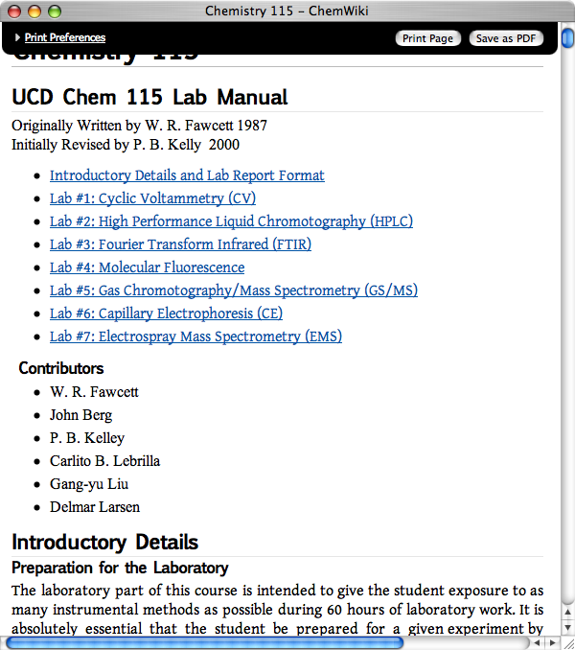
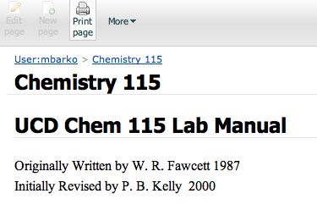
INSTANT HARD COPIES OF MAGES OR WIKITEXT VIA INTEGRATED PDF WRITER

Slide 16
THE GREATER “DYNAMIC TEXTBOOK PROJECT”
BioWiki
http://BioWiki.ucdavis.edu
GeoWiki
http://GeoWiki.ucdavis.edu
ChemWiki
http://ChemWiki.ucdavis.edu
PhysWiki
http://PhysWiki.ucdavis.edu
StatWiki http://BioWiki.ucdavis.edu
MathWiki
http://BioWiki.ucdavis.edu
“STEMWikis”

Slide 17
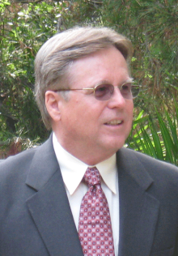
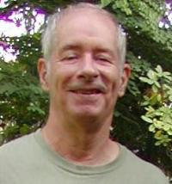
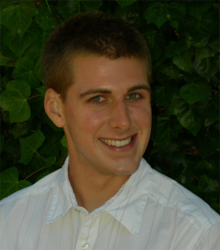
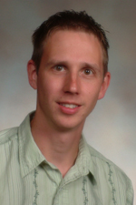

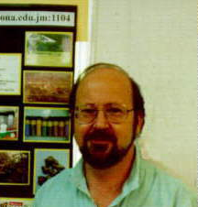
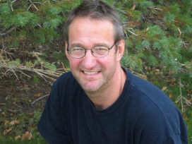
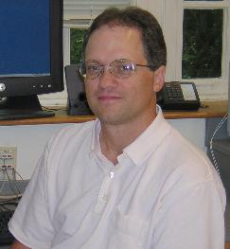
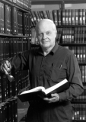
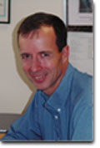
TOO MANY PEOPLE TO ACKNOWLEDGE
Ron Rusay, (Diablo Valley College)
Stephen Lower, Professor Emeritus (Simon Frasier U.)
Matt Barkovich (Medical school at UCSD)
Brent Krueger
(Hope College)
Laurence I. Peterson (Kennasaw State University).
Tim Soderberg (University of Minnesota, Morris)
David Blauch (Davidson College)
Robert J. Lancashire (University of the West Indies)
William Reusch, Professor Emeritus (Michigan State U.)
AND MANY MANY MORE…
Charles A. Wight
(University of Utah)
http://chemwiki.ucdavis.edu/Wikitexts/Development_Details/Contributors

Slide 18
The ChemWiki:
Anyone, Anywhere, Anyway
an Outsider’S COMMENT
“Before writing off ChemWiki as something that can't possibly work in practice, consider how Wikipedia was viewed when initially launched. Creating a textbook in a technical subject such as chemistry and creating a general-purpose encyclopedia may not both be equally suited to the Wikipedia model - only time will tell. One thing is clear: the economic model on which the current system of textbook publication is based may not remain viable for much longer. ChemWiki offers an intriguing alternative”. -- Rich Apodaca (http://zusammen.metamolecular.com)

