Slide 1
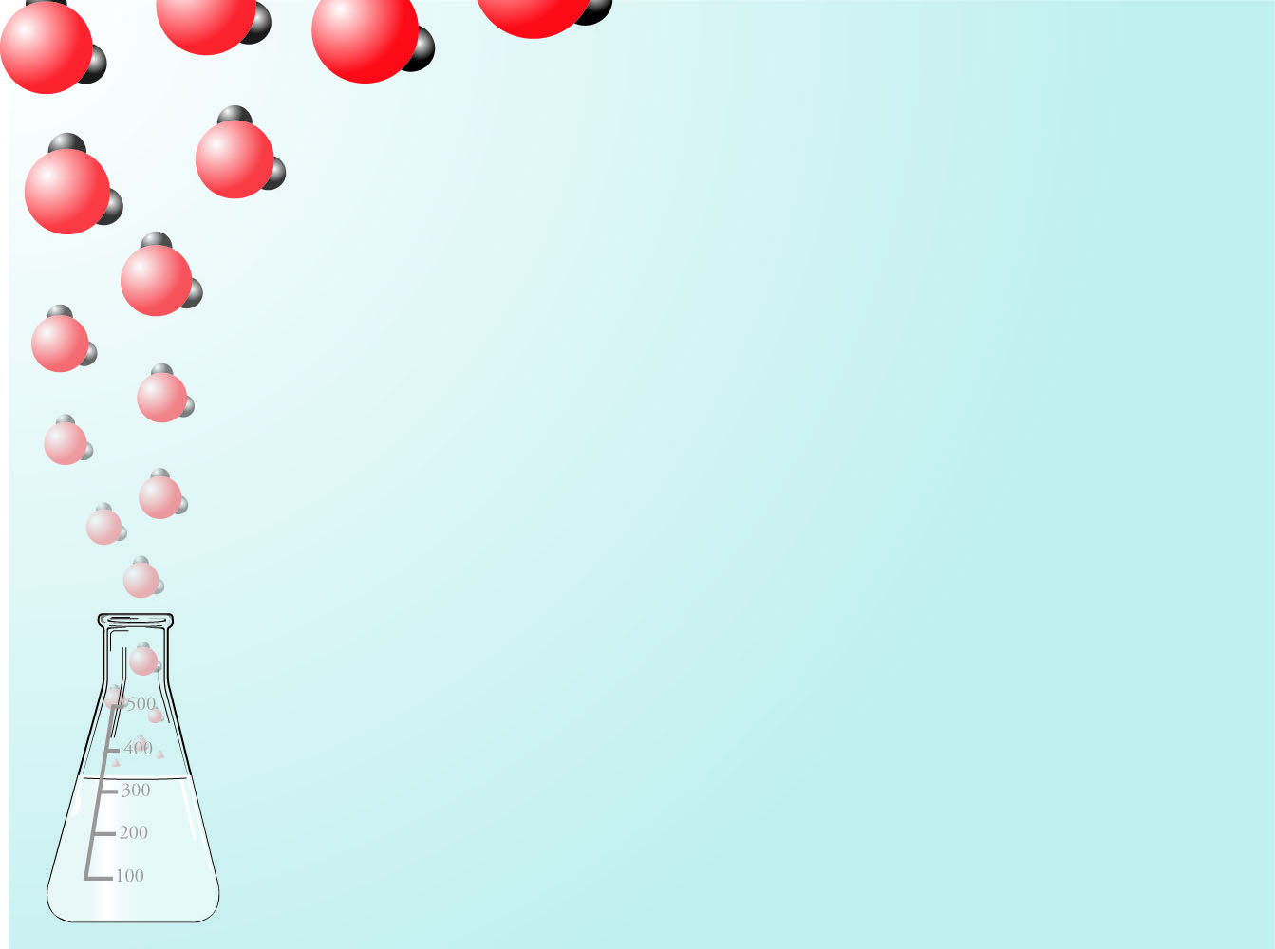
Lectures 4 and 5: Science and Technology
An Introduction to Organic Chemistry, Biochemistry, and Chemical Weapons

Slide 2
Organic Chemistry
Organic chemistry is the chemistry of carbon-based compounds.
There are two reasons why there are millions of organic chemicals.
Carbon atoms can form strong bonds to other carbon atoms and still form bonds to atoms of other elements.
There are many different ways to arrange the same atoms in carbon-based compounds.

Slide 3
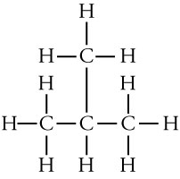
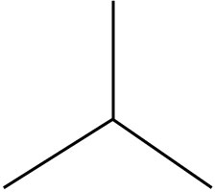
Ways to Describe Organic Compounds
Lewis structures
Condensed Formulas
CH₃CH(CH₃)CH₃
Line Drawings

Slide 4

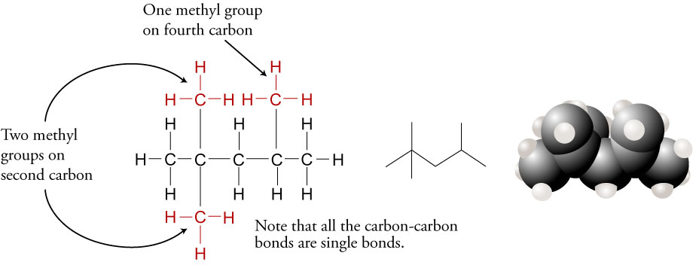
Alkanes - Hydrocarbons (compounds composed of carbon and hydrogen) in which all of the carbon-carbon bonds are single bonds
2,2,4-trimethylpentane, CH₃C(CH₃)₂CH₂CH(CH₃)CH₃

Slide 5
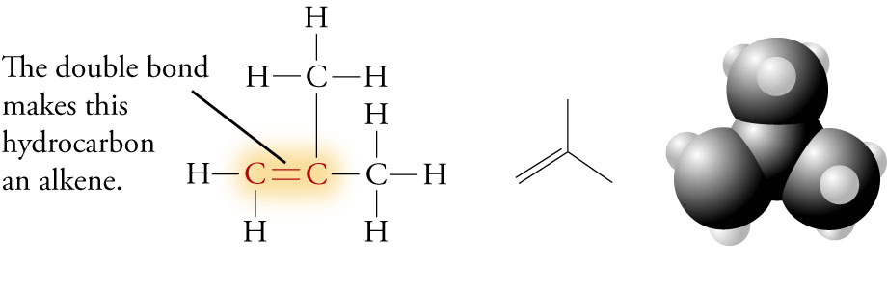
Alkenes - Hydrocarbons that have one or more carbon-carbon double bonds
2-methylpropene (isobutene), CH₂C(CH₃)CH₃

Slide 6
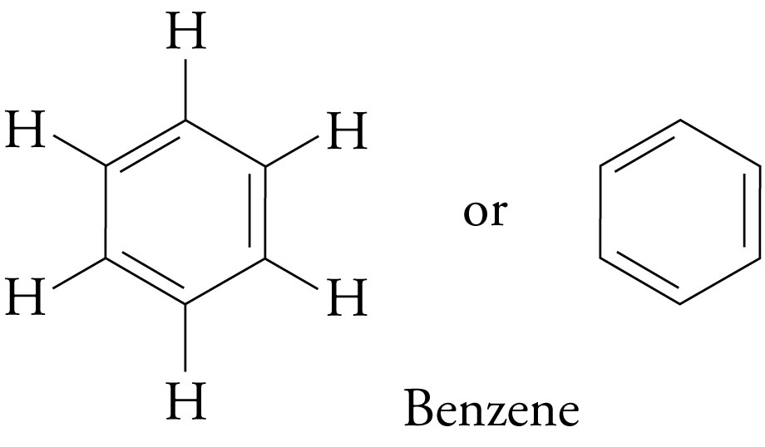
Benzene

Slide 7
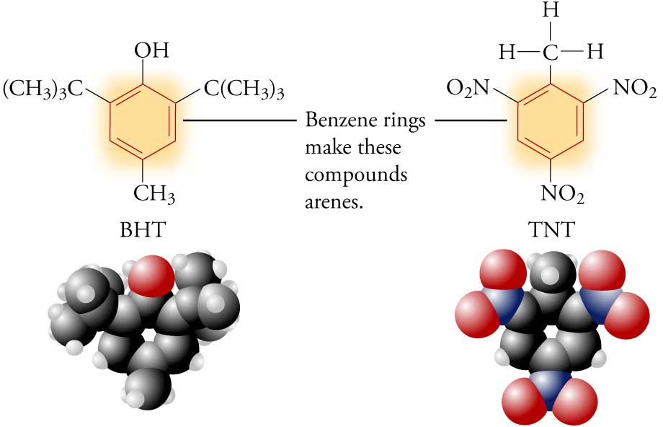
Arenes (or Aromatics) - Compounds that contain the benzene ring

Slide 8
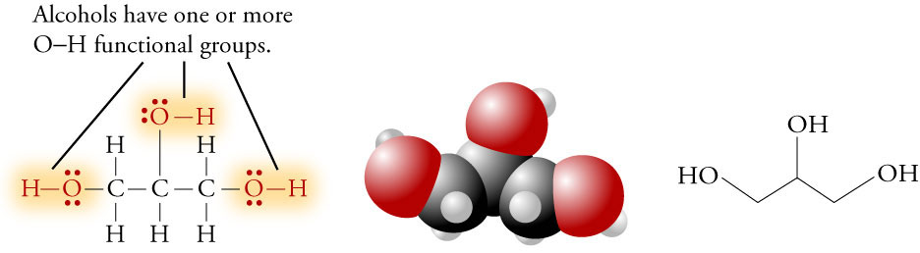
Alcohols - compounds with one or more -OH groups attached to a hydrocarbon group
Glycerol, HOCH₂CH(OH)CH₂OH

Slide 9
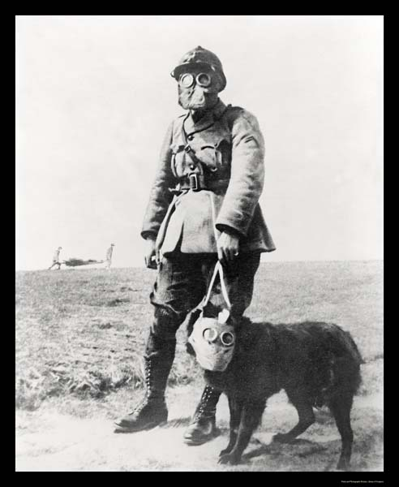
Chemical Weapons (CW)
Chemical weapons are “man-made, supertoxic chemicals that can be dispersed as a gas, vapor, liquid, aerosol (a suspension of microscopic droplets), or adsorbed onto a fine talcum-like powder to create dusty agents.” (Jonathan Tucker)
Special gas mask for dogs-1917

Slide 10
Classification of Chemical Weapons
Lethal agents – kill quickly with small quantities
Nerve agents
Blood gases
Incapacitants
Choking agents
Blistering agents
Tearing agents
Opiate-like agents

Slide 11
Choking Agents
Diphosgene, phosgene, chlorine, chloropicrin
Mode of Action: Inhalation
Physiological Effects
Agent inhaled into lungs
Fluid builds up in lungs & victim chokes on own fluid
“Dry land drowning”
Victim can die of oxygen deficiency
Form When Disseminated: Gas
Required Defensive Gear: Protective Mask
Notes:
Choking agents were among the first CW agents developed and were used extensively during World War I. These gases are relatively heavy compared to air, which meant they tended to remain close to the ground and fill depressions -- a characteristic particularly well suited to the trench warfare that dominated the battlefield at that time. The Germans used choking agents for the first time at Ypres in 1915, when they released 150 tons of chlorine along a four-mile front and inflicted 20,000 French and British casualties, including 5000 fatalities. Chlorine and Phosgene (used, most recently, in a 1995 terrorist attack in a Yokohama, Japan subway) are the best known members of this group of agents, which is named for the effects of these agents on human physiology. Inhaled in sufficient quantities, these gases induce pulmonary edema and cause the lungs to fill with fluid, ultimately choking the victim with his or her own fluid.
However, despite the fact that the technology and knowledge used to make these first generation agents is widely available, they are relatively less attractive to potential proliferants since they are ill-suited to most modern chemical warfare situations, for a number of reasons. First, they have an odor and create irritation which alerts the victim to their presence and alerts personnel time to don protective masks. Second they are slow acting and require high concentrations to reach lethal levels. Finally the high volatility rate (the speed at which an agent evaporates) of most choking agents reduces their utility for many combat situations. Nonetheless, it is important to remember that these agents can still be extremely dangerous to unprotected soldiers and civilians, as the first use at Ypres illustrated.

Slide 12
Blister Agents (Vesicants)
Sulfur mustard, nitrogen mustard, phosgene oxime, Lewisite
Mode of Action: Inhalation, Skin Contact
Physiological Effects
Burns skin, mucous membranes, and eyes, causing large water blisters on exposed skin
Causes damage primarily to upper airways
Primarily used to cause medical casualties, but can be lethal when large amounts are inhaled
Form When Disseminated: Liquid, Aerosol, Vapor, Dust
Required Defensive Gear: Protective Mask & Clothing

Slide 13
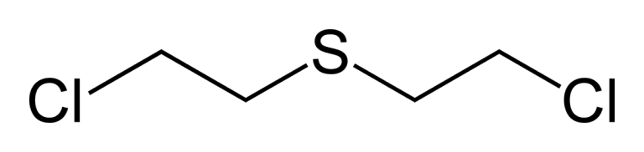
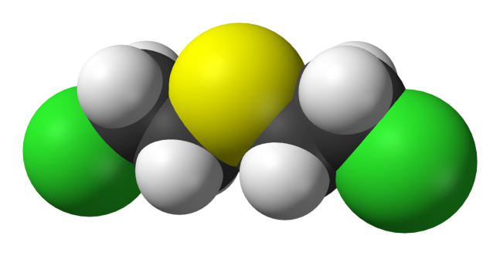
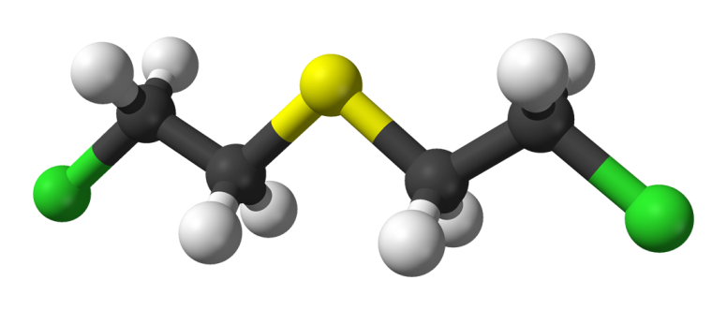
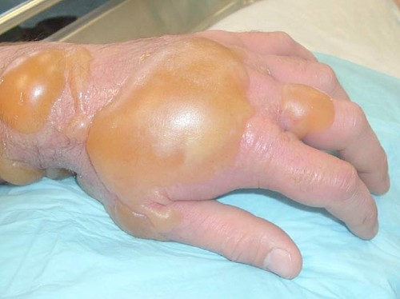
Sulfur Mustard Gas, H or HD
Although it was first made in the 19th century, it was developed by Haber and other German chemists to be used as a weapon.
Called “mustard” because of its horseradish- or garlic-like smell.
It is fat-soluble, so it dissolves in the oils in the skin, causing severe chemical burns and blisters.
http://chemapps.stolaf.edu/jmol/jmol.php?model=ClCCSCCCl

Slide 14
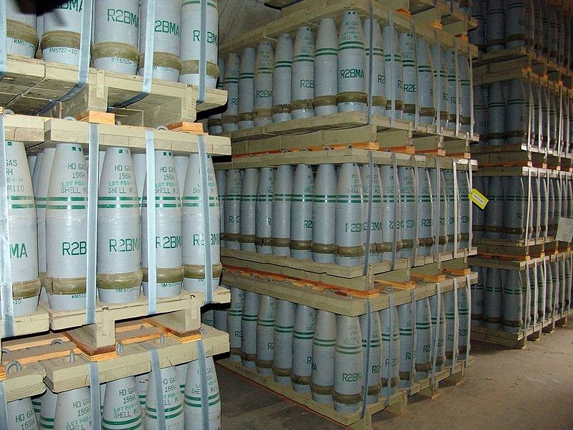
Sulfur Mustard Military History
Used first by Germans in WWI in 1917.
Captured mustard gas shells used by Allies in 1917.
Later dispersed as an aerosol, in aerial bombs, land mines, mortar rounds, artillery shells, and rockets.
It can remain on the ground for weeks, making the area dangerous long after its dispersal.
155 mm artillery shells that contained "HD" (distilled sulfur mustard agent) at Pueblo chemical weapons storage facility

Slide 15
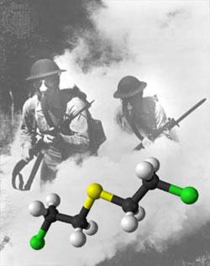
Sulfur Mustard Military History
1919: United Kingdom against the Red Army
1921-27: Spain and France against insurgents in Morocco
1930: Italy in Libya
1934, 1936-37: Soviet Union in China
1935-40: Italy against Abyssinia (now Ethiopia)
1937-45: Japanese against China
1963-67: Egypt against North Yemen
1983-88: Iraq against Iran and the Kurds
1995, 1997: Possibly Sudan against insurgents in their civil war

Slide 16
Sulfur Mustard Treatment
Early rinsing of the exposed area with Betadine (providone-iodine) dissolved in glycofural will reduce symptoms.
Can limit the formation of blisters by applying household bleach or a solution called DS2 (2% sodium hydroxide, NaOH, 70% diethylamine, CH₃CH₂NHCH₂CH₃, and 28% ethylene glycol monomethyl ether, CH₃OCH₂CH₂OH)
After initial treatment, the patient is treated in the same way that any burn victim would be treated.
Because the symptoms do not appear for about 24 hours, it less likely that the treatments would be done in time to avoid problems.
Fatal in about 2% of exposures, so mostly used as an incapacitating agent.

Slide 17
Sulfur Mustard (cont.)
“H” usually refers to an impure form of sulfur mustard with 20-30% impurities…has short shelf-life. It is relatively easy to make.
“HD” refers to a more pure form (96% pure) that can be stored longer.
Adolf Hitler claimed he was exposed to mustard gas in 1918 and temporarily blinded. He may have been trying to cover up hysterical blindness.
Disposal (more later)
Before 1972, dumped at sea
Incineration
Chemical neutralization (chemical conversion to safe substances)

Slide 18
Effect of Sulfur Mustard on DNA
Sulfur mustard forms a sulfonium ion, which attaches to the guanine nucleotide of DNA, disrupting cell division and function. This can lead to cellular death or cancer.
a “sulfonium” cation

Slide 19
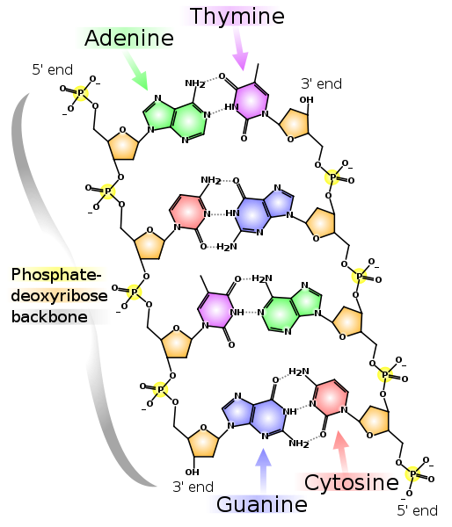
DNA Segment

Slide 20
Difference Between Theoretical and Actual Effects
The ability of CW agents to kill or hurt people depends on a number of factors, such as:
Quality of agent
Means of delivery
Environmental factors
Illustration:
In theory, less than a teaspoon of mustard gas can kill if it is inhaled into the lungs. Yet in WW I, more than 60 pounds of mustard gas were used for each man killed or wounded. Only 2% of the people affected by mustard gas actually died.

Slide 21
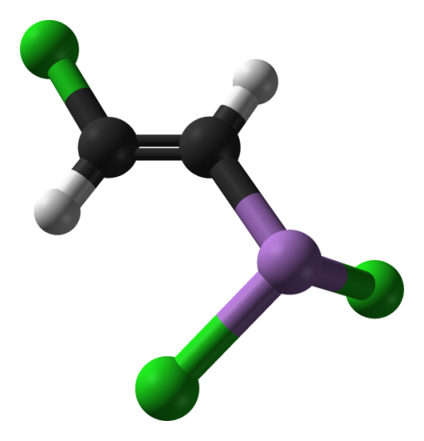
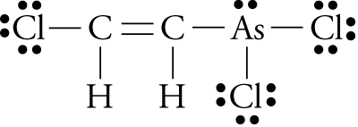
Lewisite
Easily penetrates ordinary clothing
Upon skin contact immediate pain and itching with a rash and swelling. Large blisters (similar to those caused by mustard gas) develop after approximately 12 hours
Can cause systemic poisoning leading to liver damage or death.
Inhalation causes a burning pain, sneezing, coughing, vomiting
Ingestion results in severe pain, nausea, vomiting, and tissue damage.
http://chemapps.stolaf.edu/jmol/jmol.php?model=Cl[As]%28Cl%29\C%3DC\Cl

Slide 22

Lewisite (L)
Oily, colorless liquid in its pure form and can appear amber to black in its impure form.
Odorless when pure…smells like geraniums in impure form.
Produced in the U.S. in 1918 to be used in World War I, but its production was too late for it to be used in the war.
Used only as a chemical warfare agent
Blended with sulfur mustard to lower the freezing point for cold weather use
No medical or other practical use

Slide 23
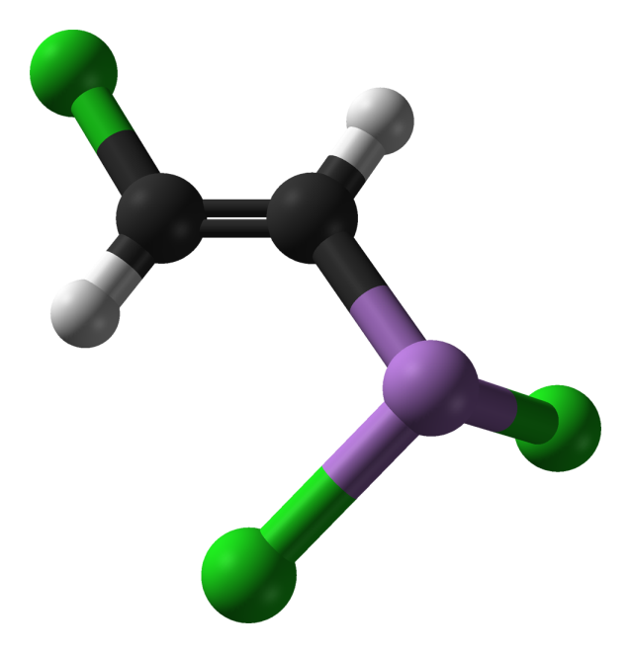
Lewisite
U.S. made 20,000 tons of it
Declared obsolete in 1950s
Most of U.S. stockpiles chemically neutralized with bleach and dumped in Gulf of Mexico
The destruction of the last of the lewisite stored in the U.S. at the Deseret Chemical Depot in Utah was completed 1/18/2012.

Slide 24
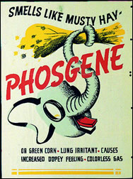
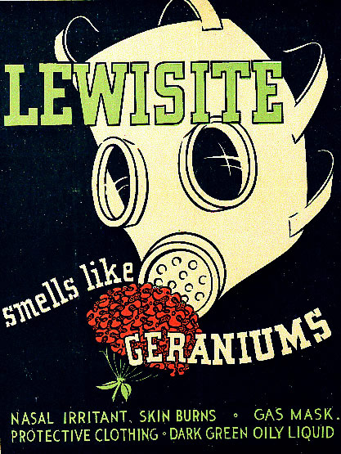
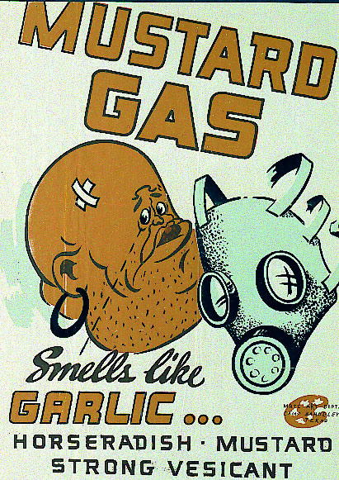
Description of Toxicity
LD₅₀ (median lethal dose) = the dose expected to kill 50% of the population exposed; typically in mg/kg of body mass
800 mg/kg (ppm) 30 mg/kg (ppm) 100 mg/kg (ppm)

Slide 25
World War I Casualties from Gas
Total Amount of Chemical Agents Used – 112,000 Tons
Nations | Non-fatal | Deaths | Total Casualties
Commonwealth Forces (Britain, Canada, Australia, New Zealand, India,...) | 180,597 | 8,109 | 188,706
France | 182,000 | 8,000 | 190,000
United States | 71,345 | 1,462 | 72,807
Italy | 55,373 | 4,627 | 60,000
Russia | 419,340 | 56,000 | 475,340
Germany | 191,000 | 9,000 | 200,000
Austria - Hungary | 97,000 | 3,000 | 100,000
Others | 9,000 | 1,000 | 10,000
Total | 1,205,655 | 91,198 (1.1% of total) | 1,296,853
Notes:
These extracts taken from ‘An Illustrated Companion to the First World War’ by Anthony Bruce. Published by Michael Joseph, London ISBN 0-7181-2781-1; www.roll-of-honour.com/ WorldWar1Overview.html

Slide 26
U.S. Chemical Warfare Service (CWS)
Formed in 1918
Headquartered at Edgewood Arsenal
Headed by General Amos Fries
When properly safe-guarded with masks and other safety devices, [chemical weapons give] the most scientific and most ingenious people an advantage over the less scientific and less ingenious…It is just as sportsman-like to fight with chemical warfare material as it is to fight with machine guns.
General Fries
Notes:
These extracts taken from ‘An Illustrated Companion to the First World War’ by Anthony Bruce. Published by Michael Joseph, London ISBN 0-7181-2781-1; www.roll-of-honour.com/ WorldWar1Overview.html

Slide 27
1925 Geneva Protocol
Protocol on the Prohibition of the Use in War of Asphyxiating, Poisonous or Other Gases, and of Bacteriological Methods of Warfare
Banned use first use of chemical and biological weapons but not their production and stockpiling
Adopted by the League of Nations
Within ten years, it was ratified by forty countries, including most of the majors powers except the U.S. and Japan.
Not ratified in U.S. for 50 years (General Fries lobbied against it, aided by a coalition of veterans' groups, the chemical industry, and the American Chemical Society.)
Many countries reserved the right to retaliate and therefore stockpiled chemical weapons.

Slide 28
CW Use in Interwar Period
Italian Use of CW in Ethiopia 1935-1936
sprayed mustard from planes and dropped aerial bombs with sulfur mustard
Italy argued that the protocol did not prohibit the use of chemical weapons in retaliation for war crimes.
estimated 15,000 casualties
Japanese against Chinese 1937-1945
Over 1,000 assaults with blister and incapacitating agents
Estimated 10,000 fatalities (99% military)
Estimated 84,000 casualties (80% military)

Slide 29
CW Use in Interwar Period
Japan began shipping CW to Manchuria in 1935.
In 1940, shipped 100,000 munitions to fight Soviets.
In 1945, retreating Japanese units dumped or buried CW stocks.

Slide 30
Blood Agents
Hydrogen cyanide, cyanogen chloride, and arsine
Mode of Action: Inhalation
Physiological Effects of Cyanide
Destroys ability of tissues to utilize oxygen
Form When Disseminated: Gas
Required Defensive Gear: Protective Mask

Slide 31
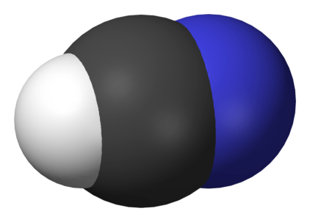

Hydrogen Cyanide, HCN
Volatile liquid – boiling point 26 °C (79 °F)
Used in industry to make many important chemicals
Fatal at concentrations as low as 300 mg/m³ in air.
Disrupts cellular respiration (the conversion of nutrients and oxygen into carbon dioxide, water, and energy) by inhibiting an enzyme in mitochondria.
Leads to dizziness, vomiting, loss of consciousness, and death
Most made from the following reaction at 1200 °C over a platinum catalyst.
2CH₄ + 2NH₃ + 3O₂ → 2HCN + 6H₂O

Slide 32
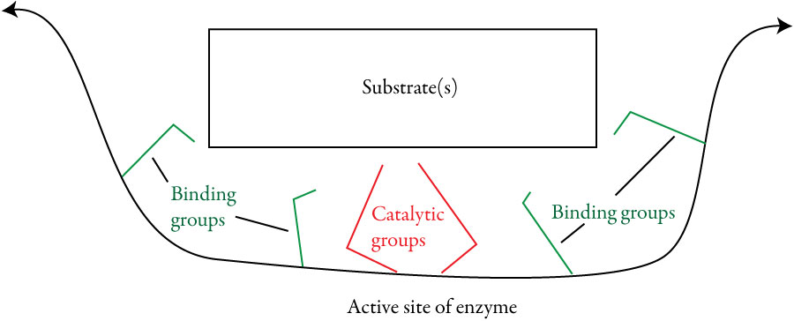
Enzymes
Enzymes are naturally occurring catalysts, primarily composed of protein. Catalysts speed chemical changes without being permanently altered themselves.
The chemicals that they act on are called substrates.

Slide 33
Enzymes
Very specific due to
Substrate shape – “Lock and Key”
Positions of binding groups, which attract substrates to the active site.
Positions of the catalytic groups that speed the reaction.
Speed chemical reactions because
Provide a different path to products that has more stable intermediates and therefore requires less energy.
Give the correct orientation every time.

Slide 34
Nerve Agents
Tabun, sarin, soman, cyclosarin, VX, Novichok
Modes of Action: Contact, Inhalation
Physiological Effects
Disrupt the mechanism by which nerves transfer messages to organs
Causes seizures and loss of body control
Exhausts muscles, including heart and diaphragm
Lethal dose can cause death from respiratory failure in five minutes
Form When Disseminated: Liquid, Vapor, Aerosol
Required Defensive Gear: Protective Mask & Clothing

Slide 35
Nerve Agents
Cause contraction of pupils, profuse salivation, convulsions, involuntary urination and defecation, and eventual death by asphyxiation as control is lost over respiratory muscles.
U.S. and the Soviet Union developed and stockpiled large quantities of nerve agents in a chemical arms race that mirrored the nuclear arms race.

Slide 36
Nerve Agents – Two Series
G-series
Produced by Germans
1936 – GA (tabun)
1939 – GB (sarin)
1944 – GD (soman)
1949 – GF (cyclosarin)
GA and GB less persistent after dispersal
V-series
More persistent after dispersal
Five well-known members
VX most important…first produced by the British in the 1950s

Slide 37
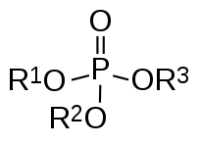
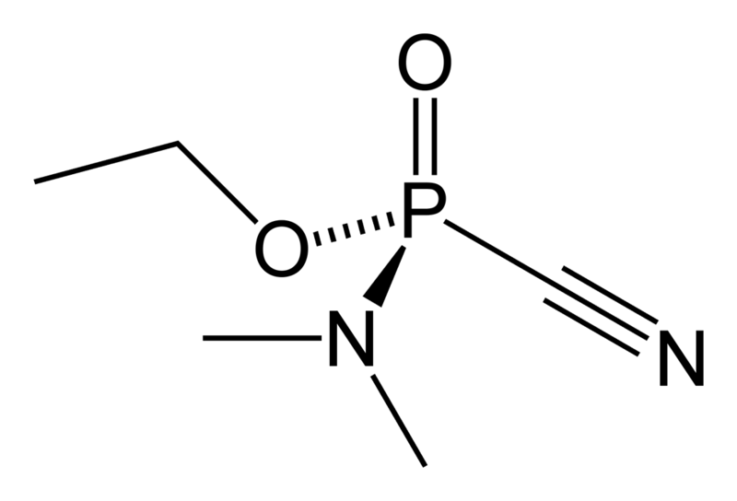
Nerve Agents
Discovered accidentally by German chemists developing pesticides.
Germany had the world’s most advanced chemical industry.
Searching for new organophosphate pesticides
Made many variations of the structure and tested them for potency.
One compound found to be very dangerous and therefore considered “taboo” (tabu in German)…called Tabun.
Notes:
Nerve agents are the CW agent of choice for most countries pursuing chemical weapons programs because they are the most lethal agents and can be produced from chemical processes very similar to those used to make pesticides and fertilizers. Nerve agents kill by repressing human brain centers responsible for managing respiration, thereby causing the body’s muscles to become constricted. This paralysis of the pulmonary musculature first induces spasms, to include vomiting and bodily excretions, and then death.
G-series CW agents such as Tabun (GA), Sarin (GB), and Soman (GD) and GF produce their incapacitating effects through both inhalation and contact. These are so-called “second-generation” agents that are very similar to pesticides and were, in fact, discovered in the 1930s by German chemists seeking new types of pesticides. G-series agents act rapidly (within seconds of exposure) and may be absorbed through the skin or the respiratory tract. However, some of these agents, particularly GA and GB, tend to be relatively nonpersistent and consequently present less of a skin hazard than a vapor hazard. in sufficient concentration, the ultimate effect of these agents is paralysis of the respiratory musculature and subsequent death. Exposure to a lethal dose may cause death in as little as several minutes. These less persistent agents are used to cause immediate casualties and to create a short-term respiratory hazard on the battlefield. Persistent G-series nerve agents such as GS and GF would present more of a skin hazard.
V-series nerve agents, including VE, VG, VM, VS, and VX, are compounds similar to, but more advanced than G-series nerve agents. Developed in the 1950s by the British, these agents tend to be more toxic and more persistent than G-agents. They present a greater skin hazard and are used to create long-term contamination of territory. Compared to most G-agents, VX, is primarily employed as a liquid, and it takes effect slightly less rapidly than aerosol nerve agents. The production process for nerve agents is widely known and requires only moderate manufacturing and chemical engineering capabilities. In order to gain some appreciation of the lethality of nerve agents, 10-15 mg of VX in contact with unprotected skin can kill an average man in just a few minutes. This means that if it were possible to deliver only that dosage to one person and no more, one gallon of VX could theoretically kill 382,000 people.

Slide 38
One Way to Do Science
Trial-and-error based on previous experience.
Steps taken by the German Gerhard Schrader working for the IG Farben chemical company and trying to make new pesticides.
Fluorine compounds are known to be toxic, so synthesized many different organic compounds with fluorine and tested them for toxicity to insects and safety for humans.
After no luck, tried adding first sulfur, then phosphorus, making a series of “organophosphate” compounds with promising characteristics.
To make the organophosphates more toxic, he added the cyanide group, which was known to be toxic, leading to tabun.
Noticed the adverse effects on himself after making it in the laboratory.
Notes:
Nerve agents are the CW agent of choice for most countries pursuing chemical weapons programs because they are the most lethal agents and can be produced from chemical processes very similar to those used to make pesticides and fertilizers. Nerve agents kill by repressing human brain centers responsible for managing respiration, thereby causing the body’s muscles to become constricted. This paralysis of the pulmonary musculature first induces spasms, to include vomiting and bodily excretions, and then death.
G-series CW agents such as Tabun (GA), Sarin (GB), and Soman (GD) and GF produce their incapacitating effects through both inhalation and contact. These are so-called “second-generation” agents that are very similar to pesticides and were, in fact, discovered in the 1930s by German chemists seeking new types of pesticides. G-series agents act rapidly (within seconds of exposure) and may be absorbed through the skin or the respiratory tract. However, some of these agents, particularly GA and GB, tend to be relatively nonpersistent and consequently present less of a skin hazard than a vapor hazard. in sufficient concentration, the ultimate effect of these agents is paralysis of the respiratory musculature and subsequent death. Exposure to a lethal dose may cause death in as little as several minutes. These less persistent agents are used to cause immediate casualties and to create a short-term respiratory hazard on the battlefield. Persistent G-series nerve agents such as GS and GF would present more of a skin hazard.
V-series nerve agents, including VE, VG, VM, VS, and VX, are compounds similar to, but more advanced than G-series nerve agents. Developed in the 1950s by the British, these agents tend to be more toxic and more persistent than G-agents. They present a greater skin hazard and are used to create long-term contamination of territory. Compared to most G-agents, VX, is primarily employed as a liquid, and it takes effect slightly less rapidly than aerosol nerve agents. The production process for nerve agents is widely known and requires only moderate manufacturing and chemical engineering capabilities. In order to gain some appreciation of the lethality of nerve agents, 10-15 mg of VX in contact with unprotected skin can kill an average man in just a few minutes. This means that if it were possible to deliver only that dosage to one person and no more, one gallon of VX could theoretically kill 382,000 people.

Slide 39
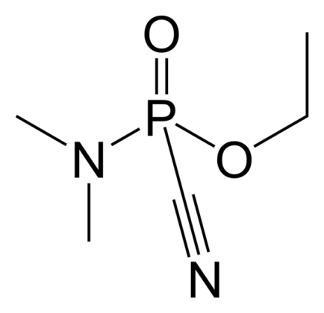
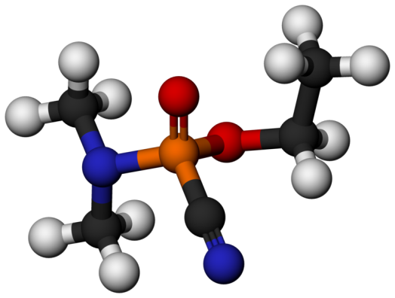
Tabun (GA)
First synthesized in 1936
Faint fruity odor…harder to detect than chlorine, phosgene, mustard gas, and hydrogen cyanide, which have more distinctive odors…troops less likely to put on gas masks
Not very volatile, which created problems with distribution
Not as stable as later nerve agents
Easier to produce than the other G-series agents (more later)
http://chemapps.stolaf.edu/jmol/jmol.php?model=N%23CP%28%3DO%29%28OCC%29N%28C%29C

Slide 40
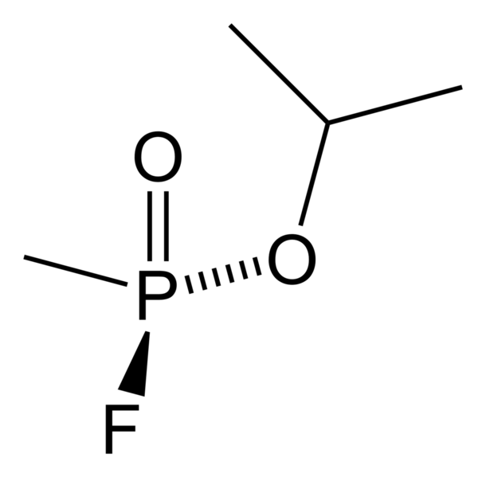
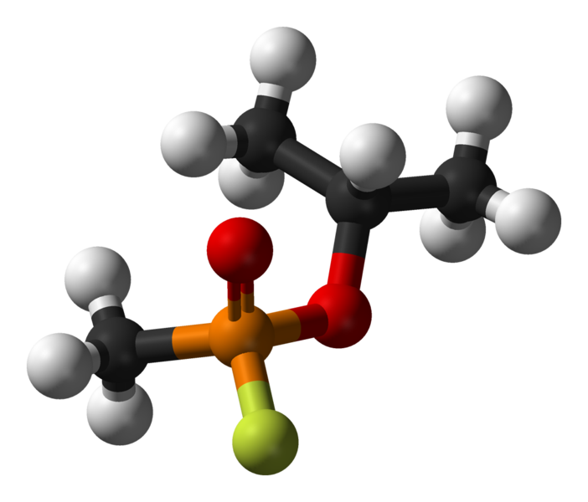
Sarin (GB)
Developed by the Germans in 1939
Named for four scientists who were important in its discovery…Schrader and Ambros of IG Farben and Rudiger and Linde or the German Army Ordinance Office
Odorless
Harder to make than tabun
More stable than tabun
More volatile than tabun
Six times as potent as tabun
Adopted as the standard nerve agent for the U.S. in 1948.
http://chemapps.stolaf.edu/jmol/jmol.php?model=FP%28%3DO%29%28OC%28C%29C%29C

Slide 41
Criteria for Selection for Military Use
Best combination of
High toxicity
Stability
Volatility
Nonflammability when explosively dispersed
Ease of decontamination
Availability of antidotes and protective drugs
Ease of production
Cost of production
Ease of transport

Slide 42
Sarin (GB)
If sarin does not have a high purity, it degrades fairly rapidly.
Its shelf-life can be extended with stabilizers.
Can be destroyed in a hydrolysis reaction with a water solution of sodium hydroxide. (more later)
A very large amount of sarin has been made, but very little of it has been used.
Iraq used sarin against Iran and the Kurds in the 1980s.
Used in the Tokyo Subway attack by Aum Shinrikyo (more later)

Slide 43
Binary Chemical Weapons
In order to minimize the dangers associated with the handling and storage of a nerve gas, the last step in its production can take place after a projectile is launched.
Isopropyl
amine
O-isopropyl
methylphosphonofluoridate
methylphosphonic
difluoride
Isopropyl
alcohol
“Sarin”

Slide 44
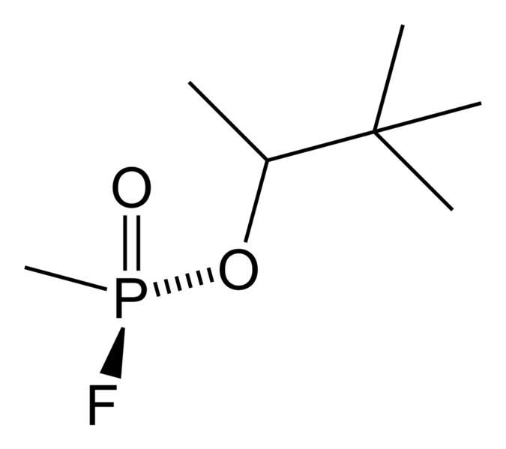
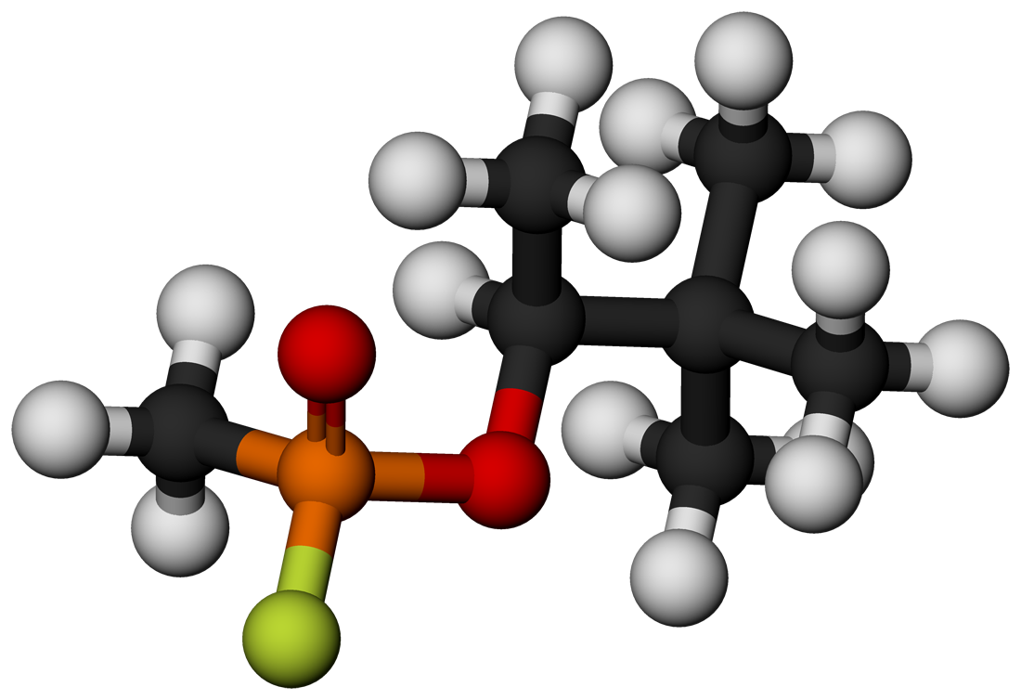
Soman (GD)
Developed by the Germans in 1944
Replaced isopropyl alcohol with the more difficult to make and more expensive pinacolyl alcohol
Twice as potent as sarin
Easily penetrates skin
Slower to evaporate than sarin
Lack or reliable antidote, making it more difficult treat accidental exposure
http://chemapps.stolaf.edu/jmol/jmol.php?model=FP%28%3DO%29%28OC%28C%29C%28C%29%28C%29C%29C

Slide 45
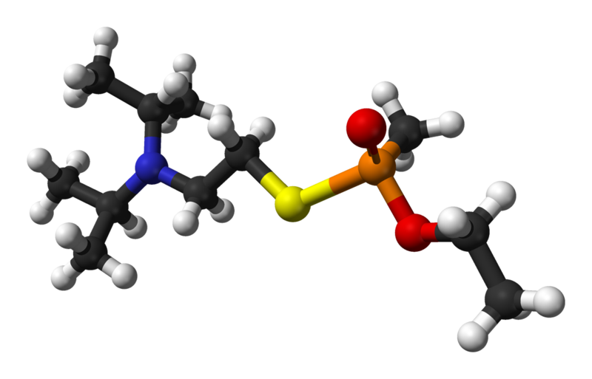
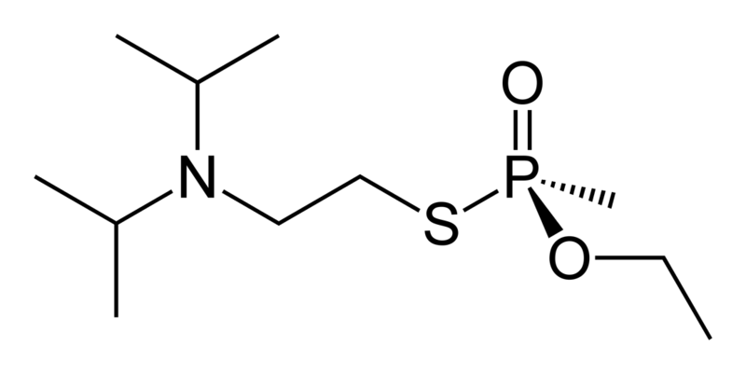
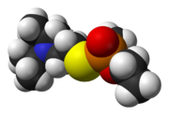
VX
One of several similar substances that were considered “venomous” and called V-agents.
First produced in England in 1954
Odorless liquid, slightly more dense than water, with a viscosity similar to motor oil.
http://chemapps.stolaf.edu/jmol/jmol.php?model=CCOP%28C%29%28%3DO%29SCCN%28C%28C%29C%29C%28C%29C

Slide 46
VX
Three times more toxic than sarin when inhaled and a thousand times more toxic when absorbed by the skin. A small drop on the skin could kill an adult in fifteen minutes.
Dispersed as an airborne mist or course spray.
Clings to whatever it hits
When sprayed on the ground, remains lethal for up to three weeks, so it is an area denial weapon.

Slide 47
Common CW Munition Types
Unitary Munitions
Easier to produce
More dangerous to store, handle & transport
Firing, spin flight & detonation mix compounds to form agent
Relatively safer to handle & store
Munition challenging to manufacture
Methylphosphonyl difluoride + 72% isopropanol and 28% isopropylamine
VX
Binary Munitions (VX)
Separator
Burster
Fuse
MD
Alcohol,
promoter
Two non-lethal compounds
Notes:
Chemical munitions can be either unitary or binary in design.
The unitary munitions contain a single canister filled with the CW agent. The munition is easier to produce because it has already been filled with CW agent at a loading facility. Only a fuse needs to be added before use. However, it is dangerous to store, handle and transport.
Binary munitions, in contrast, contain 2 separate canisters filled with relatively nontoxic precursor chemicals that must react to produce a lethal agent. The two components are brought together automatically while the binary bomb or shell is in flight to the target.. Iraq, however, took a slightly different route and mixed the two components together manually.
The development of advance binary munitions entails considerable engineering challenges to effect the necessary chemical reaction during the flight of the shell or bomb.

Slide 48
Binary Munitions
Reactants mixed immediately before firing or mixed in flight
U.S. - three binary munitions
A 155 mm artillery shell to deliver sarin (liquid isopropyl alcohol and liquid methylphosphonic difluoride, DF)
BIGEYE spray bomb to deliver VX (solid sulfur and liquid precursor QL)
Warhead for Multiple Launch Rocket System (MLRS)

Slide 49
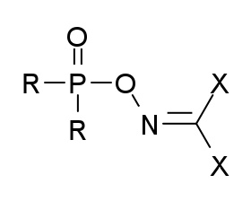
Russia’s Novichok (no-wee-shok)
Alleged Soviet secret program called Foliant
Novichok (new guy or newcomer) – nerve agents developed in the 1970s and 1980s
Intent was to develop binary agents that could be made from relatively safe substances similar to normal industrial substances, making it easier to conceal the production
Allegedly more lethal than VX
Resistant to treatment

Slide 50
Dosage Units
LD₅₀ = dose of chemical expected to kill 50% of an exposed population…typical units = mg/kg of body weight
LCt₅₀ = concentration of a chemical (in vapor phase) expected to kill 50% of a population exposed for a specified period of time…often expressed as the product of chemical’s concentration in air (mg/m³) and the duration of exposure (min)…units = mg•min/m³
ED₅₀ = dose of a chemical expected to cause a defined effect in 50% of an exposed population…typically expressed in units of mg/kg of body weight.

Slide 51
Dosage Units
ECt₅₀ = concentration of chemical (vapor phase) expected to cause a defined effect in 50% of a population exposed for a specified period of time; typically expressed as product of chemical’s concentration in air (mg/m³) and the duration of exposure (min)…typical units = mg•min/m³.
ICt₅₀ = median incapacitation concentration, concentration of chemical (vapor phase) expected to incapacitate 50% of a population exposed for a specified period of time, typically expressed as product of chemical’s concentration in air (mg/m³) and the duration of exposure (min)…typical units = mg•min/m³
TD_{LO} = Lowest toxic dose; the lowest dose of a chemical reported to cause an observable toxic effect in test animals

Slide 52
CW Lethality: Inhalation
LCt₅₀ ; in mg•min/m³
19,000
If victim is physically stressed, these numbers drop quickly!
Ex: LCt₅₀ (Sarin; GB) resting: 70 mg•min/m³
LCt₅₀ (Sarin; GB) active: 20 mg•min/m³
Concentration
3,200
1,500
400
100
15
Chlorine
Phosgene
Mustard
Tabun
Sarin
VX
Lethality
Notes:
Most CW agents are designed to enter the body either through inhalation or contact. The mode of transmission and type of agent determine the lethality of each agent. Although all are not intended to function via inhalation, all four types of CW agent are lethal if inhaled in the proper concentrations. Typically, this lethal concentration (LC) is defined as the number of milligrams of agent per minute per meter cubed (mg-min/m³) necessary to kill 50% of an exposed population. LC figures also depend upon the breathing rate of the victim. The faster a victim breathes, the more agent he or she will inhale, thereby lowering the concentration per volume of air required for lethality. For example , the lethal concentration for troops exposed to GB and engaged in mild physical activity is approximately 70 mg-min/m³. This figure drops to 20 mg-min/m³ if those same soldiers are engaged in intense physical activity and breathing heavily.

Slide 53
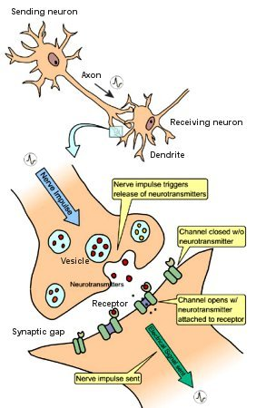
Neurotransmitters
Neurotransmitters cause nerve cells to fire.
From http://universe-review.ca/R10-16-ANS.htm

Slide 54

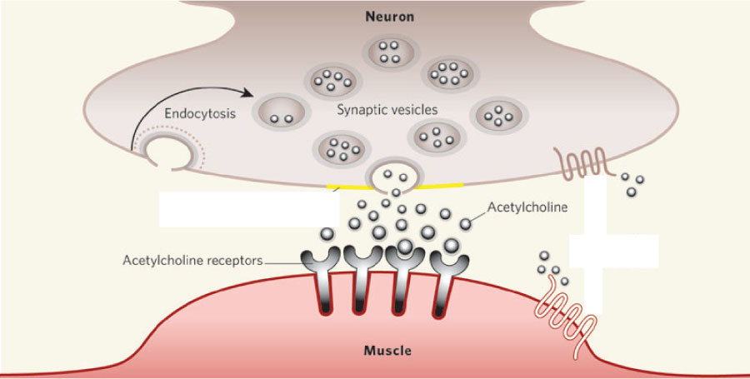
Acetylcholine and Muscle Contraction
Among other things, the neurotransmitter acetylcholine stimulates nerve cells that cause muscle contraction.
From Nature 436, 473-474 (28 July 2005)

Slide 55
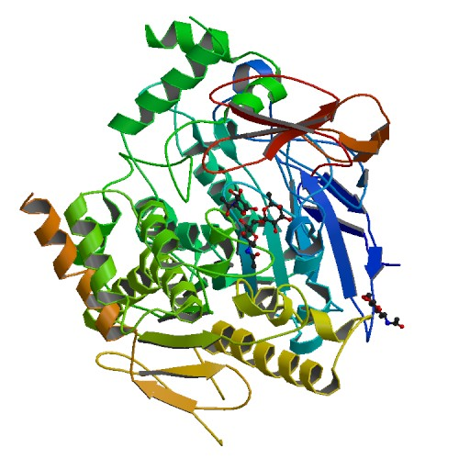
Acetylcholine, Acetylcholinesterase, and Transfer of Nerve Information
Normally, acetylcholine is broken down in the active site of an enzyme, acetylcholinesterase.
Each enzyme molecule converts about 25,000 molecules of acetylcholine per second.
Acetylcholine-acetylcholinesterase - like an on-off switch for muscles

Slide 56
Sarin and Acetylcholine-Acetylcholinesterase
Sarin forms a covalent bond to a serine side chain in the active site of acetylcholinesterase, deactivating it.
If acetylcholinesterase is deactivated, the acetylcholine levels remain high, and the switch gets stuck in the “on” position.
http://preparatorychemistry.com/nerve_agent_sarin.html

Slide 57
Effects of Nerve Gases
For skeletal muscles: uncontrolled spasms, followed by paralysis
For involuntary muscles: pupil contraction, excessive salivation, intestinal cramps, vomiting, and constriction of bronchial tubes
For central nervous system: overstimulates the brain, causing seizures
Causes glands to be overactive, secreting excess nasal mucus, saliva, and sweat
Causes death by asphyxiation through constriction of bronchial tubes, suppression of the respiratory center of the brain, and paralysis of the breathing muscles

Slide 58
Low-level Exposure to Nerve Gases
Low doses lead to inability to think clearly, insomnia, trouble concentrating, and mood swings.
Continuing exposure to low doses leads to a gradual increase in symptoms.
It can take up to months for the acetylcholinesterase levels to return to normal.

Slide 59
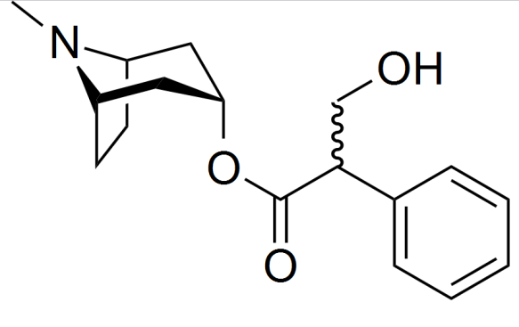
Nerve Gas Antidotes - Atropine
Standard antidote for organophosphate poisoning
Used in ancient Greece to dilate pupils (to make women's eyes prettier)
Competes successfully with one type of acetylcholine receptors. This type of receptor is found in smooth muscles and glands.
Helps relax muscles
Stops the symptoms from nerve agent poisoning, not the cause

Slide 60
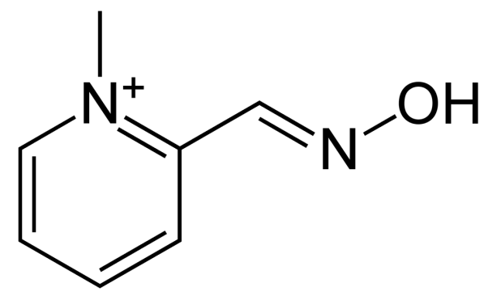
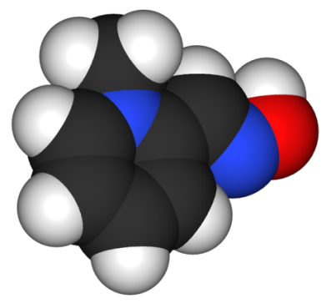
Nerve Gas Antidotes - PAM
Pralidoxime (2-pyridine aldoxime methyl chloride,) or 2-PAM
Displaces the nerve agent from the active site of acetylcholinesterase, restoring the enzyme to more normal levels
Too slow to work well alone
Works best when administered with atropine, which acts more quickly, giving the slower-acting PAM time to work.
Does not make it through the blood-brain barrier, so does not alleviate problems within the central nervous system. Alternatives are being developed.

Slide 61
Simplified PAM Deactivation of Nerve Agents
Sarin attaches to
Enzyme cholinesterase
PAM blocks this interaction:
cholinesterase
cholinesterase
Sarin
PAM
Sarin
PAM
Sarin
When sarin binds, enzyme ‘turned off’
Now enzyme ‘reactivated’
Normal activity resumes

Slide 62
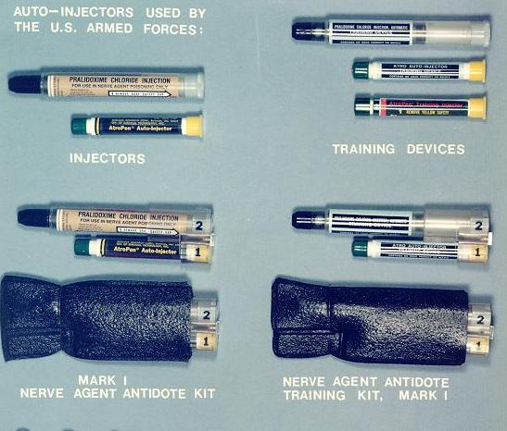
Treatment for VX Exposure
An individual who is known to be exposed to a nerve agent or who exhibits definite signs or symptoms of nerve-agent exposure should have an immediate injection of the antidotes atropine and pralidoxime (2-PAM) and a sedative/antiepileptic drug, such as diazepam or Valium. (more later)
Can be administered with an autoinjector, such as the United States military Mark I NAAK.
Remove as much of the VX as possible before moving to a non-contaminated area.
Rinse with household bleach and rinse with water.
Remove contaminated clothing and rinse skin again.

Slide 63
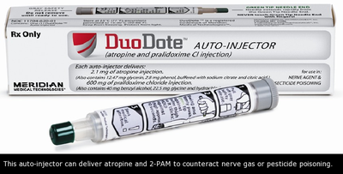
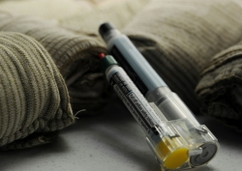
Nerve Gas Antidotes
Atropine and PAM can be administered with a pressurized syringe with a spring-loaded, recessed needle.
A catch is released and when the syringe is pressed against the leg, the spring is released, pushing the needle through clothing and into the leg, releasing the antidote.

Slide 64
Incapacitants Classification
Irritants Riot-control agents (CS, CN, etc.); pepper spray
Central nervous system stimulants (Amphetamines, cocaine, caffeine, nicotine, strychnine, metrazole)
Central nervous system depressants (Barbiturates, opioids, antipsychotics, benzodiazepines)
Psychedelics (LSD-25, psilocybin, ibogaine, harmine, MDMA…“ecstasy”, PCP)
Deliriants (Many, especially anticholinergics , such as BZ and Agent 15)

Slide 65
Physiological Incapacitants
CN (mace), CS, DM, pepper spray, fentanyl
Modes of Action: Mucous membrane irritation, vomiting inducing, sleep inducing
Physiological Effects
Causes uncontrolled tearing, itching, vomiting, unconsciousness
Act immediately
Form When Disseminated: Powder, Vapor
Required Defensive Gear: Protective Mask & Clothing

Slide 66
Opiate-like Agents
Clinical data for opiate-like compounds, comparing the effective dose (ED₅₀) and the lethal dose (LD₅₀)
This varies with the health of the subject.

Slide 67
Moscow Theater Hostage Crisis
23 October 2002 – 40-50 armed Chechens seized a crowded Moscow theater and took 850 hostages
Claimed allegiance to the Islamist militant separatist movement in Chechnya
Russian forces pumped a substance thought to be fentanyl into the building's ventilation system and raided it.
39 attackers and at least 129 of the hostages were killed.
Most of the hostages who died were killed by the toxic substance (fentanyl) pumped into the theater to subdue the militants. It is thought that their weakened condition led to a greater risk.

Slide 68
Psychochemical Incapacitants
BZ (3-3-quinuclidinyl benzilate)
Modes of Action: Inhalation, Ingestion, Injection
Physiological Effects
Potent anti-cholinergic compound (similar to atropine)
Dose <1 mg induces hallucinations and delirium
Effects peak at 8 hours and decline over next 48-72 hours
Form When Disseminated: Aerosolized solid, possibly in solvent
Required Defensive Gear: Protective Mask, Suits

Slide 69
Chemical Weapons Convention (CWC)
An arms control agreement that bans the production, stockpiling, transferring, and use of chemical weapons.
Approved by the U.N. General Assembly in November, 1992.
Open for signature in 1993
With some conditions, the U.S. ratified CWC in 1997.
http://www.cwc.gov/
http://www.opcw.org/chemical-weapons-convention//
http://www.opcw.org/news-publications/publications/history-of-the-chemical-weapons-convention/

Slide 70
CWC General Obligations
1. Each State Party to this Convention undertakes never under any circumstances:
(a) To develop, produce, otherwise acquire, stockpile or retain chemical weapons, or transfer, directly or indirectly, chemical weapons to anyone;
(b) To use chemical weapons;
(c) To engage in any military preparations to use chemical weapons;
(d) To assist, encourage or induce, in any way, anyone to engage in any activity prohibited to a State Party under this Convention.

Slide 71
CWC General Obligations (cont.)
2. Each State Party undertakes to destroy chemical weapons it owns or possesses, or that are located in any place under its jurisdiction or control, in accordance with the provisions of this Convention.
3. Each State Party undertakes to destroy all chemical weapons it abandoned on the territory of another State Party, in accordance with the provisions of this Convention.
4. Each State Party undertakes to destroy any chemical weapons production facilities it owns or possesses, or that are located in any place under its jurisdiction or control, in accordance with the provisions of this Convention.
5. Each State Party undertakes not to use riot control agents as a method of warfare.

Slide 72
CWC Definitions
Toxic Chemical = Any chemical which through its chemical action on life processes can cause death, temporary incapacitation or permanent harm to humans or animals.
Precursor = Any chemical reactant which takes part at any stage in the production by whatever method of a toxic chemical.
Key Component of Binary or Multicomponent Chemical System = The precursor which plays the most important role in determining the toxic properties of the final product and reacts rapidly with other chemicals in the binary or multicomponent system.

Slide 73
CWC Schedule 1
http://www.opcw.org/chemical-weapons-convention/annex-on-chemicals/a-guidelines-for-schedules-of-chemicals/
Schedule 1 chemicals have few or no uses other than as chemical weapons or to make chemical weapons.
Examples include the nerve gases, sulfur mustards, nitrogen mustards, and lewisite
They are the most highly regulated.
http://www.cwc.gov/index_chemicals_sch1.html

Slide 74
CWC Schedule 2
Schedule 2 chemicals are chemicals that could be used as weapons or to make weapons, but also have legitimate small-scale uses.
Examples include Amiton (a V-series nerve gas) and BZ.
http://www.cwc.gov/index_chemicals_sch2.html

Slide 75
CWC Schedule 3
Schedule 3 chemicals have large-scale uses other than chemical weapons.
Chemical plants producing more than 30 Mg per year must report to the Organisation for the Prohibition of Chemical Weapons (OPCW).
The plants can be inspected, and there are restrictions on export to countries that have not signed the CWC.
Phosgene and hydrogen cyanide are examples.
http://www.cwc.gov/index_chemicals_sch3.html

Slide 76
CWC Parts A and B
Each schedule is divided into
Part A – the offending chemicals themselves
Pat B – their precursors (chemicals used to produce the offending chemicals)

Slide 77
Organisation for the Prohibition of Chemical Weapons (OPCW)
Intergovernmental organization located in The Hague, Netherlands
“…implementing body of the [CWC]…given the mandate to achieve the object and purpose of the Convention, to ensure the implementation of its provisions, including those for international verification of compliance with it, and to provide a forum for consultation and cooperation among States Parties.”
http://www.opcw.org/about-opcw/
http://www.opcw.org/

Slide 78
Organisation for the Prohibition of Chemical Weapons (OPCW)
Model of multilateralism - 188 member states that contain 98% of the world’s population.
8 nonmember states
Signatory states that have not ratified the CWC
Israel
Myanmar
States that have neither signed nor ratified the CWC
Angola
Egypt
North Korea
Somalia
Syria
South Sudan

Slide 79
OPCW Tasks
Bringing suspected chemical weapons possessors into CWC
Verifying the destruction of declared chemical weapons, including those in abandoned CW weapons
Verifying the destruction or conversion of CW plants
Monitoring future compliance with CWC

Slide 80
States Outside CWC
Israel
Analysts believe that Israel initiated a CW program between mid-1950s and mid-1980s
Refuses to ratify CWC until there’s more regional participation
Israel’s chemical industry is advanced and diverse
Although Israel is capable of creating CW weapons, there is insufficient information available to reconstruct their CW program.
http://www.nti.org/country-profiles/israel/
Myanmar
CW ambitions unconfirmed
Accused of using CW in 1990s and again in 2005 and 2009…denied by ruling junta
http://www.idsa.in/cbwmagazine/Myanmar_pbaruah_0410

Slide 81
States Outside CWC
Egypt
Used CW in North Yemen
Thought to have inherited mustard agent and phosgene from British forces when they withdrew in 1954
May have nerve agents
Refuses to join CWC until Israel joins the Nuclear Nonproliferation Treaty (NPT)
Thought to have helped Iraq get CW production capabilities
http://www.nti.org/e_research/profiles/Egypt/Chemical/index.html

Slide 82
States Outside CWC
North Korea
Thought to have 2500-5000 metric tons of phosgene, hydrogen cyanide, mustard agent, and sarin
Has capable but aging chemical industry
http://www.nti.org/country-profiles/north-korea/
Syria
Began developing CW in 1973
Much outside help
Have sarin, tabun, VX, and mustard gas
Helped by chemical brokerage houses in the Netherlands, Switzerland, France, Austria, and Germany
http://www.globalsecurity.org/wmd/world/syria/cw.htm

Slide 83
CWC Declared CW
Seven of the 188 member states declared chemical weapons stockpiles: Albania, India, Iraq, Libya, Russia, South Korea, and the United States.
Russia largest stockpile…about 40,000 metric tons at seven arsenals
U.S. – 28,577 metric tons at nine stockpiles

Slide 84
Challenges for Destruction of Chemical Weapons
Choosing safest and most environmentally sound destruction techniques
Paying high costs
Meeting deadlines that were set before the process of destruction was determined.

Slide 85
Albania, India, and South Korea
Albania
With help from the U.S., Albania was first to destroy CW (16 metric tons of mustard gas and a small quantity of lewisite and other chemicals)
OPCW certified the completion of the destruction in 2007
South Korea
Declared CW but details not made public
OPCW certified the completion of the destruction in 2008
India
Declared 1044 metric tons of sulfur mustard
OPCW certified the completed destruction in 2009.

Slide 86
United States Destruction of Chemical Weapons
When U.S. Senate ratified CWC on April 25, 1997, the articles of ratification specified, among other things,
Highest priority on protection of public health and the environment
Development of nonincineration techniques
National dialogue of stakeholders…federal, state, and local officials, environmentalists, public health experts, and military officials

Slide 87
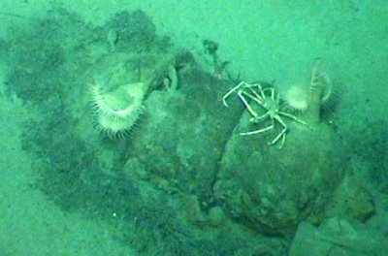
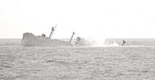
Ocean Dumping of Chemical Weapons
http://cns.miis.edu/multimedia/interactive_files/cw_dumping.htm

Slide 88
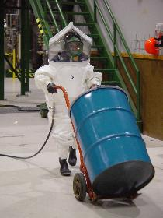
U.S. Army's Chemical Materials Agency (CMA)
The CMA stores and destroys the U.S. chemical weapons.
http://www.cma.army.mil/
A student fully encapsulated in a protective suit at the Chemical Demilitarization Training Facility at Aberdeen Proving Ground, Md., rolls a simulated waste barrel in the Demilitarization Equipment Room.

Slide 89
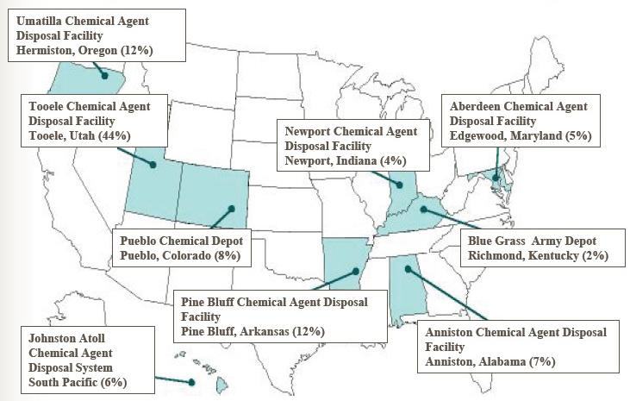
United States CW Disposal Facilities
http://www.opcw.org/index.php?eID=dam_frontend_push&docID=12373

Slide 90
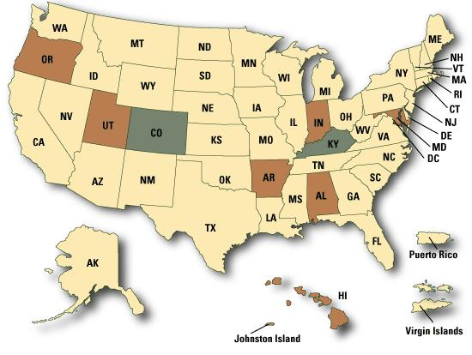
Status of CW Disposal Facilities
Green - States and Regions with Chemical Weapons Stockpiles Yellow - States and Regions without Chemical Weapons Stockpiles Brown - States and Regions that had Chemical Weapons Stockpiles
http://www.cma.army.mil/map.aspxhttp://www.cma.army.mil/map.aspx

Slide 91

United States Destruction of Chemical Weapons

Slide 92

United States Destruction of Chemical Weapons
Johnston Atoll
800 miles southwest of Hawaii
Chemical weapons have been stored on Johnston Island since 1971.
CW formerly held in Okinawa
1990 – CW from the Federal Republic of Germany were transferred to Johnston Atoll for destruction
1991 - range-recovered chemical munitions were brought from the Solomon Islands.
1981-2000 - world's first full-scale facility built to destroy chemical weapons.
Incineration of CW finished in 2000

Slide 93


United States Destruction of Chemical Weapons
Newport, Indiana
August 2008 – 100% of VX neutralized by mixing with water and sodium hydroxide and heating to 194°F (90°C)
Edgewood, Maryland
Agent destruction operations began in April 2003 and were completed in February 2006.
Pine Bluff, Arkansas
Completed destruction of sarin, VX, and blister agents by incineration on April, 2010
VX at Newport

Slide 94

United States Destruction of Chemical Weapons
Anniston, Alabama
Completed destruction of sarin, VX, and blister agents by incineration on September 22, 2011
Umatilla (yü-mə-ˈti-lə), Oregon –
10/25/11 - Completed incineration at 2,700 degrees Fahrenheit of 3,717 tons of nerve gas and blister agent
Destruction of mustard agent at Umatilla

Slide 95

Umatilla, Oregon CW Destruction Facility

Slide 96
United States Chemical Weapons Destruction
Tooele (tü-ˈe-lə), Utah
Destruction facility for chemical agents stored at the Deseret (de-zə-ˈret) Chemical Depot
The last chemical agent munitions were destroyed on Jan. 21, 2012.

Slide 97
United States Remaining Chemical Weapons
Blue Grass, Kentucky
Chemical weapons will be destroyed by chemical neutralization.
Has 523 tons of nerve agents GB and VX, and mustard agent in projectiles, warheads, and rockets.
http://www.cma.army.mil/bluegrass.aspx
Pueblo, Colorado
Will destroy 2,371 metric tons of mustard agent stored in different types of projectiles and mortars by neutralization.
http://www.cma.army.mil/pueblo.aspx

Slide 98


Destruction of VX (more later)
VX can be converted into safer substances by combining it with a concentrated solution of sodium hydroxide, NaOH.
The reaction is called hydrolysis, in which water, H₂O, divides into H, which combines with one part of a molecule, and OH, which combines with another part of the molecule, splitting the molecule into two parts.

Slide 99
United States Destruction of Chemical Weapons
Will miss April 29, 2012 deadline
OPCW OK’d an extension in the December 2011 meeting.
U.S. Congress has set 2017 as date for 100% destruction
U.S. Army projects 2021 as a more likely end point
Will have cost $40 billion

Slide 100

Russian CW Sites
http://www.opcw.org/index.php?eID=dam_frontend_push&docID=12373

Slide 101
Russia Destruction of Chemical Weapons
1987 – discontinued production of CW and stated intention to destroy and not replace CW
1989 – U.S. and Russia signed Wyoming MOU
Bilateral exchange of information
Verification inspections
1997 – ratified CWC
2002 – neutralization facility for destruction of lewisite
By August 2011 – Five more destruction facilities…one more planned

Slide 102
Russia Destruction of Chemical Weapons
Oct. 24, 2011: Alexander Studenekin, Moscow's envoy to the OPCW reported that Russia has destroyed about 65% of its declared chemical weapons.
U.S. through Cooperative Threat Reduction program has committed $1 billion to help
Likely to finish after 2015
OPCW OK’d an extension in the December 2011 meeting.

Slide 103
Libya Chemical Weapons
From http://www.opcw.org/the-opcw-and-libya/libya-fact-and-figures/
Joined CWC in 2004
Libya declared possession of the following materials, which were verified by OPCW inspections:
24.7 metric tons of sulfur mustard
1,390 metric tons of precursor chemicals
3,563 unloaded chemical weapons munitions (aerial bombs)
3 chemical weapons production facilities
Since declaring this stockpile, Libya has destroyed under OPCW verification:
55% of its sulfur mustard stockpile
40% of its precursor chemicals, and
100% of its unloaded CW munitions.

Slide 104
Libya and CWC
From http://www.opcw.org/the-opcw-and-libya/libya-fact-and-figures/
OPCW has confirmed that Gaddafi had mustard gas shells that he had not declared, despite Libya’s membership in the OPCW.
Libya’s deadline for completing destruction of its remaining CWs has been extended by the OPCW to 29 April 2012.
Under the Convention, the OPCW’s mandate is to inspect and verify chemical weapons destruction activities. Maintaining security of stockpiles until they are destroyed is the responsibility of the Libyan government.

Slide 105
Summary
By 2012, 50,619 metric tons, or 71.10%, of the world's declared stockpile of 71,195 metric tons of chemical agent have been destroyed.
4,680 inspections have taken place at 195 chemical weapon-related and 1,103 industrial sites on the territory of 81 States Parties since April 1997.
Worldwide, 4,913 industrial facilities are liable to inspection.

Slide 106
Factors Affecting the Ability to Make Chemical Weapons
Availability of chemical knowledge
Availability of precursors
Availability of chemical equipment
Knowledge of production techniques (known for over 40 years)
Because all of these are increasing, there are about 100 countries that have the capability to make simple chemical weapons, such as phosgene, hydrogen cyanide, and sulfur mustard.
Because the synthesis of nerve agents requires high temperatures and highly corrosive chemicals, a smaller number of countries could make nerve gases.

Slide 107
Factors Affecting the Ability to Make CW
Desired quantity
Desired purity
For a variety of reasons, products of chemical reactions are rarely pure, so after the initial reactions, steps are taken to purify the product.
Concern for safety of workers
Concern for the environment

Slide 108

Production of Sulfur Mustard
Relatively easy to make and conceal.
Thiodiglycol and concentrated hydrochloric acid react to form sulfur mustard
(HOCH₂CH₂)₂S + 2 HCl → (Cl-CH₂CH₂)₂S + 2 H₂O
Thiodiglycol
Used to make many things, including pen inks, plastics, pesticides, dyes, and photographic developing solutions
5 U.S. producers of thiodiglycol and some foreign producers
Schedule 2 part B chemical
About 100 firms purchase it
Can be made indigenously in different ways, including from 2-chloroethanol and sodium sulfide
Does not require sophisticated equipment
Distillation leads to improved purity, which allows longer storage
Plant cost of $5-10 million

Slide 109
Ways to Circumvent Export Controls on Precursors
Substitute uncontrolled chemical for controlled one.
Purchase relatively small quantities from multiple sources
Produce precursors from simpler, uncontrolled substances…costly.

Slide 110
Iraqi Mustard Program
Back-Integration = synthesizing precursor compounds from simpler ones that are not export controlled or are available from domestic sources
thiodiglycol
sulfur mustard
Embargo placed on this by Western Countries in early 80’s
Thionyl chloride
Schedule 3 Part B
Ethylene oxide
not controlled
sulfur mustard
Notes:
In fact, there are 9 production processes for sulfur mustard which have been
documented in the published chemical literature.
(4) The fourth possibility is to manufacture precursor chemicals from simpler compounds whose
export is not controlled or that are available from domestic sources. This is called “back-integrating.”
Iraq, for example, applied back-integration to mustard gas production in the early 1980s. Unable to
make thiodiglycol indigenously, it ordered the precursor from foreign sources. However, when an
embargo threatened the supply from Western countries, Iraq developed an indigenous production
capability based on reacting ethylene oxide with hydrogen sulfide.
thionyl chloride -- used in herbicides, surfactants, drugs, vitamins, and dyestuffs

Slide 111


Production of Tabun
Made from widely available phosphorus oxychloride (POCl₃ – scedule 3 part B), hydrogen cyanide (HCN), dimethyl amine (NH(CH₃)₂), and ethanol (C₂H₅OH). All are used to make other substances, including pharmaceuticals, pesticides, missile fuels, and gasoline additives
Must handle highly toxic HCN gas.
Does not require use of corrosive materials and does not produce highly reactive intermediates.

Slide 112

Production of Sarin
Most easily prepared from methylphosphonyl difluoride and isopropyl alcohol.
CH₃P(O)F₂ + (CH₃)₂CHOH → [(CH₃)₂CHO]CH₃P(O)F + HF
Three technical hurdles
Involves corrosive hot hydrochloric acid, HCl, and hydrogen fluoride, HF, so need corrosion resistant equipment, e.g. vessels and pipes of an alloy that is 40% nickel…Monel and Hastalloy.
To make CH₃P(O)F₂ (schedule 1, part b), alkylation reaction in which methyl, -CH₃, group is added to the phosphorus atom is technically difficult.
Distillation necessary to produce high-purity necessary for long storage.
Plant cost $30-50 million

Slide 113


Sarin Weapons
The sarin made at the Rocky Mountain Arsenal in Colorado was put in M34 cluster bombs and smaller shells, such as the 155mm shell.
M34 bombs (left below) had 76 sarin-filled bomblets / 1000 pounds overall
Stored at various army depots and in Okinawa
A stockpile of 155mm shells are on the right.

Slide 114

Other Nerve Gas Weapons
M55 rocket
About 478,000 made
6 feet long
Range six miles
Filled with about five quarts of nerve agent
Explosive burster charge to disperse agent
Many leaked, causing disposal problems

Slide 115



Honest John Rocket
About 478,000 made
Contained 356 spherical 4-5 inch bomblets, each with about a pound of nerve gas.
Range 16 miles
Designed to break apart over target, releasing the bomblets that detonated on impact, dispersing the nerve agent.

Slide 116

Production of VX
Phosphorus trichloride is methylated, forming methyl phosphonous dichloride, which reacts with ethanol to form a diester. This is reacts with N,N-diisopropylaminoethanol to produce phosphonite, which reacts with sulfur to form VX.
Has difficult alkylation step but not corrosive HF gas.

Slide 117
Other Necessary Components
Containment and waste treatment.
Additives to stabilize and augment the effects of CW agent
Design and produce munitions
Designed to convert liquid or powdered agent into an aerosol (tiny droplets that stay suspended in air for several hours)
Can be found in open patent literature
Simplest – agricultural sprayer from aircraft
Filling of munitions…very dangerous, so requires sealed building and controlled atmosphere
Storage and transportation

Slide 118
Common CW Precursors
Most precursors have legitimate commercial uses.
Dual-use nature impedes detection of CW programs.
Trade in precursors is monitored and controlled.
Chmical Compound | Commercial Uses | CW Agent
Thiodiglycol | plastics, textile dyes, ink | Mustard gas
Phosphorus trichloride | plasticizers, insecticides | Sarin
Sodium cyanide | dyes & pigments, nylon, metal hardening | HCN
Methylphosphonic difluoride | organic synthesis | Sarin, VX
Phosphorus pentasulfide | insecticides, lubricants, pyrotechnics | VX
Notes:
The term “precursor” is used to describe the chemical compounds that are combined to form a lethal CW agent. () Most precursors also have legitimate commercial applications.

Slide 119



Production Process (Simplified)
Precursors stockpiled
Combined in
reactor under
controlled
conditions, often
with catalysts
Piped to
chemical
processing
area
Precursors react to
form new compounds
Agents are stored until filled into munitions
Distillation & filtration separates
& purifies agents and byproducts
Notes:
This slide depicts, in a very simplified form, a typical production process for chemical warfare agents. Many CW agents, especially older agents, are relatively simple to produce. They are often based on technology that is at least 80 years old and sometimes older, putting them well within the reach of virtually any country with a chemical industry that wants them. Newer agents, especially nerve agents, are more difficult to produce; however, much of the technology for these agents is widely available in the public domain.

Slide 120



Equipment
Standard chemical process equipment could be suitable for a clandestine CW program, but specialized equipment is preferable.
corrosion resistance (high nickel content)
equipment designed for handling extremely toxic substances (e.g. double seal pumps)
Safety equipment (incinerators, toxic gas monitors, etc.) also has dual-uses.
Hastelloy pumps & valves
Glass lined pipes
Notes:
In many ways, production of CW agents is like that of legitimate commercial compounds. Both involve use of standard chemical process equipment, including reactor vessels, in which production actually occurs; heat exchangers, to control temperature; and various pumps, pipes, valves, and other items that control the movement of chemicals throughout the plant. (The greatest similarities occur between pesticide and nerve agent production units because these agents are so closely related.)
So, standard chemical process equipment could be suitable for a clandestine CW program. However, specialized equipment is preferred. Equipment that is resistant to corrosion - such has Hastelloy and other high nickel alloys- has important applications in CW because of the highly corrosive compounds encountered in CW agent production. Double-seal pumps and other equipment that is designed to handle exceptionally toxic compounds are also preferred.

Slide 121


Large-Scale Chemical Reactors

Slide 122



CW Agents Production Equipment
Jacketed Pipe Heat Exchanger-
keeps reactions at proper temps
Glass Lined Pipe & Fittings-
Good for corrosive
chemicals
Glass Lined Steel Cyclones – used to separate large batches of chemicals
Notes:
Recognition of Biological Equipment Detection/Identification
In the upper left are heat exchanger pipes for maintaining the appropriate temperature. In the upper right are many glassed lined fittings for use in a highly corrosive environment. A cyclone is a type of centrifugal separator that is used in the Chemical Process Industry. They are designed for the separation of gas/liquid and gas/solid mixtures, where the solid or liquid generally consists of fine particles (a dust/powder, or a mist).

Slide 123
It’s not that easy.
Example: Aum Shinrikyo
$2 BILLION assets; 40,000 members, government deference
$10 million plant; 100 scientists/engineers
Goals: sarin- 2 tons/day; 70 ton arsenal; small targets
Achieved: ~2 kg sarin/attack
Auditorium (Feb 1994)
Dormitory (June 1994)
Subway (March 1995)
Casualties: 17 total killed

Slide 124
Detecting the Production of Chemical Weapons
Can be cooperative, within the framework of CWC, or noncooperative, based on intelligence agents, remote sensing, and covertly placed monitoring devices
On-site inspections established by the OPCW are important.
Because the evaluation of intent is important, intelligence-gathering services are important.

Slide 125
Indicators (Signatures) of CW Production from Remote or On-site Inspections
Detection of chemical weapons in the plant itself
Detection of chemical weapons in the plant waste stream
Detection of precursors
Detection of decomposition products
Aspects of plant design
Testing of munitions and delivery systems
Biomarkers in plant workers, vegetation, or other animals

Slide 126
Indicators (Signatures) of CW Production from Remote or On-site Inspections
Patterns of material and equipment imports
Developing countries require outside help to make CW, e.g. Iraq and Libya got CW production plants from outside sources.
Purchase of glass-lined pipes and corrosion-resistant alloys (can be dual use)
Tracking precursors is difficult because many are used widely in commercial applications
Ratios of starting materials and catalysts might be useful
Economic dislocations, e.g. diverting a chemical plant to CW production might lead to fewer pharmaceuticals and pesticides available

Slide 127
Indicators (Signatures) of CW Production from Remote or On-site Inspections
Visual Signatures (Most external features of CW plant are the same as an ordinary commercial chemical plant)
Construction of large chemical plant not reported in chemical trade press
Plant in remote location
High level security
Large distances between buildings to complicate air attacks
Proximity to metal-machining factory capable of making munitions
Presence of trucks to carry hazardous materials
Lack of steel drums and other common packing materials
Few plants and animals near plant
Flurry of activity, suggesting an accident

Slide 128
Indicators (Signatures) of CW Production from Remote or On-site Inspections
Internal production signatures obtained by authorized onsite inspections
Production equipment – no one component identifies CW production, but there are unique combinations…e.g. specialized pumps and valves with double seals
Unique ways of heating and cooling reaction vessels (Some intermediates react explosively with water, so use other heat-exchanging fluids and cooling towers rather than steam vents.)
Corrosion-resistant materials (increasingly common in chemical industry)
Safety and pollution-control equipment…tightly sealed enclosure, negative pressure, remote control, pumps with double or triple seals, different ventilation and emission control systems
Unique waste treatment and disposal

Slide 129
Indicators (Signatures) of CW Production from Remote or On-site Inspections
Chemical Signatures from collection and analyzing of samples
Because analysis of chemicals derived from onsite visits can provide proprietary information about a company, the analysis and publication of data must balance the need to verify CW and the need to protect business information
CWC verification searches for specific known chemicals
Phosphorus-methyl (P-CH₃) bonds are characteristic of nerve agents
Phosphorus-fluorine (P-F) bond for sarin and soman

Slide 130
Reasons for Detection
Alarm
All-clear
Verification and identification
Mapping of ground contamination
Mapping of decontamination requirement
http://www.opcw.org/our-work/assistance-and-protection/protection-against-chemical-weapons/detection/

Slide 131
Detection Technology
Agent identification can be done to some extent by means of a combination of detection devices.
Laboratory analysis of samples collected is necessary for more reliable information.
http://emedicine.medscape.com/article/833933-overview#a1

Slide 132

M8 Detection Paper
Two dyes and one pH indicator on paper
Blotted on liquids that arouse suspicion. It identifies CAs by changing colors within 30 seconds of exposure.
Nerve agent yellow
Mustard agent red
VX causes the indicator to turn to blue which, together with the yellow, will become green/green-black.

Slide 133
M8 Detection Paper (cont.)
Advantages – sensitive, inexpensive, quick
Disadvantage - other substances can also dissolve the pigments.
Brake fluid, antifreeze, and insect repellent yield false-positive readings.
False readings are especially undesirable in civilian situations because they may lead to mass panic.
Therefore, chemical detection paper is combined with other techniques.

Slide 134

M9 Detection Paper
M9 paper has adhesive backing that allows it to be attached to clothing and equipment.
Color change (Red, Reddish brown, Pink, Purple) indicates chemical agent but does not identify a specific agent
Tends to react faster than M8 paper
Can be attached to vehicles. Vehicles are limited to a speed of about 20 mi/h.

Slide 135

M22 Detector
Portable, operates independently after system startup, and provides an audible and visual alarm.
Simultaneously detects nerve and blister agent vapors
Detection leads to more precise identification using other techniques.

Slide 136

M256A1 Chemical Kit
Portable kit detects nerve gas, mustard gas, and cyanide and usually is used to define areas of contamination.
Used extensively during the Gulf War but is also available commercially.
Contains a package of M8 paper, detailed instructions, and a vapor sampler (12 enzymatic tickets that contain laboratory filter paper for detecting CA vapors).

Slide 137
M256A1 Chemical Kit (cont.)
Eight glass ampoules, six containing reagents for testing and two in an attached chemical heater.
Ampoules are crushed between the fingers and direct the flow of liquid reagent to wet the test spots.
Each test spot or detecting tablet develops a distinctive color for a chemical agent.
Detects all agents at levels below those that can kill or injure people.
Prone to false-positive results, but it has not been demonstrated to produce false-negative results.

Slide 138

Colorimetric Tubes
Use enzymatic techniques to identify CAs.
Hand pump draws a sample into a specific tube, and the concentration of the substance is read from the tube.
Simple and inexpensive
Different tubes for different agents.
Requires knowledge of which CA is likely to be present in a given environment.
A tube for each possible CA must be used for thorough detection.

Slide 139

Colorimetric Tubes (cont.)
Example: test for mustard gas
Cl(CH₂)₂S(CH₂)₂Cl (mustard agent)
+ pyridine-CH₂-p-phenylidene-NO₂ (colorless)
reacts at 110 °C in the presence of NaOH to give
Cl(CH₂)₂S(CH₂)₂N=CH-pyridine-NO₂ (blue)

Slide 140

Detection Tickets
For nerve agents
Two parts, one with enzyme-impregnated paper and the other with substrate-impregnated paper.
When the package is broken and the enzyme paper wetted, the substrate part of the ticket is exposed to the test vapor by means of a pump.
Two parts put together for two minutes.
Can also be used without a pump (by waving it in the air) but this gives a slightly less sensitivity.

Slide 141
Detection Tickets (cont.)
If the enzyme part of the ticket has turned a weak blue color, nerve agent is not present.
The blue change of color requires an active enzyme - some form of cholinesterase. In the presence of nerve agents, the enzyme is inhibited and no change of color occurs.
Detection tickets of this kind cannot distinguish between the different nerve agents.
2,6-dichloroindophenylacetate (red) + cholinesterase
produces 2,6-dichloroindophenol (blue)

Slide 142

Ion Mobility Spectroscopy (IMS)
Used in many handheld and stand-alone detection devices
Gaseous sample drawn into a reaction chamber using an air pump.

Slide 143

Ion Mobility Spectroscopy (IMS)
Sample ionized , most commonly using radioactive beta emitters such as nickel-63 or americium-241
Ions pulled through a tube by an electric field.
A gas opposes the ion motion
Ions hit detector at end of tube
Migration time related to ion’s mass, charge, and shape.

Slide 144
Ion Mobility Spectroscopy (IMS)
Substances identified according to the time it takes to traverse the distance to the detector and the amount of electrical charge detected.
Pattern compared to a sample of clean air; if different and unique to certain types of agents, the alarm sounds.
Limitation - compounds with similar molecular masses take similar times to drift, e.g. wintergreen oil (molecular mass = 152) will be incorrectly identified as mustard gas (molecular mass = 158)
Positive hits should be confirmed by a second technique.

Slide 145

Improved Chemical Agent Monitor (ICAM)
IMS device
Used extensively in the Gulf War, even attached to certain vehicles.
Handheld device that continuously displays the concentration of nerve agents or mustard agents.
Prone to erroneous detection in enclosed spaces and areas of strong vapor concentration (e.g. heavy smoke).
Available for commercial purchase and are used by many medical response teams.

Slide 146

Advanced Portable Detector (APD)
IMS device
Sold commercially to HAZMAT response teams for domestic preparedness.
Handheld device can be powered by batteries.
Can detect mace and pepper spray as well as nerve agents, blister agents, and hazardous compounds.

Slide 147


Infrared Radiation Detection Techniques
Long-range detectors and point detectors
IR radiation used to excite molecules
Each agent absorbs unique wavelengths and yields a unique pattern referred to as a fingerprint.

Slide 148

M21 Remote Sensing CA Alarm
The military uses the M21 Remote Sensing Chemical Agent Alarm (RSCAAL)
Based on infrared detection.
Can detect a vapor cloud from 5 km with an 87% detection rate.
Continuously monitors a background and notes the change in spectral information if a vapor cloud obstructs the background
Limited in that it must be stationary and can be obstructed by snow and rain.

Slide 149


Joint Service Lightweight Standoff Chemical Agent Detector (JSLSCAD)
Infrared (IR) detection system
Passive detector of chemical agent vapors at ranges up to 5 kilometers and ultimately to 10 kilometers.
Lightweight and fully automatic detection system
360-degree coverage from a variety of tactical and reconnaissance platforms

Slide 150

Flame Photometric Detector (FPD)
A flame of hydrogen is used to burn a sample of air. The color of the flame is analyzed by a photometer for concentrations of sulfur and phosphorous (key components in nerve gas and mustard).
Highly sensitive yet is prone to false-positive results by detecting other gases that contain significant concentrations of sulfur or phosphorus but are nonhazardous.
AP2C handheld detector uses this technology.
Federal agencies and international agencies use this for mass screenings and for confirming decontamination of casualties.

Slide 151

Miniature Automatic Continuous Agent Monitoring System (MINICAMS)
Based on combining gas chromatography, which separates components, with flame photometry.
A typical cycle lasts 3-5 minutes, enabling continuous monitoring of the environment.

Slide 152


Surface Acoustic Wave Detector
Have chemically selective coated piezoelectric crystals that absorb target gases. The absorption causes a change in the resonant frequency of the crystal that is measured by a microcomputer.
Able to identify and measure many CAs simultaneously.
Inexpensive
SAW MiniCAD mk II
Joint Chemical Agent Detector (JCAD) ChemSentry

Slide 153

Carbon Nanotube Gas Ionization Detector
May soon be used for chemical agents
Nanotubes generate high electric fields
Different gases cause different electrical conductance for the nanotubes, which can be used to identify the substance.

Slide 154
Department of Homeland Security Recommended Criteria for Choosing Detection Devices
http://emedicine.medscape.com/article/833933-overview#a1
Unit cost | Cost per piece of equipment including all support equipment and consumables
Chemical agents detected | Ability to detect nerve and blister agents
Toxic industrial chemicals and materials detected | Ability to detect toxic chemicals produced by industry
Sensitivity | Lowest concentration of chemical agent that results in positive response; ideally, lower than levels necessary for injury to personnel
Resistance to interferents | Ability of device to ignore agents such as smoke, moisture, or other chemicals that prevent the device from accurately providing a response

Slide 155
Department of Homeland Security Recommended Criteria for Choosing Detection Devices
Response time | Time it takes to collect a sample, analyze, determine if an agent is present and provide feedback
Start up time | Time to set up and initial a sampling
Detection states | Ability to detect agent in vapor, aerosol, or liquid form
Alarm capability | Visual and/or audible alarm
Portability | Ease of transport, which encompasses weight and dimensions
Power capabilities | Battery versus AC electrical power

Slide 156
Department of Homeland Security Recommended Criteria for Choosing Detection Devices
Battery needs | Type, amount, cost, and operating life if powered by batteries
Operational environment | Extremes of conditions under which the device can operate
Durability | How well the device withstands rough handling
Operator skill level | Skill involved in using the device
Training requirements | Number of hours and type of educational background required for operation

Slide 157

Laboratory Instruments
Gas Chromatography/Mass Spectrometry (GCMS)
Gas chromatograph separates components
Mass spectrometer breaks substances into fragments and provides a mass spectrum that reflects the masses of the fragments. Comparison of mass spectrums to those of known substances helps to identify substances tested.

Slide 158

Mass Spectrometer

Slide 159


Mass Spectrum
Numbers are mass to charge ratio.
http://www.ncbi.nlm.nih.gov/pmc/articles/PMC2577157/

Slide 160


Laboratory Instruments -
Nuclear Magnetic Resonance (NMR): Analyzing Chemicals Based on Their Nuclei’s Spins Under Magnetic Force
Nuclei with an odd mass or odd atomic number have "nuclear spin“ (includes ¹H and ¹³C)
Moving charges create magnetic fields.
The nuclear spin sets up a magnetic field that can be influenced by an external magnetic field (H₀)
They behave like tiny bar magnets.
They line up with their spin aligned or opposed to the magnetic field.

Slide 161
NMR: Nuclear Resonance and Chemical Shifts
We apply energy to “flip” the spins of nuclei.
Unique energy required for different nuclei in a compound
Nuclei in compounds are in different electronic environments.
Energy applied through radio waves…keep varying frequency until the ‘flip’ happens
When you hit the right frequency and spin ‘flips’, the radio wave and nucleus resonate.
You plot this resonance to learn about the chemical environment of the nuclei.
¹H nuclei in magnetic field:
S
S
S
S
Record the frequency
when the nuclei ‘flipped’ on NMR spectra
N
N
N
S
S
N
N
N
H₀
This one’s spin is opposed.
now they all line up!
H₀

Slide 162



Nuclear Magnetic Resonance
Spectrum:

Slide 163

Sarin NMR Spectrum
NMR Spectra
for sarin:

Slide 164

Egyptian Involvement in Yemen Civil War (1963-1967)
Monarchy in Yemen overthrown in 1962
Egypt supported new government and helped to suppress royalist groups
Royalist fled to caves…hard to get with conventional weapons.

Slide 165
Egyptian Involvement in Yemen Civil War (1963-1967)
Early 1960s, Egyptian President Gamal Abdel Nasser pursued CW.
Foreign assistance from Moscow and Germany, some of whom helped develop CW for Hitler
In 1963, Egyptian forces used tear gas, phosgene, and mustard gas on the royalist guerillas in their mountain caves
CW were either from abandoned British CW or from new ones supplied by the Soviet Union.

Slide 166
Egyptian Involvement in Yemen Civil War (1963-1967)
Saudi Arabia filed complaint with U.N. claiming Egypt violated the 1925 Geneva Protocol that Egypt had signed and ratified.
Nasser denied use of CW
Journalists in Yemen in 1967 reported a large chemical attack that killed over 100 people. The effects on the people harmed suggested the possible first use of nerve gas in warfare.

Slide 167

Legacy of World War II: Abandoned CW in China
China alleges 2,000,000 shells ; Japan claims 680,000 shells.
At least 17 sites (mostly in Manchuria)
Many munitions are rusted and leaking.
2,000 CW casualties since WW II
Japan has agreed to take responsibility for destruction.

Slide 168
Abandoned CW in China

Slide 169
Case Study: Iraq
Before the 1991 Persian Gulf War, Iraq possessed the largest and most sophisticated CW program in the developing world.
Due to UNSCOM inspections, more is known about Iraq’s CW program than any other country.

Slide 170
Iraq and Chemical Weapons: Motivations
CW of military value in defensive/offensive operations against Iranian troops in the Iran-Iraq war (1980-1988)
Fend off human wave attacks
Also useful for internal security purposes
Depopulate anti-government Kurdish villages
Threat of CW retaliation to deter Israeli attack
Deter/raise costs of Allied invasion
Exploit U.S. sensitivity over mass casualties
Notes:
Turning from the discussion of nuclear force building, other proliferators like Iraq have had considerable experience with chemical weapons. Indeed, since the early 1980s, CW has served a variety of purposes for Baghdad. These include use as an effective force multiplier and as a tool for internal security. Iraq’s highly publicized threat to retaliate with chemical weapons may have deterred Israel from preemptively attacking Iraq’s nuclear installations in 1990. Baghdad’s CW capability certainly did not deter the Allied coalition from attacking Iraq in 1991.

Slide 171
Iraq’s Chemical Arsenal: Agent Types
Produced large quantities of blister agents
Produced hundreds of tons of “nerve” agent
Tabun & sarin were of poor quality, only 4-6 week shelf-life
production of VX as early as 1985 and continuously until December 1990 “on an industrial scale” (2MT/day)
Produced large amounts of a glycolate anticholinergic incapacitating agent known as “Agent 15,” which is believed to be either identical to BZ or a closely related derivative

Slide 172
Iraq’s Chemical Arsenal: Munitions
Iraqi CW agents were deployed in a variety of munitions.
Developed crude binary munitions, whose precursors were mixed manually by front-line personnel prior to use
Developed a special CW version of the 122mm rocket, in which 2-3 agents could be mixed and matched
Produced 50 binary chemical warheads for the Al-Hussein missile (modified Scud-B)
contained alcohol precursors for 60:40 mixture of sarin/cyclosarin (GB/GF, respectively)
at least three CW flight tests prior to the Gulf War

Slide 173
Iraqi CW Use in War with Iran
“The invaders should know that for every harmful insect there is an insecticide capable of annihilating it, whatever their number, and Iraq possesses this annihilation insecticide.”
An Iraqi government radio broadcast
Believed to have commenced in Spring `82 with nonlethal gas (e.g. CS) to stem human wave attacks.
Escalated to use of lethal gas in Summer 1983 as Iran crossed into Iraqi territory.
Increased use probably to offset Iran’s superior human resources.
Use continued until ceasefire in 1988.
Estimated use of CW in 1982-1988 : 195 times
UN sent six investigation teams to Iran; four to Iraq during 1984-1988.
Notes:
Iraq's use of CW against Iran was at first modest, with non-lethal tear gas being used to fend off human wave attacks. As Iranian troops moved into Iraqi territory, however, this escalated to the use of lethal gas. Following a two-year cessation -- brought about, in part, by US. protests over Iraq's use of CW -- Baghdad resumed the use of CW in 1986. It made routine use of CW thereafter until the cease-fire in 1988. By one estimate, Iraq employed CW 195 times during the war.

Slide 174


Iran-Iraq War (1980-1988)
1982: Tear gas (CS)
1983: Haj Umran, mustard gas
1983: Penjwin, mustard gas
1984: Siege of Basra, Tabun, mustard gas
1988: Majnoon Island, mustard gas, Tabun
1988: Chemical warfare against the Kurds with mustard gas, Tabun
Notes:
1982: Iraqi use of CS (tear gas) achieving extreme disorganization at the Iranian tactical level, ruining the Iranian operation.
1983: fighting near Haj Umran, the Iraqis used mustard gas against an Iranian force which had captured a mountain top position. Unfamiliarity with the gas characteristics caused the attack to fail. Mustard gas is heavier than air and seeks the lowest elevation. The Iraqis discovered this as they attempted to counterattack up the mountain only to be met and overwhelmed by their own gas.
1983, November: Penjwin, this use showed a rapid learning curve on the Iraqi’s part - they fired large quantities of mustard gas at the attacking Iranians.
February 11-22, 1984: (major use) The collapse in February of a promising attack by 100,000 Iranians to capture Basra was put down largely due to the Iraqi use of mustard and nerve gases (tabun) - via aerial bombardment and artillery - which contributed to the loss of some 40,000 unprotected troops. This was the first recorded large-scale use of nerve agent. The Iranians had attempted to attack through the Hawizah Marshes in an effort to cut the Basra-Baghdad road. In this instance, the Iraqis located and isolated the forward elements of the attacking force with mustard, cutting them off almost entirely from resupply by land. When the Iraqis attacked, they encountered Iranians who had no ammunition and who had not eaten for days.
February 25, 1986: the “Dawn 9” Iranian counter-offensive against the Fao peninsula. Iraq used nerve gas heavily - casualties reached 5,000/day.
In 1988, Iraq used CW in an offensive mode at the battle of Majnoon Island (Jan), weakening Iranian forward positions and limiting rear operations. Iraq also used a combination of mustard and nerve agents on its own dissident Kurdish population, who had been collaborating with Iran, in civilian villages and rebel encampments. Many of the surviving Kurds were driven into Turkey.
Even so, CW accounted for only 5% of the 1 million total fatalities of the eight-year-long war.

Slide 175
Iran-Iraq War (1980-1988)
By 1987
Simultaneous use of non-persistent nerve gas on forward positions and persistent mustard gas against rear areas.
1500-2000 CW-filled rockets fired in battle of Al Faw (1988).
Bombing with multiple CW agents inflicted 5000 casualties (15% fatal) in Battle of Majnoon Island (1988)
Some Soviet technical advice, training suspected
All told, estimated 45,000 Iranian casualties due to Iraqi CW
Notes:
As noted on the preceding slide, another reason for the temporary break in Baghdad's use of CW was to enable a reorganization of its Chemical Corps. This was part of Iraq's overall learning curve with regard to chemical warfare. Early on, the Iraqi Army not only experienced self-inflicted CW casualties, but also failed to employ CW with maximum effectiveness. However, with the reorganization of the Chemical Corps, and suspected assistance from the Soviet Union, Iraq was able to overcome these shortcomings by 1987. All told, an estimated 45,000 Iranian casualties were attributed to Iraqi CW.

Slide 176
Iraq Versus the Kurds
al-Anfal campaign against the Kurds involved chemical attacks against Kurdish villages in 1987 and 1988
Most infamous: Halabja, March 17, 1988; alleged use of mustard gas, nerve agents, cyanide. Estimated killed was 5,000 persons.
Notes:
The pictures are said to have been taken in the aftermath of Saddam's attack using chemical weapons and cluster bombs on the Kurdish city of Halabja (population estimated at 70,000) on March 17, 1988. Halabja is located about 150 miles northeast of Baghdad and 8-10 miles from the Iranian border. The attack, said to have involved mustard gas, nerve agent and possibly cyanide, killed an estimated 5,000 of the town's inhabitants. The attack on Halabja took place amidst the infamous al-Anfal campaign, in which Saddam brutally repressed yet another of the Kurdish revolts during the Iran-Iraq war. Saddam is also said to have used chemical weapons in attacking up to 24 villages in Kurdish areas in April 1987.

Slide 177
Iraqi CW and the 1991 Gulf War
Preparations
Sheltered CW stocks built up on Iraqi territory near Kuwait Theater of Operations (KTO)
CW protection and decontamination gear dispensed to troops in KTO
Detailed instructions on use issued to unit commanders
Aircraft conspicuously loaded with CW, then unloaded
Notes:
Chemical weapons also figured into Iraq's war plans as it braced for a showdown against coalition forces in 1990-1991. A number of CW preparations were made by the Iraqi military in and near the Kuwaiti Theater of Operations. In part, these measures were intended to deter attack by raising the prospect of mass casualties, a perceived coalition weak spot. Beyond that, however, it does appear that the Iraqi leadership intended to employ CW on the battlefield, with use instructions given to unit commanders. Their failure to do so has been attributed to a variety of factors, although fear of retribution appears to be key.

Slide 178
Iraqi CW and the 1991 Gulf War
Possible explanations for lack of large-scale CW use
Short shelf-life of agents, compounded by inability to replenish following Allied bombing of production plants
Attrition of Iraqi command and control system, as well as delivery systems (i.e. artillery)
Fear of non-conventional retaliation by Allies or Israel
Adverse weather and wind conditions blowing northward
Notes:
Chemical weapons also figured into Iraq's war plans as it braced for a showdown against coalition forces in 1990-1991. A number of CW preparations were made by the Iraqi military in and near the Kuwaiti Theater of Operations. In part, these measures were intended to deter attack by raising the prospect of mass casualties, a perceived coalition weak spot. Beyond that, however, it does appear that the Iraqi leadership intended to employ CW on the battlefield, with use instructions given to unit commanders. Their failure to do so has been attributed to a variety of factors, although fear of retribution appears to be key.

Slide 179
Iraqi Command and Control
Overall command apparatus highly centralized, with Saddam Hussein exercising personal control
Saddam routinely intervened at corps and division level.
Frequent use of CW against Iran
Saddam initially approved on case-by-case basis.
In late 1986, he delegated use authority to lower levels of command.
In 1990, Saddam Hussein warned Israel that he had pre-delegated authority to retaliate to a nuclear attack with strategic CW strikes against Israeli cities.
Hedge against “decapitation” of command structure
Notes:
Command and control arrangements for Iraqi CW reflect elements of centralization as well as predelegation. Given Saddam Hussein's tight reign over the military and Iraqi society at large, it is likely that he personally authorized the initial use of CW against Iran. As the use of CW became more frequent and routine in the later years of the war, it is possible that authority to employ it had been predelegated to lower levels of command. Predelegation did figure into Iraq's CW doctrine against Israel in 1990. The non-use of CW against coalition forces, however, casts doubt on whether Iraqi commanders would have fulfilled such threats.

Slide 180
Iran and CW
With help from Western European countries, facilities were built in Iran for making mustard gas, phosgene, and hydrogen cyanide.
Ayatollah Khomeini was against CW on religious grounds (Koran forbid poisonous weapons).
1987 – Khomeini relented and authorized CW against Iraq
Used CW in 1987 and 1988 with little military impact
Later banned use but continued to create a stockpile of CW for possible future use.
Notes:
Command and control arrangements for Iraqi CW reflect elements of centralization as well as predelegation. Given Saddam Hussein's tight reign over the military and Iraqi society at large, it is likely that he personally authorized the initial use of CW against Iran. As the use of CW became more frequent and routine in the later years of the war, it is possible that authority to employ it had been predelegated to lower levels of command. Predelegation did figure into Iraq's CW doctrine against Israel in 1990. The non-use of CW against coalition forces, however, casts doubt on whether Iraqi commanders would have fulfilled such threats.

Slide 181
Case Study: Libya History
From http://www.nti.org/country-profiles/libya/
Early 1980s – Libya begins to develop chemical weapons – motivations may have been
To compensate for Libya’s relative military weakness compared to likely opponents (Israel and Egypt)
Other countries in the region thought to be developing chemical weapons…Egypt, Iraq, and Syria.
1985-2003 – three chemical weapons facilities constructed
Pharma-150
75 miles south of Tripoli
Disguised as a pharmaceutical plant
Pharma-200 underground 650 miles from Tripoli
Pharma-300 or Rabta II at Tarhunah
Two 200-450 ft tunnels covered with 100 ft of sandstone shields and lined with reinforced concrete.

Slide 182

Case Study: Libya
Rabta
Tarhunah

Slide 183

Libya’s Suspected Plant at Tarhunah
U.S. released artist’s rendition of entrance to Tarhunah site as part of public campaign to put pressure on Libya.

Slide 184
International Help for Pharma-150
Ihsan Barbouti
Iraqi-born businessman
His Frankfurt-based engineering firm was linked to a CW plant in Iraq.
Used front companies to ship chemical equipment, supplies, construction plans, and personnel to Libya
Involved 30 German companies, several Austrian engineers, and Swiss banks
Prime contractor Imhausen-Chemie, West German company
Most equipment and supplies left European ports with false documents
Used front companies to reroute equipment and supplies through ports in the Far East

Slide 185
International Help for Pharma-150
Construction done under tight security by 1300 low-wage workers from Thailand.
Libya claimed it was a pharmaceutical plant, but unusually large and spread out for that.
Ringed by high fences
Because production facility enclosed in warehouse-like structure, overhead photography not useful in identification, except for oversized air-filtration system suggesting CW production
Intelligence agencies questioned foreign workers, who described the plant equipment layout, leading to the conclusion that the plant had a CW facility, a storage building, and a metal-working plant suitable for making munitions

Slide 186
International Help for Pharma-150
West German government obtained plans of plant, showing strong security facilities, including airtight windows and doors, gas-tight walls, burn-off unit, corrosion-resistant lining of pipes, and escape routes.
August 1988: accidental spill, releasing toxic wastes, killing pack of wild desert dogs whose bodies were detected by satellite…Panicked Libyan officials called Imhausen-Chemie for emergency advice, and U.S. intelligence intercepted the conversation.
September 14, 1988 – State Department, “The U.S. now believes Libya has established a CW production capability and is on the verge of full-scale production of these weapons.”

Slide 187
Libya CW History
From http://www.nti.org/country-profiles/libya/
1988 – President Reagan threatens air strike against Parma-150 plant.
January, 1989 – West German (Imhausen-Chemie) and Japanese companies found to be aiding in the construction of Pharma-150.
1990 – U.S. intelligence community learns of China’s plan to supply Libya with about 10,000 tons of saran and tabin precursors.
May 1990 – before U.S. is able to attack facility, satellite photos show what was thought to be a fire at the facility…turns out to be tire fire…U.S. accuses Libyans of faking fire to avoid attack.
1993 – Libya and other Arab countries initially reject CWC.

Slide 188
Libya CW History
From http://www.nti.org/country-profiles/libya/
October 2003 – Libya consents to U.S. and British inspections of laboratories and military facilities
19 December 2003 – Libya publically announced intention to abandon development of WMD. This was the first admission of CW production.
2 February, 2004 – Libya becomes 159th state party to join CWC.
March 2004 - arsenal of aerial bombs crushed by bulldozers
Two of the former chemical weapons production facilities demolished down to their foundations
With OPCW’s approval, third facility converted into a pharmaceuticals plant

Slide 189
Libya CW History
From http://www.opcw.org/the-opcw-and-libya/
November 2005 – OPCW grants Libya an extension until December 2011 for destruction of CW
October 2010 – destruction of sulfur mustard started - 55% destroyed
February 2011 - heating component of the neutralization unit malfunctioned…operations suspended. OPCW recalled its on-site inspectors until destruction activities could resume.
Due to the mounting crisis, the spare part needed to repair the destruction facility could not be delivered. The OPCW moved the destruction deadline to 29 April 2012, the maximum allowable under the Convention.

Slide 190
Libya CW History
2011 – Qaddhafi did not use CW against those participating in the uprising…maybe due to only limited amount of CW and no delivery system…success of CWC?
16 September 2011 - The United Nations formally recognized the new government in Tripoli as the legitimate authority of Libya, which assumed Libya’s obligations under the CWC to complete destruction of the remaining stockpiles.
The OPCW Technical Secretariat is now engaged in regular consultations with the Libyan government and other Member States to enable the return of OPCW inspectors to examine conditions at the storage depot and verify destruction operations when they recommence.
See http://www.opcw.org/the-opcw-and-libya/ for further updates.

Slide 191
Chemical Weapons Still in Libya
From 28 September, 2011 http://www.opcw.org/news/article/captured-chemical-weapons-in-libya-were-declared-to-the-opcw-by-former-government/
Libyan sources have informed the OPCW that they are taking all necessary measures to control stockpiles of chemical weapons that were captured last week.
These are the same stocks that were declared to the OPCW by the former regime of Muammar Qaddafi in compliance with the Chemical Weapons Convention (CWC).
The OPCW has not been advised by the Libyan sources of the discovery of any previously undeclared stockpiles.

Slide 192
Chemical Weapons Still in Libya
From 28 September, 2011 http://www.opcw.org/news/article/captured-chemical-weapons-in-libya-were-declared-to-the-opcw-by-former-government/
Remaining chemical weapons stored at a military facility about 700 kilometers southeast of Tripoli.
Stockpiles consist of about 9 metric tons of sulfur mustard agent and over 800 metric tons of precursor chemicals.
The new government in Tripoli, which has been recognized by the United Nations, inherits Libya’s obligations as a State Party to the CWC to destroy the remaining stockpiles in their entirety under international verification by OPCW inspectors.

Slide 193
Chemical Weapons Still in Libya
From 28 September, 2011 http://www.opcw.org/news/article/captured-chemical-weapons-in-libya-were-declared-to-the-opcw-by-former-government/
The OPCW is closely monitoring developments in Libya and will be prepared to return its inspectors to the country as soon as circumstances permit. Once destruction activities are able to resume it should be possible to destroy the remaining sulfur mustard agent, which poses the biggest concern, within a month.

Slide 194
Libya Chemical Weapons
From http://www.opcw.org/the-opcw-and-libya/libya-fact-and-figures/
Libya declared possession of the following materials, which were verified by OPCW inspections:
24.7 metric tons of sulfur mustard
1,390 metric tons of precursor chemicals
3,563 unloaded chemical weapons munitions (aerial bombs)
3 chemical weapons production facilities
Since declaring this stockpile, Libya has destroyed under OPCW verification:
55% of its sulfur mustard stockpile
40% of its precursor chemicals, and
100% of its unloaded CW munitions.

Slide 195

Syria Chemical Weapons
Syria is one of only eight Chemical Weapons Convention non-member states.
Thought to have large amounts of sarin, tabun, mustard gas, and VX.
Has both production and delivery capabilities
Reported to have four or more production facilities
Blister and nerve agents added to long-range Scud missiles
Al-Safir chemical warfare complex (right, marked in green) and the Kafr Aakkar missile base (left, marked in light blue). An SA-2 missile is seen on the far right (marked in red)
http://defense-update.com/analysis/analysis_230907_syria_cw.htm

Slide 196

Syria Chemical Weapons
Concern that Syrian CW will be given to groups who might use them against Israel, such as Hezbollah
Also concern that CW might be captured by Syrian rebels or radical terrorist groups.
Syria relies on other countries for precursors. Iran may be helping provide materials.

