Slide 1
PASCO scientific:
Solid State Spectroscopy with SPARK
Tom Loschiavo
Chemistry Education manager

Slide 2
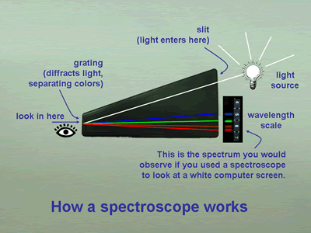
Notes:
Typical plastic classroom spectrometer. Fun for looking at white light source but if difficult for students to Hard for students to use with emission tubes. The spectrum is not very quantitative and the trying to tie this to atomic structure can lead to more confusion than clarity.

Slide 3
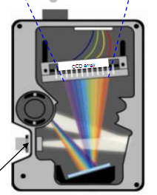
Spectrometer basics
The light passes through an optical geometry
of focusing mirrors and a reflection grating.
The spectrum falls on a linear CCD array with
hundreds of tiny sensors in a row so that each
sensor (often called a pixel) in the array corresponds to one wavelength.

Slide 4
Spectroscopy in the curriculum
Emission –
  Light and matter / structure of atoms
Absorption
  Ion identification in solution
  Solute concentration – Beer’s Law
  Kinetics
  Equilibrium

Slide 5
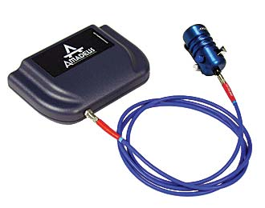
Amadeus Spectrometer
Range: 350-850 nm
Resolution: 3 nm (FWHM)
Light Source: Tungsten
Notes:
The PASCO Amadeus spectrometer from Ocean Optics

Slide 6
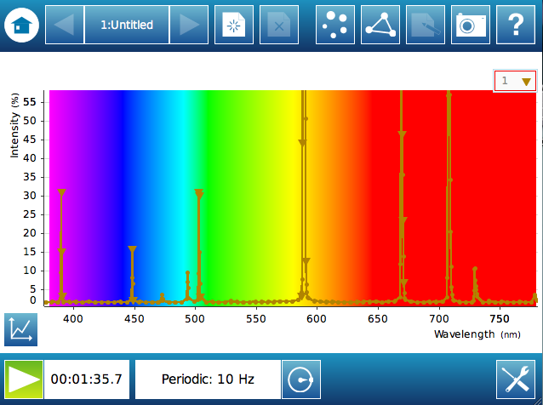
Amadeus on the SPARK
Add SPARKvue image
Notes:
Helium spectrum using the Amadeus spectrometer with SPARK software
(Intergation 500 ms)

Slide 7
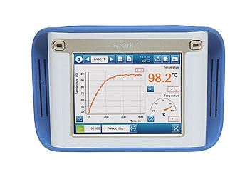
SPARKvue
Data Logging and Analysis software
Same look/feel on handheld and on Computer
Multiple Chemistry relevant sensors (include a Chemistry Sensor)
Notes:
Helium spectrum on the SPARK stand-alone device

Slide 8
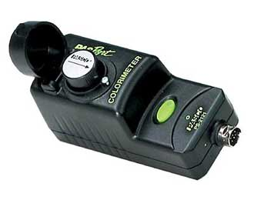
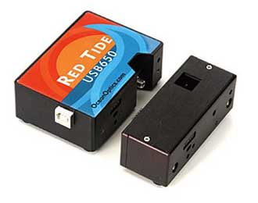
Other Spectroscopic Solutions
Colorimeter - Absorbance and % Transmission of at 4 wavelengths
(660 nm, 610 nm, 565 nm, 468 nm)
Red-Tide – Higher resolutions spectrometer
(Range: 350-1000 , Resolutions 2 nm)
Notes:
Other spectroscopy solutions
Colorimeter – only does solution spectroscopy at 4 wavelengths
Red Tide – Higher resolution spectrometer

Slide 9
Tom Loschiavo
Chemistry Education manager - PASCO scientific
loschiavo@pasco.com
www.pasco.com

