Slide 1
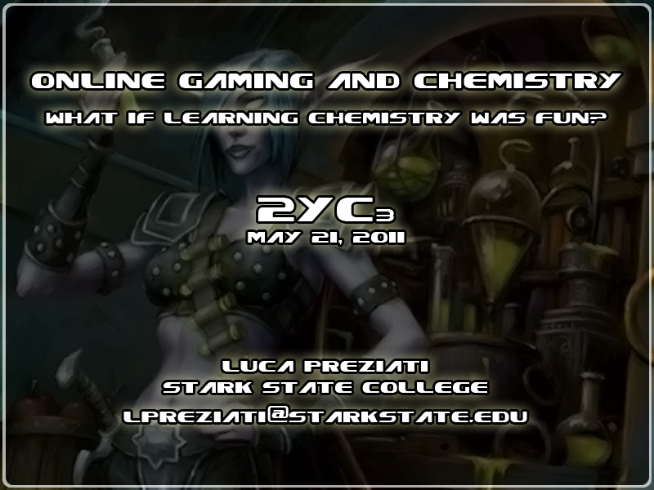

Slide 2
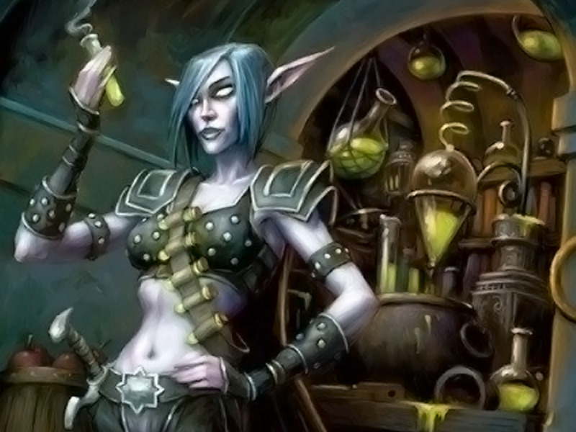
This is a
Night Elf (NE)
She is preparing a potion
using her “Alchemy” skill
This picture comes from
World of Warcraft (WoW).
WoW is a MMORPG

Slide 3

OUTLINE
Part 1: Edutainment
Why World of Warcraft?
Multimedia and the human brain
Game Design Basics
What makes some games so fun and addictive?
Part 2: The Present
Synesthesia and multimedia
Online games available today
Part 3: The Future
Quick Response Codes
Second Life

Slide 4


WHY WORLD OF WARCRAFT?
More than 12 million subscribers as of October, 2010
WoW is a virtual world with its own economy, history, chemistry (called alchemy) and biology
Most WoW players learn a huge amount of information about the game very rapidly. For instance, almost every player knows that Bronze is an alloy made of tin and copper because that is one of the craftable items in WoW

Slide 5

LEARNING AND THE HUMAN BRAIN
SYNESTHESIA
A
B
Which of these shapes is named Booba and which is named Kiki ?
Beethoven 5th Symphony on youtube

Slide 6
LEARNING AND THE HUMAN BRAIN
MULTIMEDIA
“There are multiple memory systems that are governed by distinct and interacting neural substrates”⁴
Multimedia information is often perceived by the human brain as “fun” and “interesting”. This is a list of content forms that the brain can memorize:
Text
Audio
Still Images
Animation
Video
Smell
Touch
Taste
Pain
Acceleration/body position
Emotion
Interactivity
The content forms in bold are used in video games
⁴ Elizabeth A Phelps, “Human emotion and memory: interactions of the amygdala and hippocampal complex”

Slide 7
MULTIMEDIA AND THE HUMAN BRAIN
INTERACTIVITY
Histogram of the average normalized gain <g>: red bars show the fraction of 14 traditional courses (N=2084), and blue bars show the fraction of 48 interactive engagement courses (N=4458)¹
¹ Richard R. Hake, “Interactive-engagement versus traditional methods: A six-thousand-student survey of mechanics test data for introductory physics courses”

Slide 8
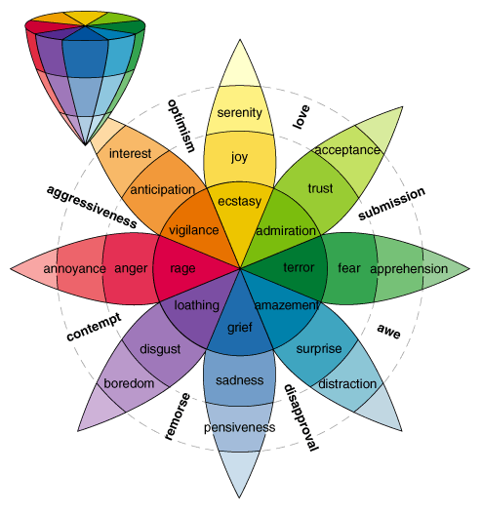
LEARNING AND THE HUMAN BRAIN
EMOTIONS
“We are just starting to explore more complex interactions between emotion and memory that could be unique to human function”⁴
⁴ Elizabeth A Phelps, “Human emotion and memory: interactions of the amygdala and hippocampal complex”
Plutchik’s flower

Slide 9
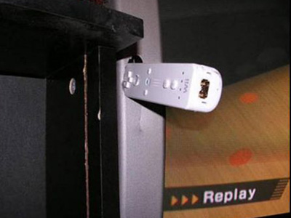
GAME DESIGN BASICS
MMORPG: Massive Multiplayer Online Role Playing Game
“Many players report that the emotions they feel while playing an MMORPG are very strong”²
Common features in MMORPG’s:
Progression: The character improves, the players feels like there is a reason to play the game, a motivation.
Social Interaction: most MMORPG’s require some degree of teamwork
² Ge Qian, “Psychological Perspectives on Social Behaviors of Chinese MMORPG Players”,

Slide 10
GAME DESIGN BASICS
PVE: Player Versus Enemy
PVP: Player versus Player
Griefer: is a player in a multiplayer video game that deliberately irritates and harasses other players.
Learning Curve: It is impossible for a player to enjoy a game if he does not know how to play. Most games come with a game manual, but almost no one reads the manual.
Video games are designed to teach the game concepts while actually playing the game, the player should have fun within seconds when playing the game for the first time.
A steep learning curve is synonymous of game design failure.

Slide 11

GAME DESIGN BASICS
Behavioral Game Design (aka reinforcement): a player will get rewards while playing a game (level-ups, in-game currency, equipment, etc.) The best games are designed to carefully combine a fixed ratio, random ratio and variable ratio reward schedules to intentionally create addiction in the player.³

Slide 12
WHAT MAKES SOME ONLINE GAMES SO
FUN AND ADDICTIVE
Game Design Components
Extensive use of multimedia
Interactivity – not Reactivity
Emotion
Social interaction:
  Teamwork
  Competition
Reinforcement learning
Results
Fun
Engagement
Motivation/Addiction

Slide 13

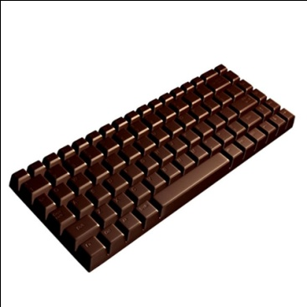



INTERACTIVITY – NOT REACTIVITY
A few definitions from Information Science…
Non interactive: a message is not related to previous messages
Reactive: a message is related only to one immediately previous message
Interactive: a message is related to a number of previous messages and to the relationship between them
Typing an answer and getting “correct/incorrect” as a feedback is not interactivity

Slide 14
SYNESTHESIA AND MULTIMEDIA
Concepts of game and graphic design are easy to apply to a power point presentation, for instance, functional groups could have their own color:
-COOH | Carboxylic acids in red (they often behave like acids)
-N- | Amines in blue (they often behave like bases)
-OH | -COOH + -OH → -C-O- Alcohols in yellow and esters in orange, since in Fischer esterification an ester is obtained from an alcohol and a c. acid
-C-O-
O
O
-COOH
“Colorful” does not always mean “better”

Slide 15




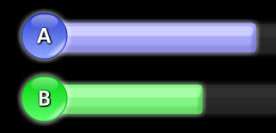

ONLINE CHEMISTRY GAMES AND TOOLS
 | Cellcraft: Very good for the Biology part of GOB chemistry http://www.kongregate.com/games/CellCraft/cellcraft
 | Eterna: Developed by Carnegie Mellon University and Stanford University, a game about RNA. http://eterna.cmu.edu
 | ChemGameTutor: Several chemistry topics, but it is a platform (not a good thing) http://www.chemgametutor.com/
 | Quia: 780 Chemistry games, but most of them are low quality games http://www.quia.com/shared/chemistry/
 | Online Clicker: Online tool for smart phones http://www.starkchemistry.com/clicker/cpanel.htm (For the instructor; password=Fischer) http://www.starkchemistry.com/clicker/ (For the students)
 | Ice: Online game under development, only molecular mass, mass and moles are already available http://www.starkchemistry.com/ice

Slide 16

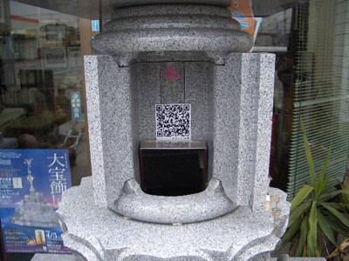
QUICK RESPONSE CODES
Quick response codes are matrix barcodes that can be read by camera phones; they are used to store:
Text
Internet links
Contact information
Etc.
QR codes are a bridge between printed information and the internet; they are an extremely versatile tool, already very common in Japan.
Japanese tombstone equipped with a QR code for the deceased website

Slide 17



QUICK RESPONSE CODES
Creating a QR code is very simple, there are many websites, like this one, that will generate a QR code for you:
http://qrcode.kaywa.com/
A few examples:
My email Online Clicker 2yc3.org

Slide 18
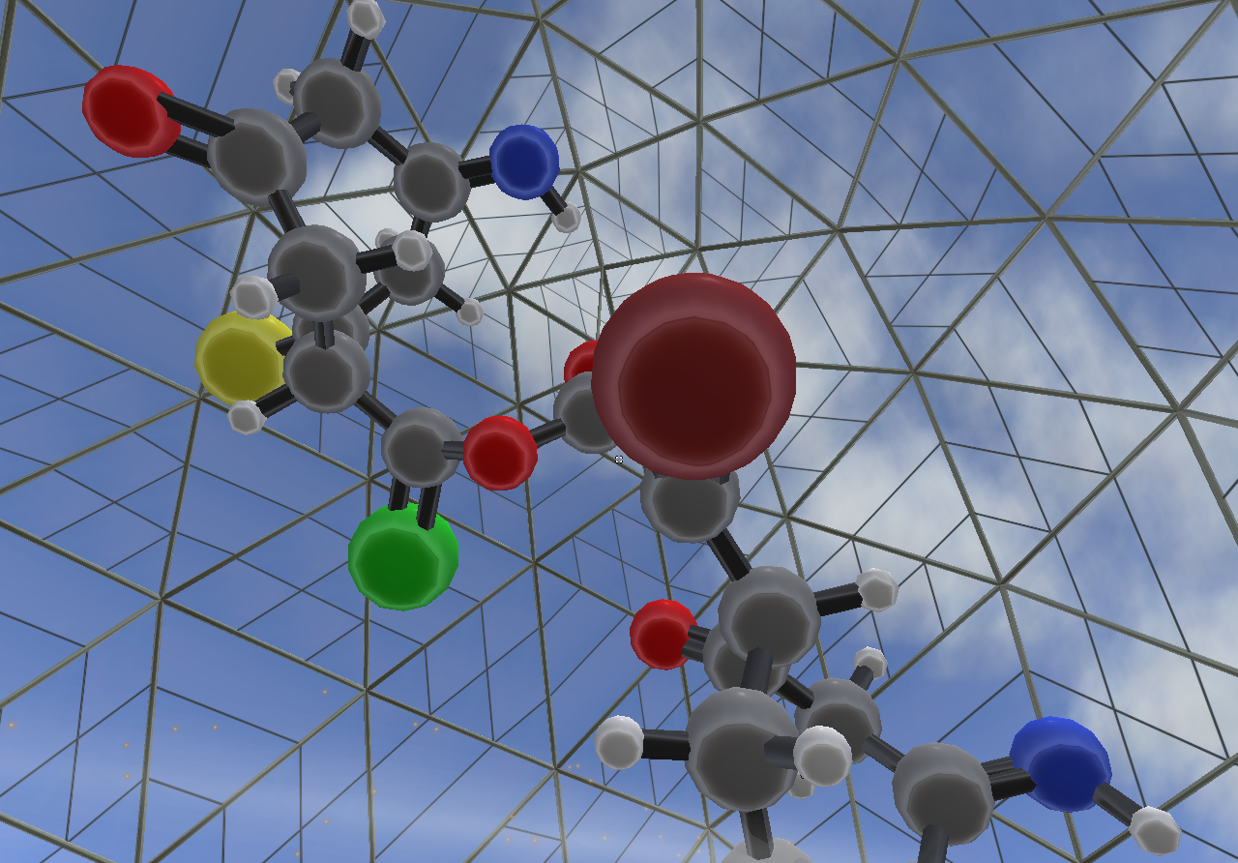
SECOND LIFE
Second Life (SL) is an online virtual world developed by Linden Lab. What makes SL special is the fact that each “resident” can create game content.
Wikipedia has a wealth of links about “Education in Second Life”:
http://en.wikipedia.org/wiki/Education_in_Second_Life
The ACS interactive museum in Second Life

Slide 19
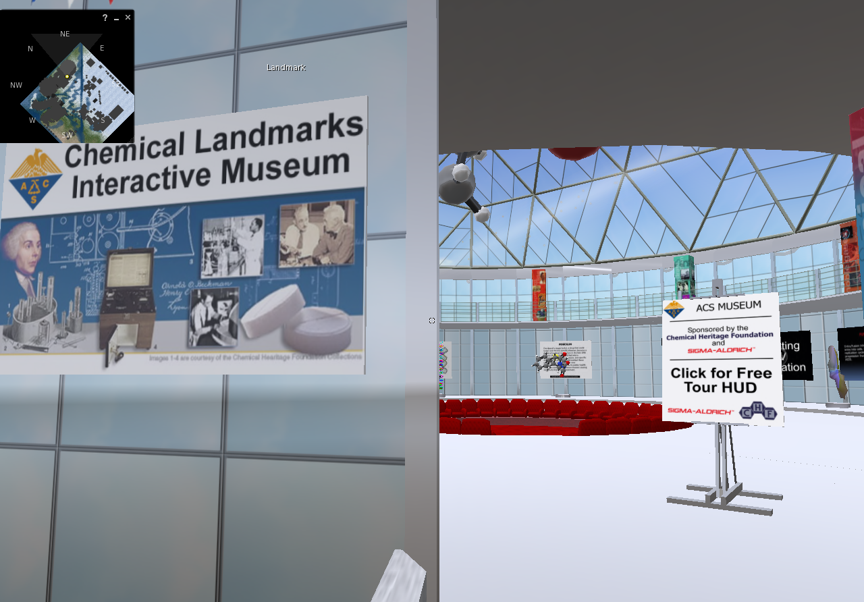
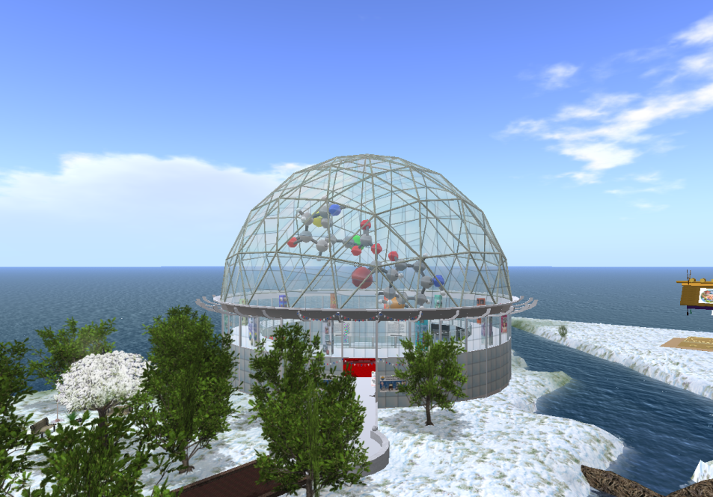
SECOND LIFE
Second Life is a 3D virtual world where users can meet, voice chat and share their creations, video and presentations.
Second life already has places that resemble virtual classrooms

Slide 20
REFERENCES
Richard R. Hake, “Interactive-engagement versus traditional methods: A six-thousand-student survey of mechanics test data for introductory physics courses”, Am. J. Phys., Vol. 66, No. 1, January 1998, 64-74
Ge Qian, “Psychological Perspectives on Social Behaviors of Chinese MMORPG Players”, Entertainment for Education. Digital Techniques and Systems, 2010, 192-202
http://www.gamasutra.com/view/feature/3085/behavioral_game_design.php?page=1
Elizabeth A Phelps, “Human emotion and memory: interactions of the amygdala and hippocampal complex”, Current Opinion in Neurobiology 2004, 14:198–202

